Slide 1

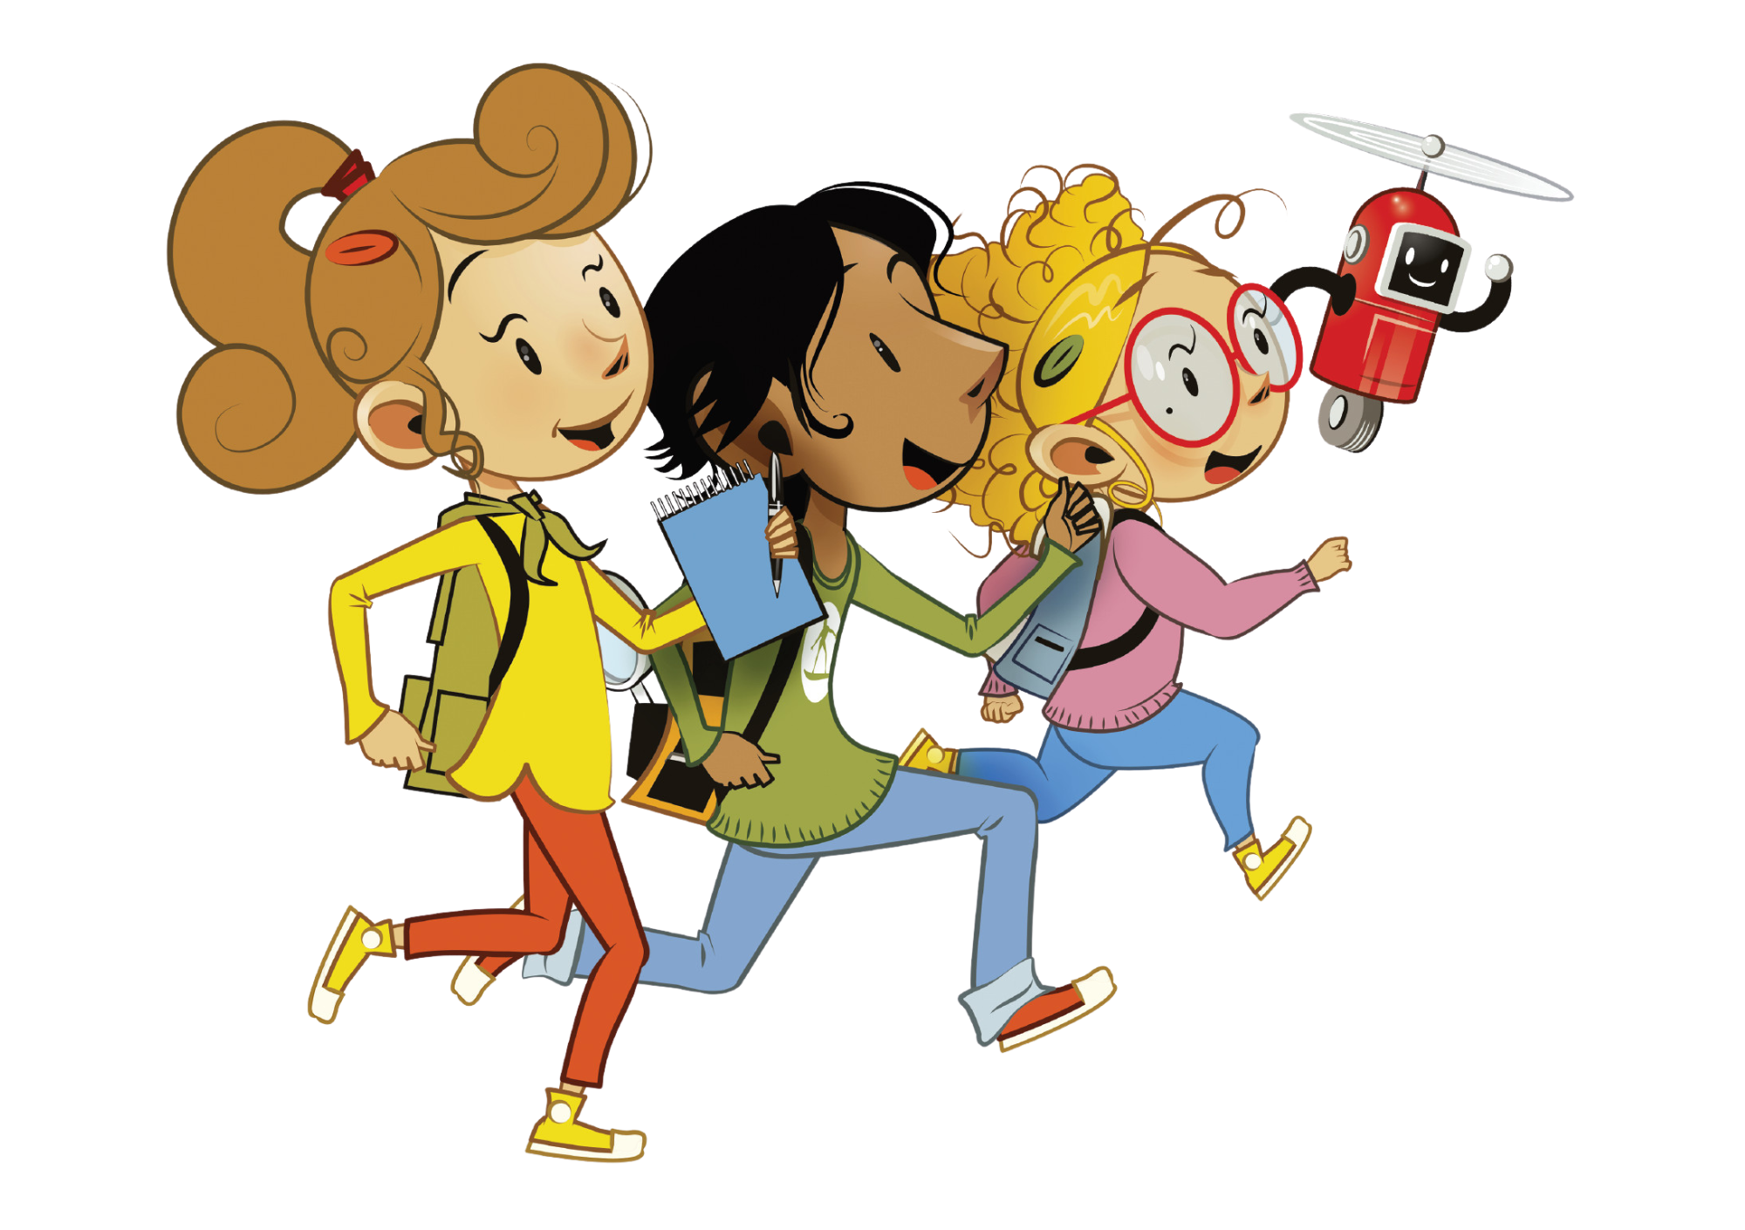

UNIT 7 – MY PARTY
Lesson 4 – Phonics

Slide 2
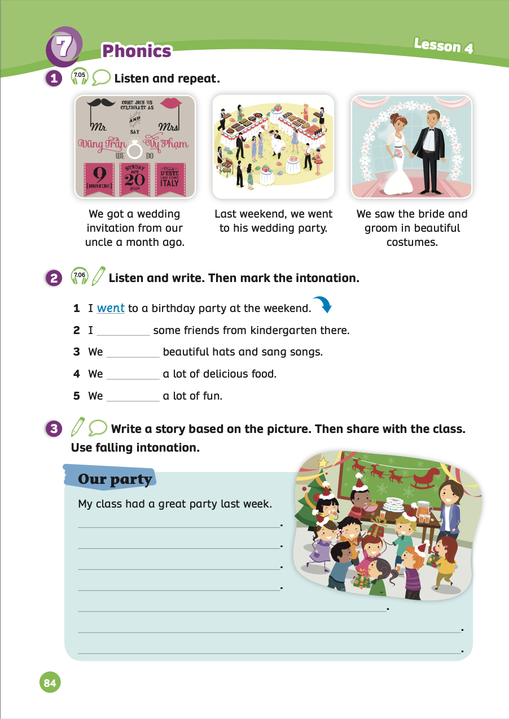
UNIT 7 – Lesson 4
We’re learning…
- To correctly read and pronounce falling intonation in statements - To write a story based on a picture
- PB p.84
- AB p.65

Slide 3


WARM-UP ACTIVITY
Divide the class into groups of 3 or 4. Each group takes out a pen or a marker.
Show the slides with prompt sentences, students look at them and guess the words.
Then, students raise the pen or marker to say the answers.
The fastest group speaks clearly and correctly will receive 2 points.

Slide 4

GUESS THE WORD
Wedding Guessing Games

Slide 5

What word is it?
?
We are very happy.
It appears after the wedding.
Click to reveal the answer
Have “honey” in it.
Honeymoon
Notes:
honeymoon

Slide 6
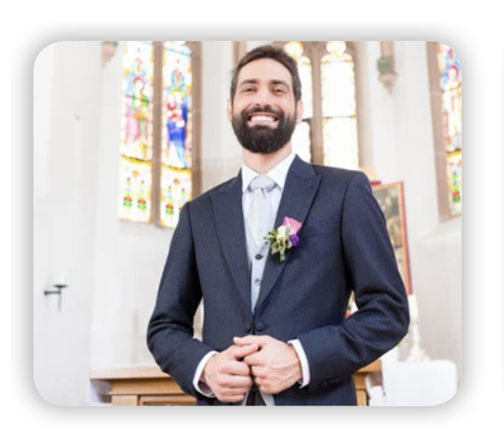
What word is it?
?
I’m smiling.
I’m preparing for
my wedding.
Click to reveal the answer
I’m a man.
groom
Notes:
groom

Slide 7

What word is it?
?
I received it yesterday.
It is from my friend's wedding.
Click to reveal the answer
It is made of paper.
invitation
Notes:
invitation

Slide 8
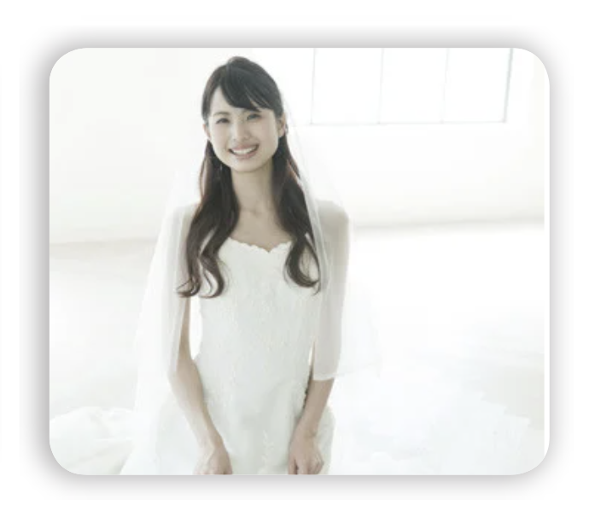
What word is it?
?
I’m very happy.
I will have a small family.
Click to reveal the answer
I’m a woman.
bride
Notes:
bride

Slide 9
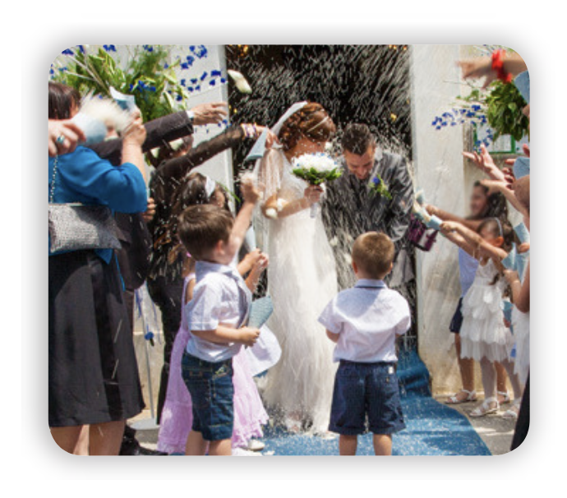
What word is it?
?
It has many flowers.
There are many guests and food.
Click to reveal the answer
The bride and groom wear nice costumes.
wedding
Notes:
wedding

Slide 10
GUESS THE WORD
THANK YOU!

Slide 11

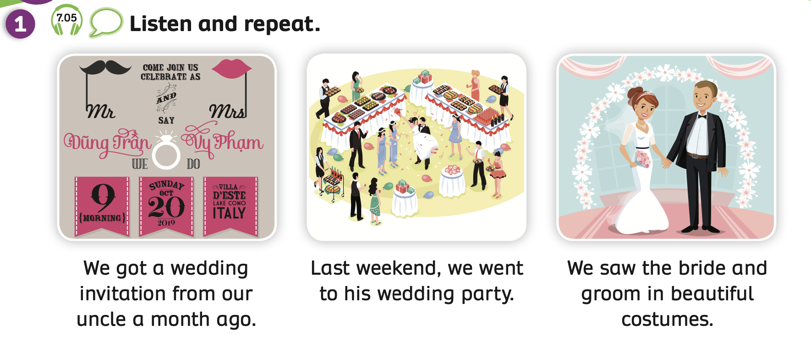
PUPILS’ BOOK p.84
Have students look at the pictures and sentences.
Play the audio the first time, students just listen.
Play the audio again, pause after each sentence for students to repeat and read along.

Slide 12

PUPILS’ BOOK p.84
We got a wedding invitation from our
uncle a month ago.
INTONATION
Students listen again to each sentence.
Then, the teacher explains that will learn about the intonation in statements falls at the end of the sentence.
Students listen to the teacher’s guide and repeat the sentences with correct intonation.

Slide 13
PUPILS’ BOOK p.84
Last weekend, we went to his wedding party.
INTONATION
Students listen again to each sentence.
Then, the teacher explains that will learn about the intonation in statements falls at the end of the sentence.
Students listen to the teacher’s guide and repeat the sentences with correct intonation.

Slide 14
PUPILS’ BOOK p.84
We saw the bride and groom in
beautiful costumes.
INTONATION
Students listen again to each sentence.
Then, the teacher explains that will learn about the intonation in statements falls at the end of the sentence.
Students listen to the teacher’s guide and repeat the sentences with correct intonation.

Slide 15
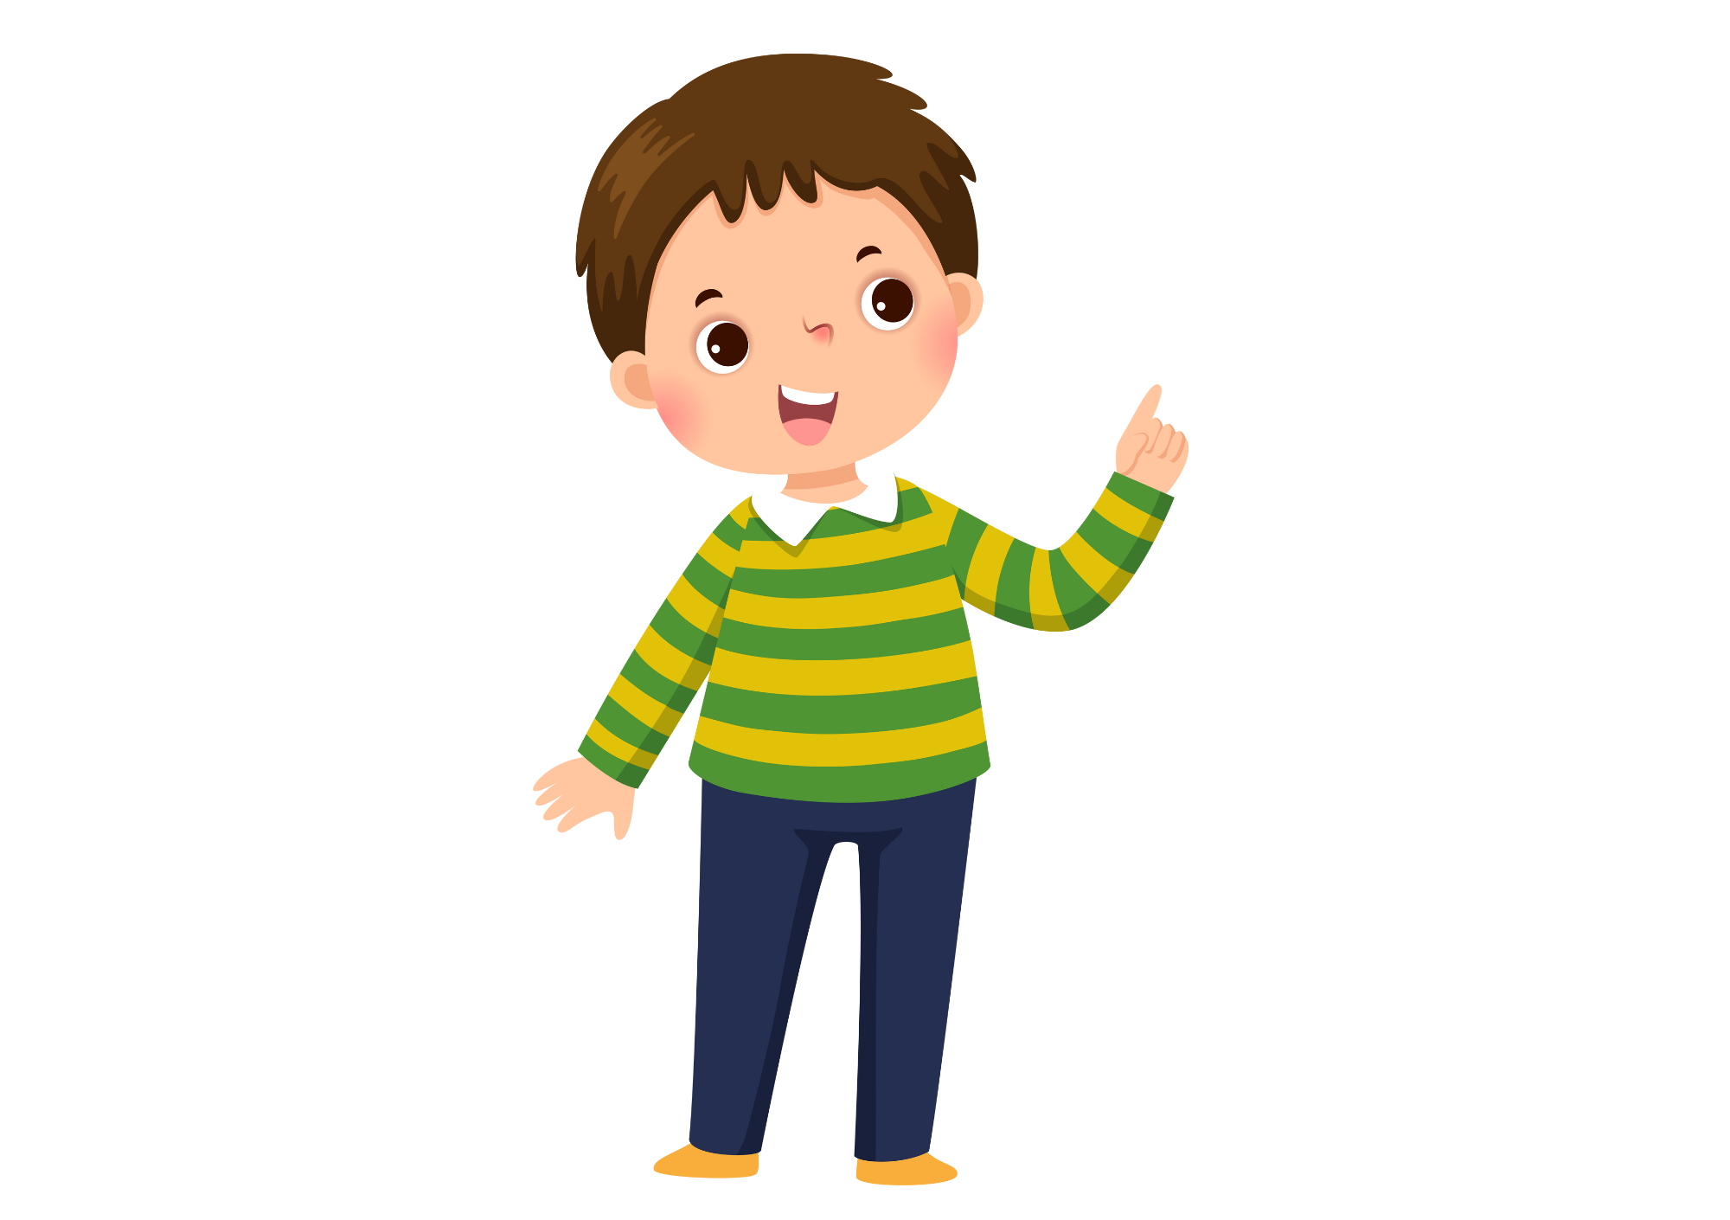
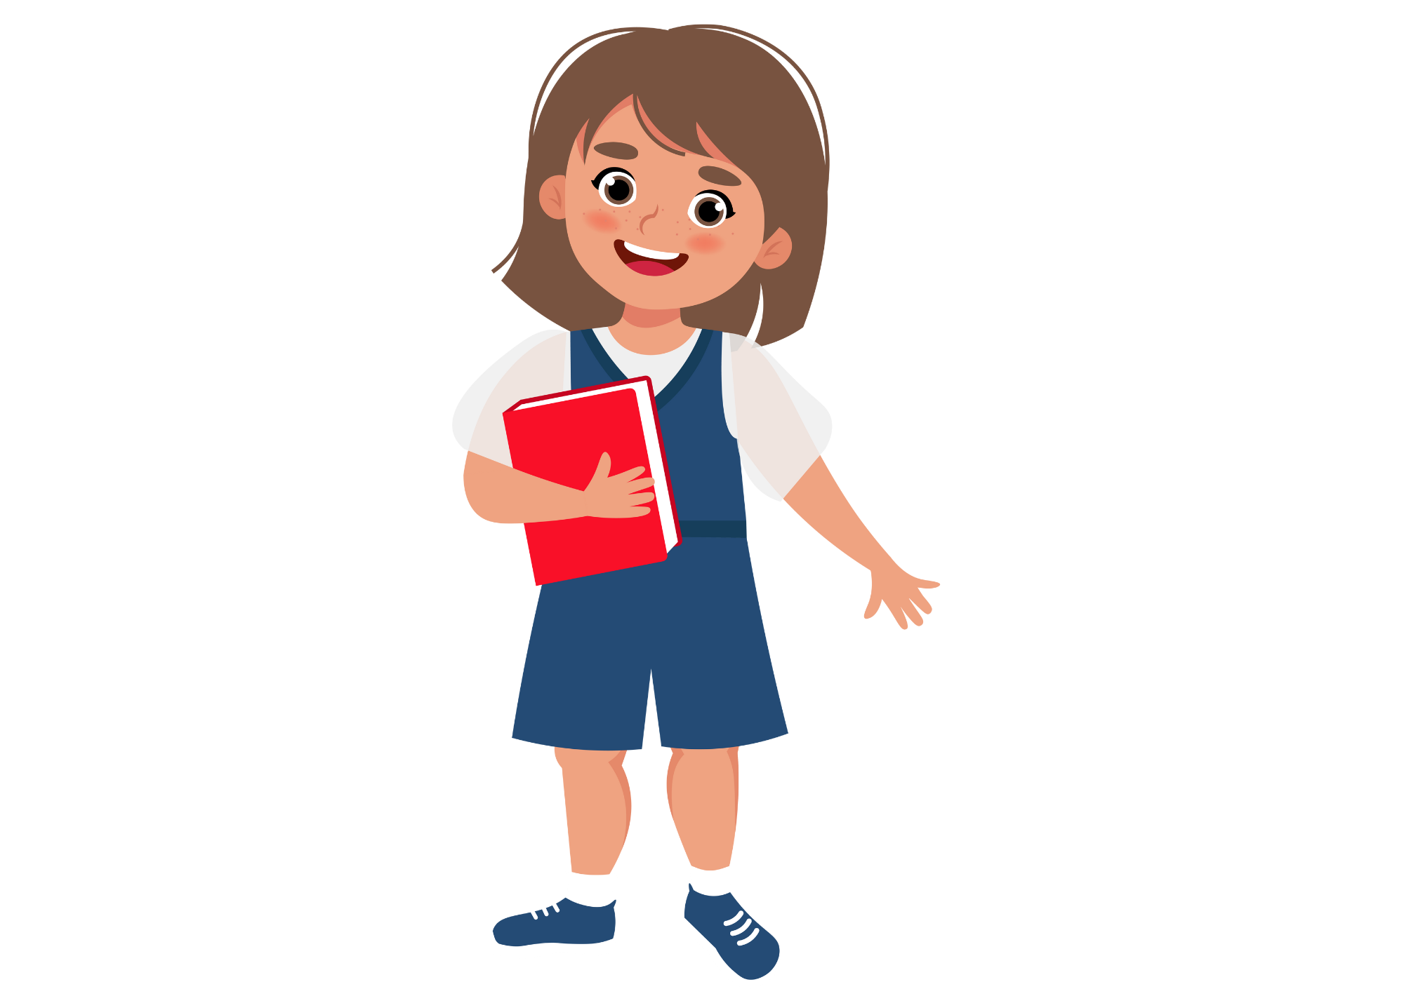
PUPILS’ BOOK p.84
Last weekend, we went to his wedding party.
We got a wedding invitation from our uncle a month ago.
We saw the bride and groom
in beautiful costumes.
Work in pairs.
Look at Activity 1, then switch roles to read each sentence.
After students finish, teacher invites some students to call out the sentences.

Slide 16
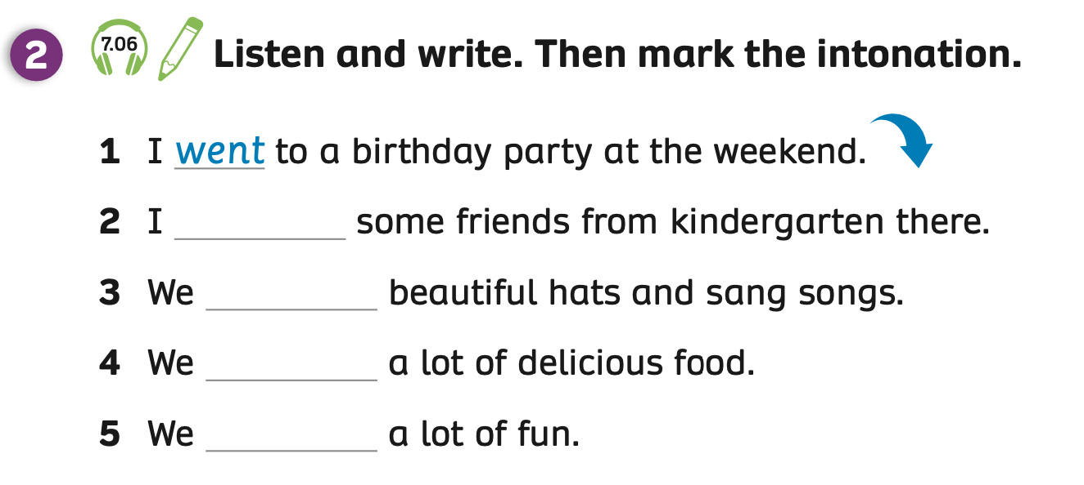
PUPILS’ BOOK p.84 – PRE LISTENING
Underline the keyword.
KEYWORD
Work in pairs look at Activity 2.
Then, underline the keywords in each sentence.

Slide 17
PUPILS’ BOOK p.84 – LISTENING
met
wore
ate
had
ANSWER
INTONATION
Play the audio, students listen and write the answers.
Play audio again, students listen and mark the intonation.

Slide 18
PUPILS’ BOOK p.84 – POST LISTENING
Activity: SPEAKING TIME
After listening, ask students to work in pairs to read and pronounce the falling intonation of each sentence in Activity 2.
Switch roles to practice together.
Ask some students to present in front of the class and receive 2 points.

Slide 19
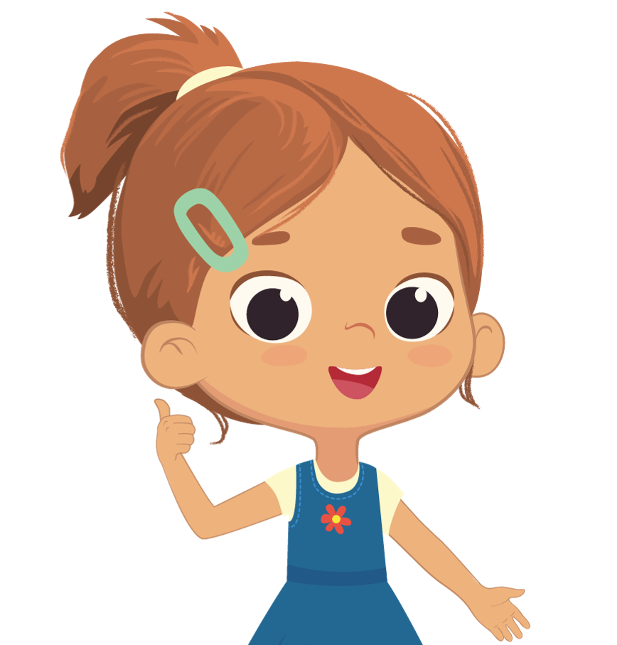
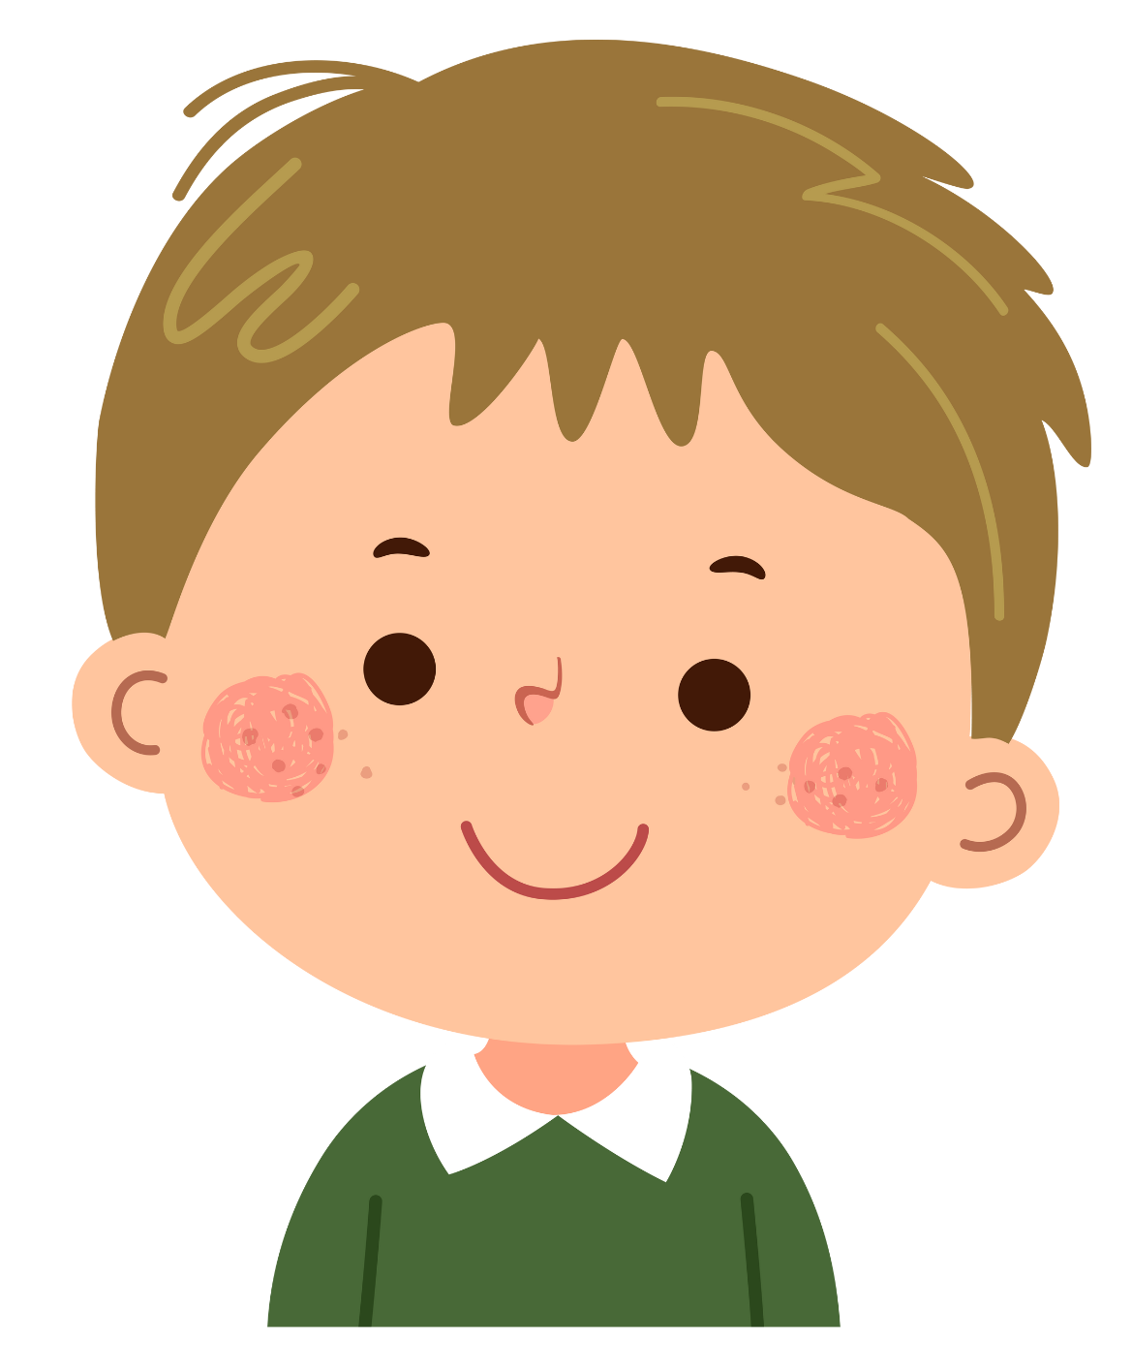
PUPILS’ BOOK p.84 – POST LISTENING
I went to a birthday party at the weekend.
I met some friends from kindergarten there.
We wore beautiful hats and sang songs.
We ate a lot of delicious food.
We had a lot of fun.

Slide 20
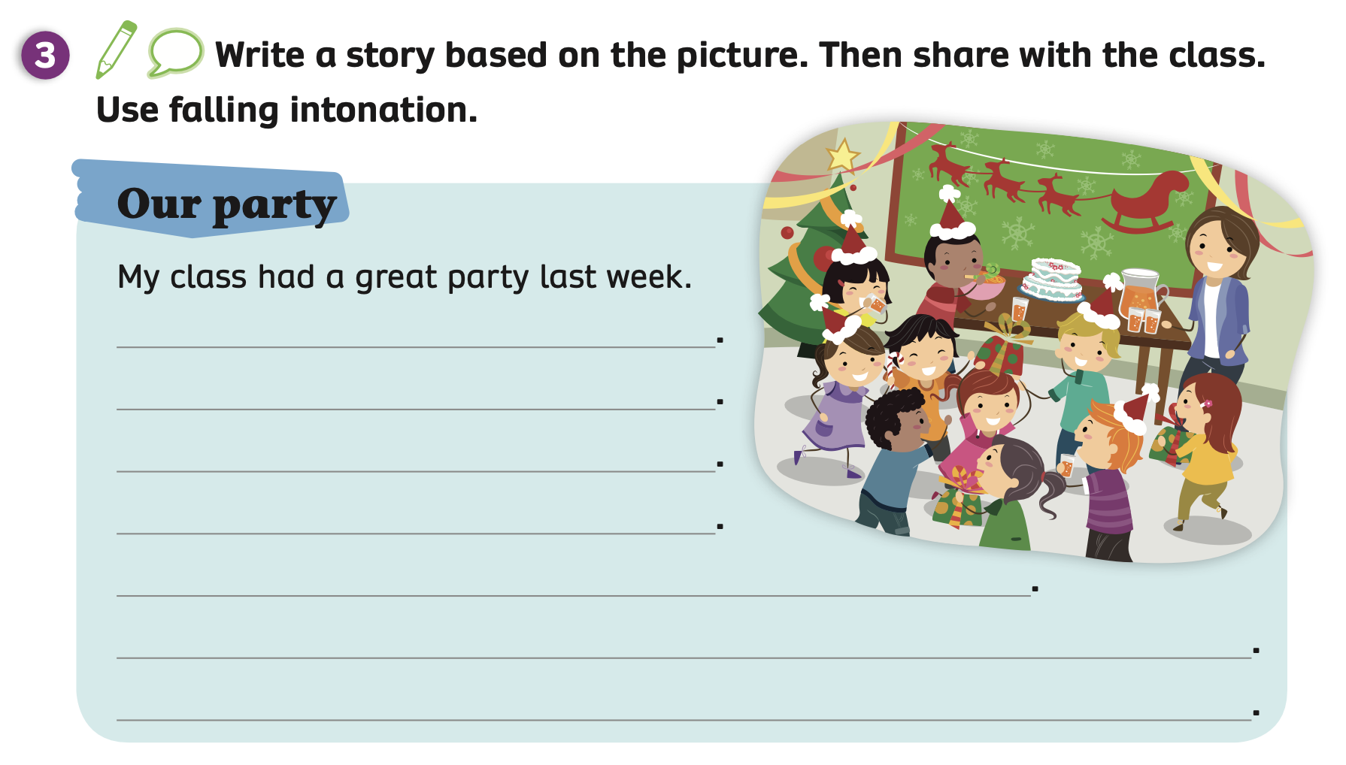
PUPILS’ BOOK p.84 – PRE WRITING
Brainstorm
Have students look at the picture in Activity 3, then brainstorm to answer about the picture with these questions: “What was the party about?”, “What were they doing?”, “What were there at the event?”, ”How did they feel?”.

Slide 21
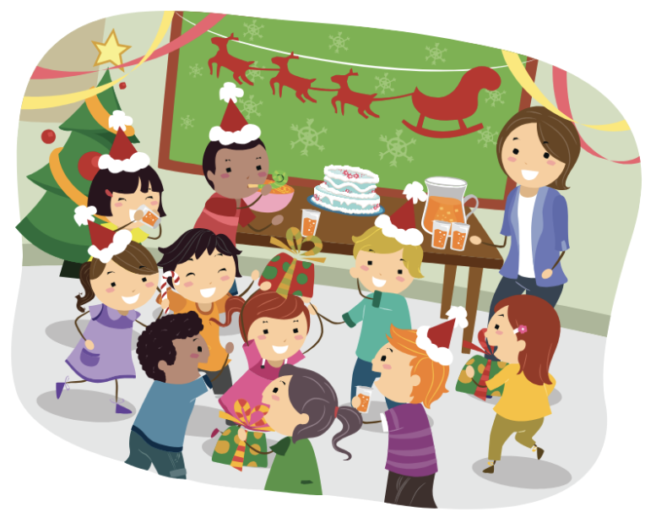
PUPILS’ BOOK p.84 – PRE WRITING
What was the party about?
It was the Christmas party.
Work in pairs to ask and answer about these questions.
Teacher invites some pairs to present in front of the class and give them 2 points.

Slide 22
PUPILS’ BOOK p.84 – PRE WRITING
What were they doing?
They were changing gifts, eating food.
Work in pairs to ask and answer about these questions.
Teacher invites some pairs to present in front of the class and give them 2 points.

Slide 23
PUPILS’ BOOK p.84 – PRE WRITING
What were there at the event?
There were Xmas hats, cake, juice, gifts,...
Work in pairs to ask and answer about these questions.
Teacher invites some pairs to present in front of the class and give them 2 points.

Slide 24
PUPILS’ BOOK p.84 – PRE WRITING
They were very happy.
How did they feel?
Work in pairs to ask and answer about these questions.
Teacher invites some pairs to present in front of the class and give them 2 points.

Slide 25
PUPILS’ BOOK p.84 – WRITING
Party: Christmas
Objects: cake, juice, Xmas hats, gifts
Did: ate cake, drank juice, changed gifts
Feel: happy, excited, a lot of fun
It was ….
There were ….
We ate …., drank …., changed …
We were … / We had …
Students open their notebooks and write a story with the example.

Slide 26
PRODUCTION
My class had a great party last week.
It was a Christmas party.
There were Xmas hats, gifts, cake, juice.
We ate cake, drank juice, changed gifts.
We had a lot of fun.
Invite some students to read the story and pronounce falling intonation.
Give them 2 points if they have a good presentation.

Slide 27
HOMEWORK
Review vocabulary.
Do exercises in the Activity Book (page 65).
Check the answers in the Teacher’s Book (page 145) or Active Teach.

Slide 28
UNIT 7 – Lesson 4
We’ve learned…
- To correctly read and pronounce falling intonation in statements - To write a story based on a picture
- PB p.84
- AB p.65

