Slide 1

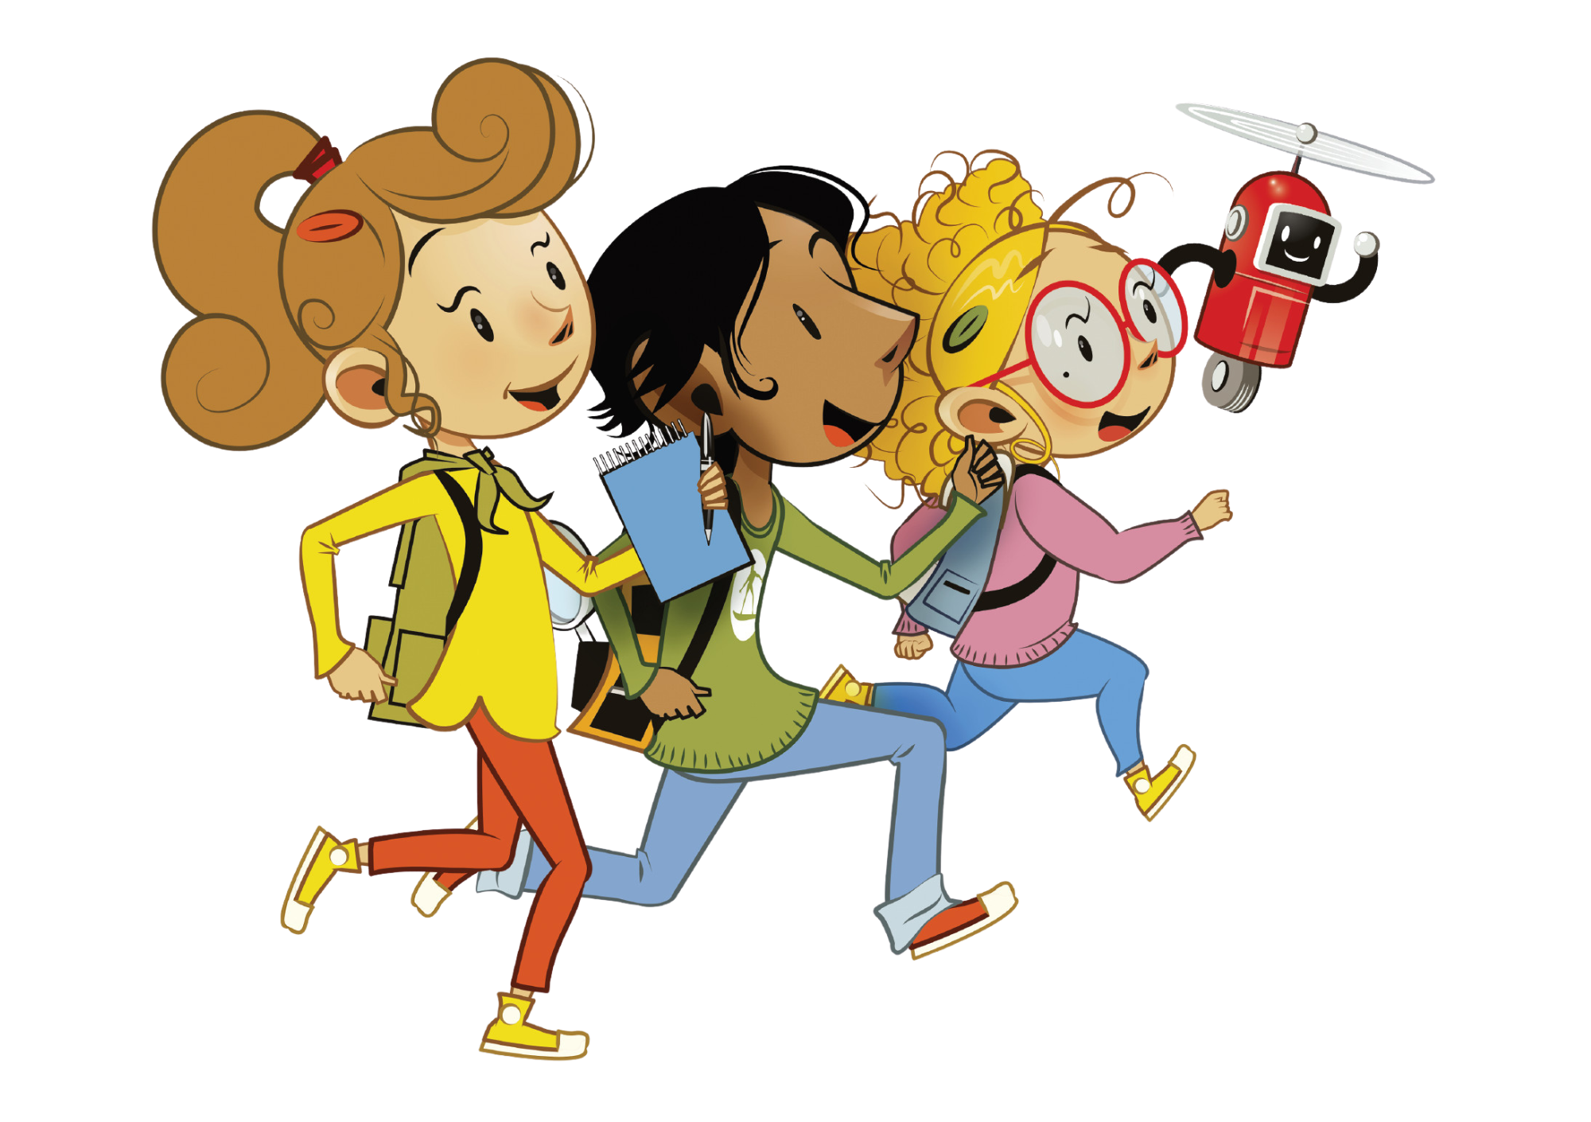

UNIT 7 – MY PARTY
Lesson 5B – Vocabulary and Grammar 2

Slide 2
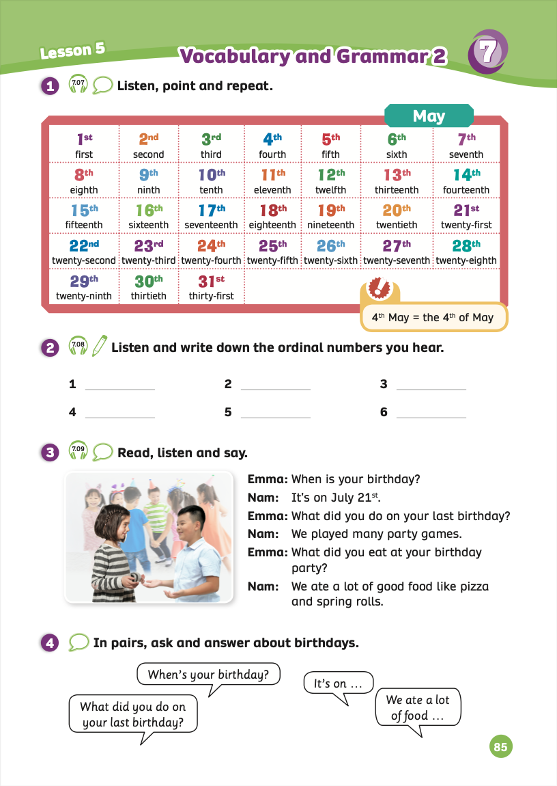
UNIT 7 – Lesson 5B
We’re learning…
- To use ordinal numbers
- To correctly call out the days of the month
- To use the structures:
When is your birthday?
What did you do on...? We ate a lot of food.
- PB p.85
- AB p.66

Slide 3


WARM-UP ACTIVITY
- Divide the class into groups of 4. Invite each member of each team to stand up and join in the activity.
- The teacher shows pictures of the ordinal numbers about a month of the year on the slide. Students look, then call out the names of missing numbers.
- The fastest student with the correct answer receives 2 points.

Slide 4

1st
2nd
?
3rd
4th
5th
6th
7th
8th
9th
?
10th
CHECK

Slide 5
?
?
21st
22nd
23rd
24th
?
25th
26th
27th
28th
CHECK

Slide 6
18th
19th
?
20th
21st
?
22nd
23rd
24th
25th
CHECK

Slide 7
11th
?
12th
13th
14th
15th
16th
17th
18th
?
CHECK

Slide 8
29th
30th
?
31st
1st
2nd
?
?
3rd
4th
CHECK

Slide 9
9th
?
12th
10th
11th
13th
14th
15th
?
16th
CHECK

Slide 10
24th
27th
?
25th
26th
?
28th
29th
?
30th
31st
CHECK

Slide 11




VOCABULARY – REVIEW
1st: first
2nd: second
….
7th: seventh
8th: eighth
….
13th: thirteenth
25th: twenty-fifth
14th: fourteenth
19th: nineteenth
….
26th: thirtieth
20th: twentieth
….
….
Divide the class into groups of 5 or 6. Each member writes down 31 ordinal numbers alternately.
E.g: Student 1 writes about 1 to 6, student 2 writes 7 to 12,…
The fastest group with the correct answer will receive 2 points.

Slide 12

GRAMMAR
STRUCTURE – SENTENCES
Use these sentences to ask about birthdays.
What did you do on…?
We + V-ed/ Irregular verbs…

Slide 13
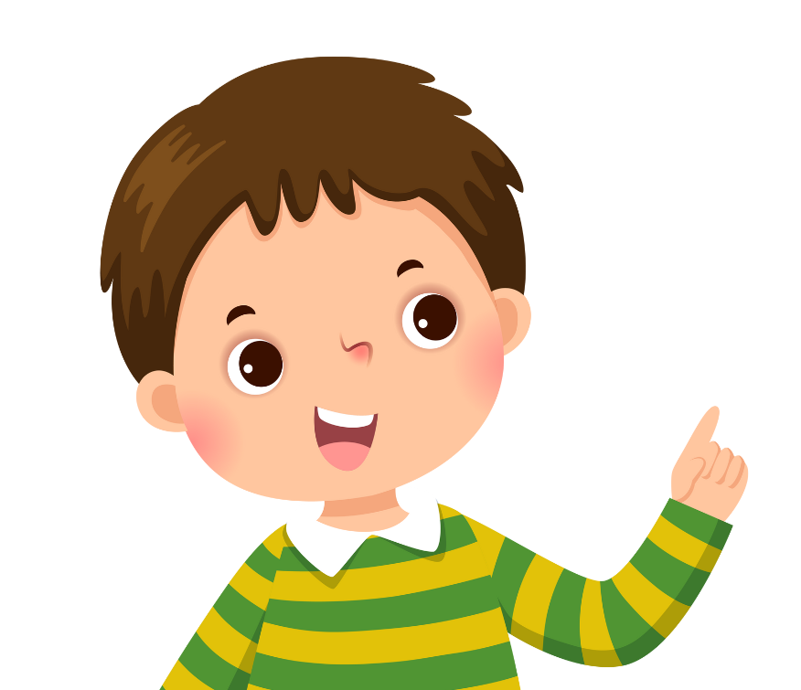

GRAMMAR – Pupils’ book (p.85)
It’s on July 21st.
When is your birthday?
We played many party games.
What did you do on your last birthday?
We ate a lot of good food like pizza and spring rolls.
What did you eat at your birthday party?
Nam
Emma
Ask students to work in pairs look at the bubble speech.
Then, practice to ask and answer these sentences in Activity 3.
Switch roles to practice again.

Slide 14
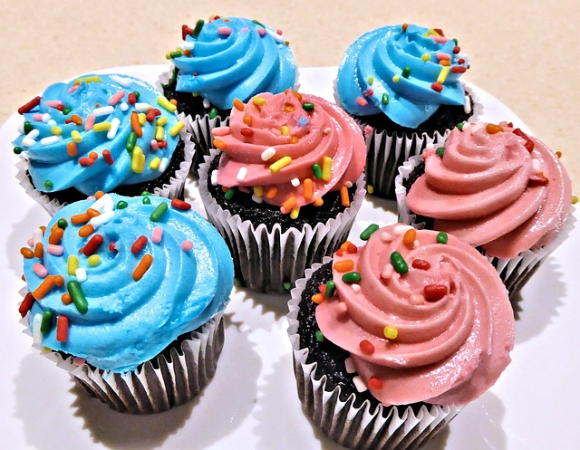
GRAMMAR PRACTICE
eat/ cupcakes / birthday party
ANSWER
We ate cupcakes at the birthday party.
- Ask students to work in groups of 4. Put a marker or a pen in the middle of each group.
- Students look at the picture and 2-3 keywords, and then they make a correct sentence.
- Students raise their marker or a pen to get a chance to say the answers.
- The fastest team with the correct sentence receives 2 points.

Slide 15
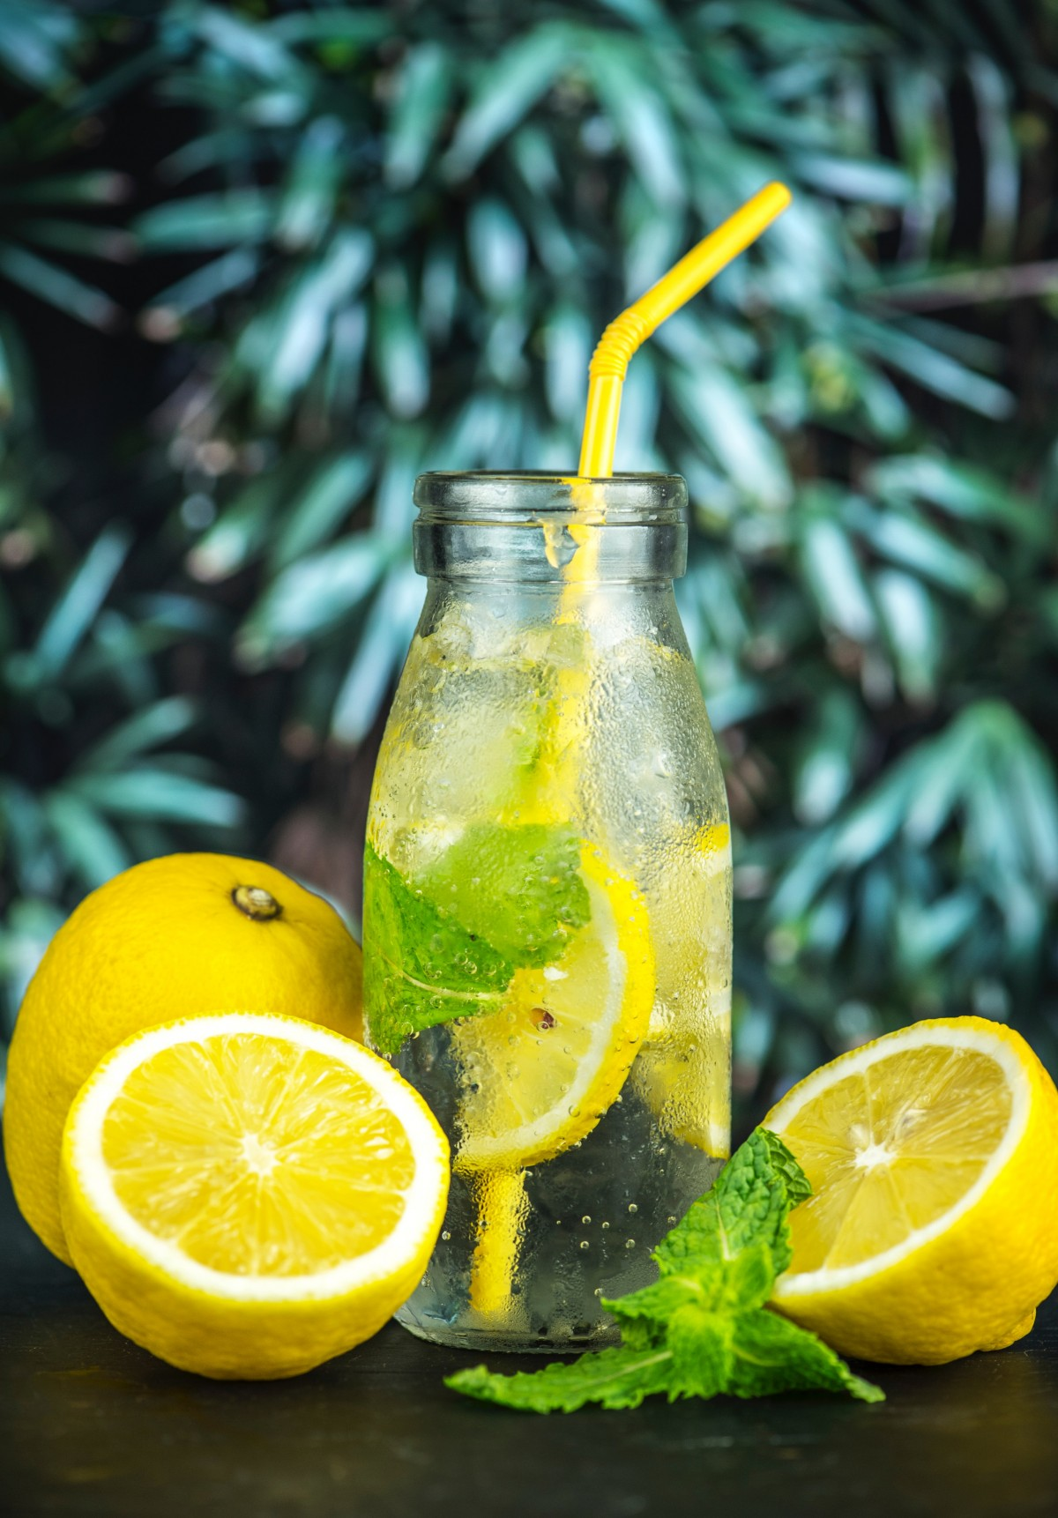
GRAMMAR PRACTICE
drink/ lemonade / Lily’s party
ANSWER
We drank lemonade at Lily’s party.
- Ask students to work in groups of 4. Put a marker or a pen in the middle of each group.
- Students look at the picture and 2-3 keywords, and then they make a correct sentence.
- Students raise their marker or a pen to get a chance to say the answers.
- The fastest team with the correct sentence receives 2 points.

Slide 16
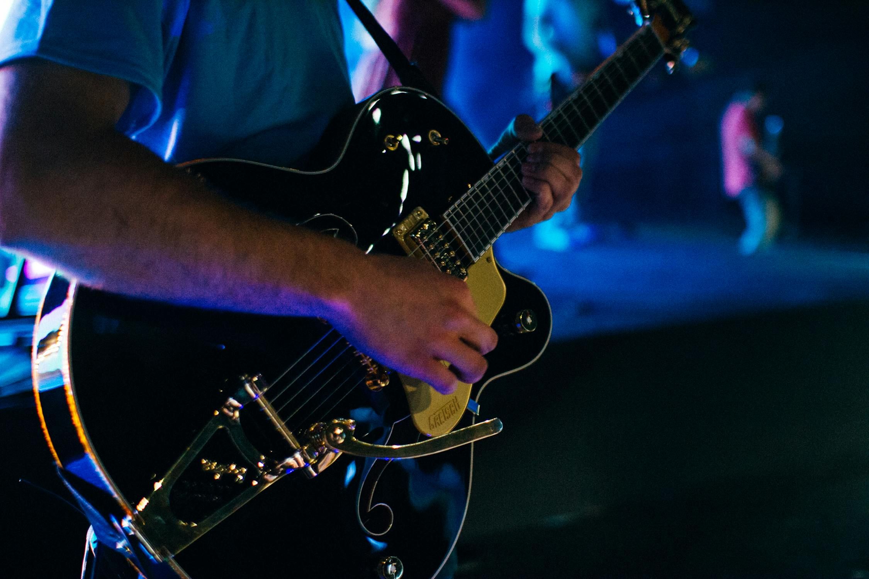
GRAMMAR PRACTICE
play/ guitar / wedding
ANSWER
He played the guitar at the wedding.
- Ask students to work in groups of 4. Put a marker or a pen in the middle of each group.
- Students look at the picture and 2-3 keywords, and then they make a correct sentence.
- Students raise their marker or a pen to get a chance to say the answers.
- The fastest team with the correct sentence receives 2 points.

Slide 17
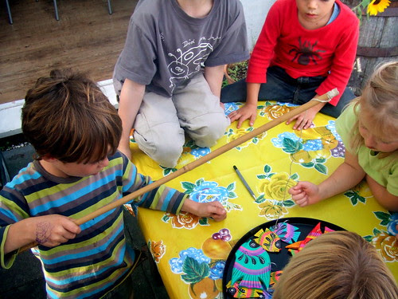
GRAMMAR PRACTICE
play/ party games / Christmas party
ANSWER
We played party games at the Christmas party.
- Ask students to work in groups of 4. Put a marker or a pen in the middle of each group.
- Students look at the picture and 2-3 keywords, and then they make a correct sentence.
- Students raise their marker or a pen to get a chance to say the answers.
- The fastest team with the correct sentence receives 2 points.

Slide 18
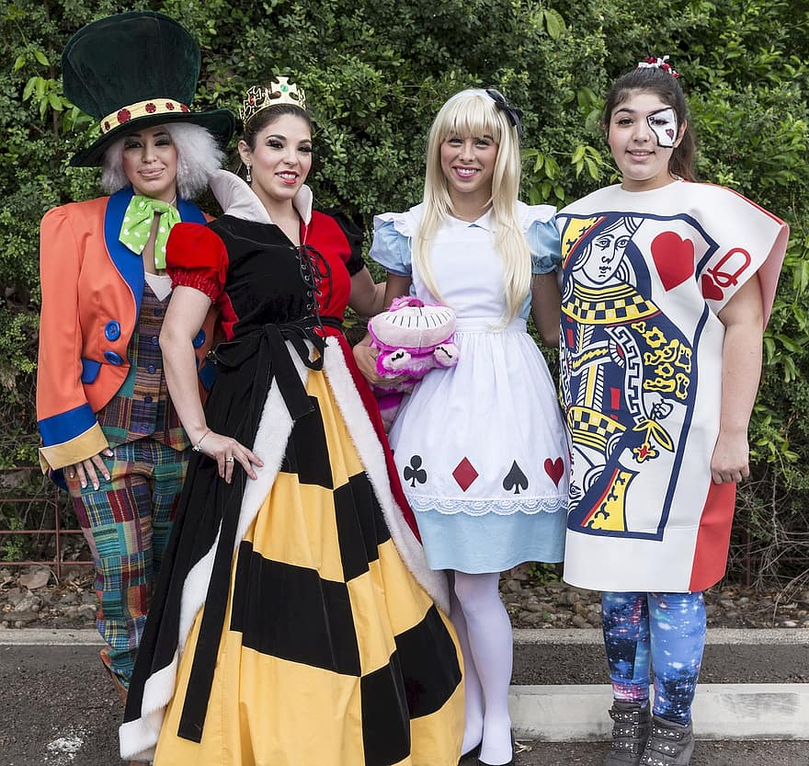
GRAMMAR PRACTICE
wear/ beautiful / costumes
ANSWER
They wore beautiful costumes.
- Ask students to work in groups of 4. Put a marker or a pen in the middle of each group.
- Students look at the picture and 2-3 keywords, and then they make a correct sentence.
- Students raise their marker or a pen to get a chance to say the answers.
- The fastest team with the correct sentence receives 2 points.

Slide 19

GRAMMAR PRACTICE
Divide the class into groups of 4 or 5.
The teacher shows flashcards of learned vocabulary about the party on the board.
Students look, then make the sentences to ask and answer with flashcards.
The teacher goes around to check.
Invite some students to make the sentences and give them points.

Slide 20

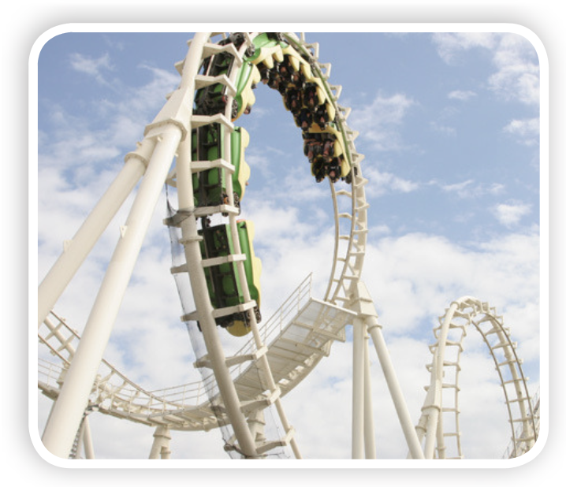
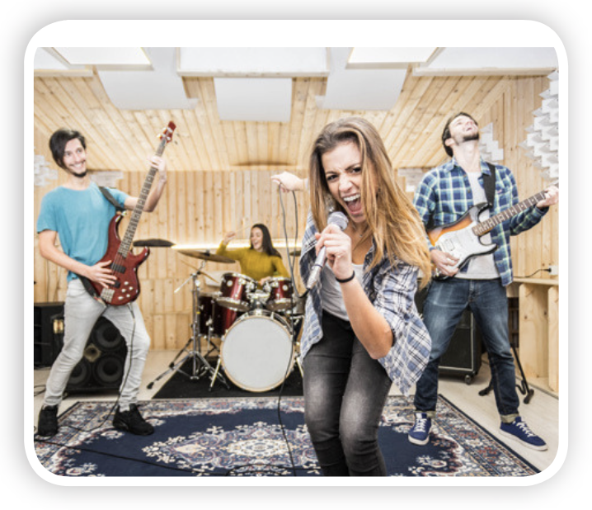
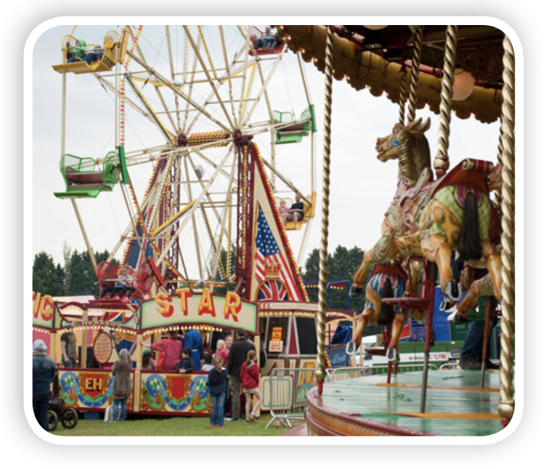
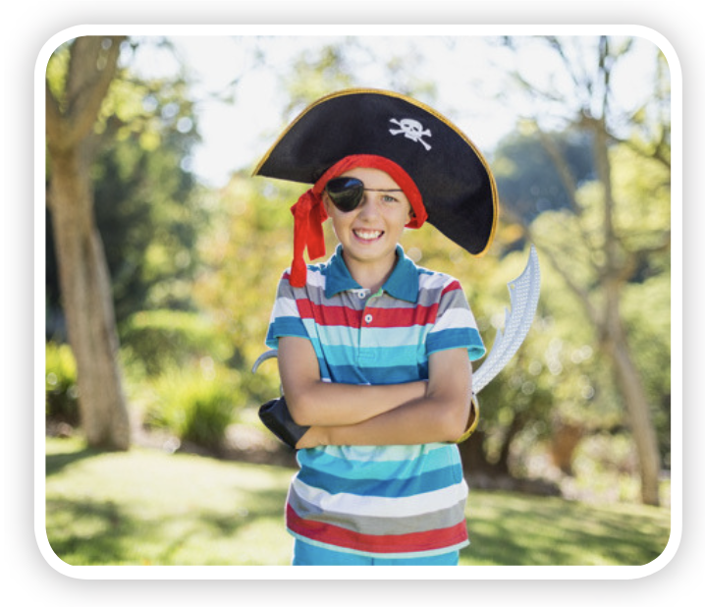
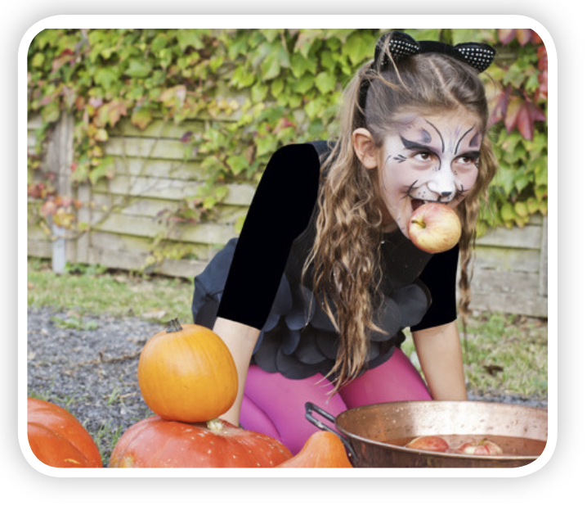
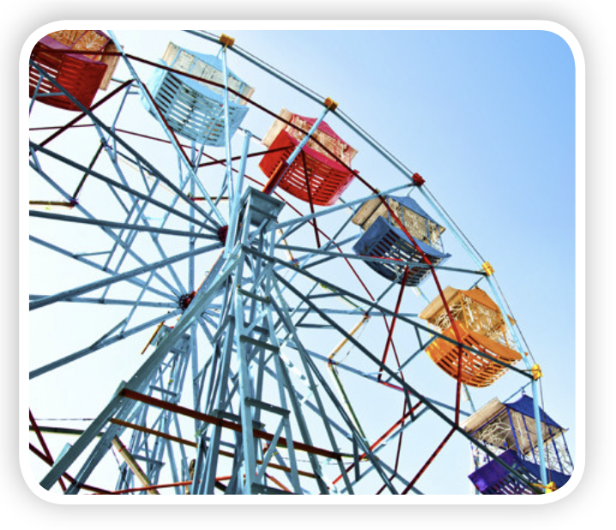
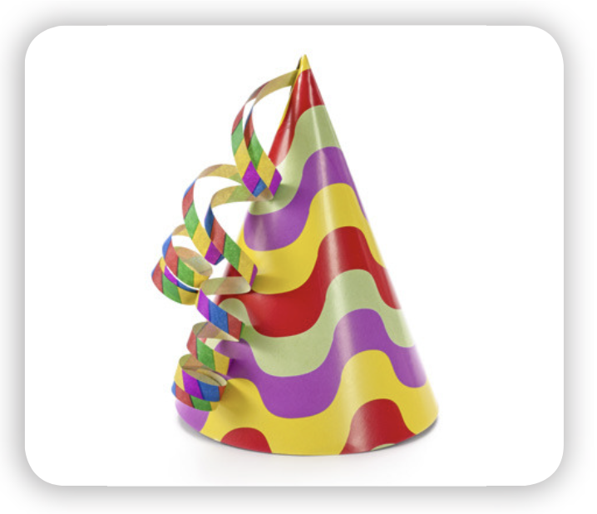
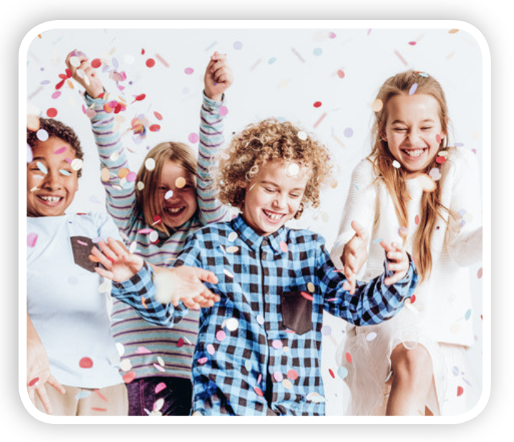
GRAMMAR PRACTICE
I played in a band.
I played rollercoaster.
It’s on 4th June.
What did you do on your last birthday?
I played party games.
What did you play at your party?
When’s your birthday?

Slide 21
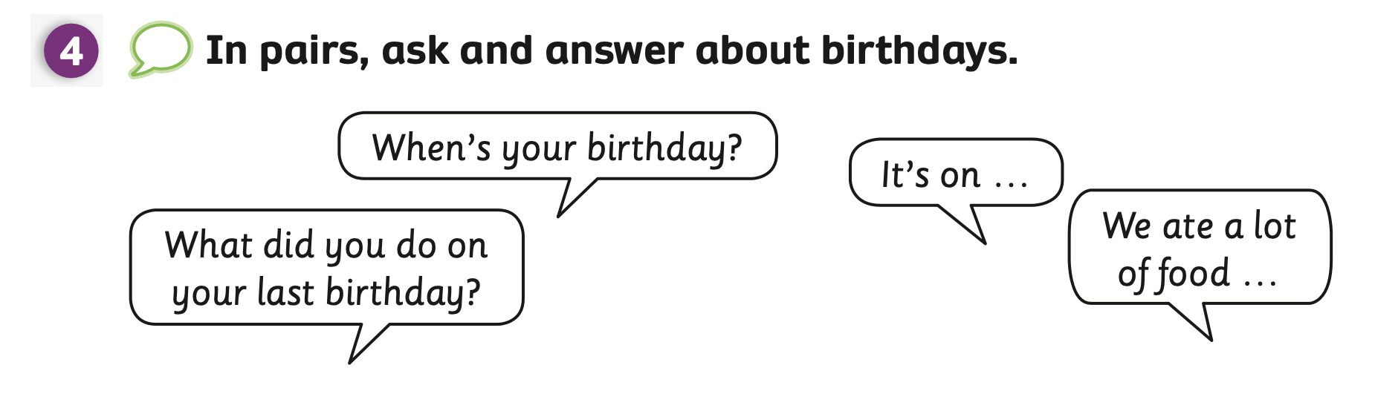
Pupils’ book (p.85)
- Draw students’ attention to 2 questions and elicit how they might answer.
- Show the example bubbles, students look at them and read aloud.

Slide 22
Pupils’ book (p.85)
When’s your birthday?
It’s on …
2nd February
6th September
15th December
- Divide the class into 2 teams. One team asks and one team answers.
- Then, they switch roles.

Slide 23
Pupils’ book (p.85)
What did you do on your last birthday?
I ….
played in a band
played party games
dressed up
- Divide the class into 2 teams. One team asks and one team answers.
- Then, they switch roles.

Slide 24
Pupils’ book (p.85)
What did you eat at
your birthday?
I ….
ate cake
drank lemonade
ate spring rolls
- Divide the class into 2 teams. One team asks and one team answers.
- Then, they switch roles.

Slide 25
PRODUCTION
- Divide students into pairs. Students practice asking and answering the questions.
- After finishing 2 questions, they say Bingo.
- Invite some pairs to present in front of the class.

Slide 26
HOMEWORK
Review vocabulary.
Do exercises in the Activity Book (page 66).
Check the answers in the Teacher’s Book (page 147) or Active Teach.

Slide 27
UNIT 7 – Lesson 5B
We’ve learned…
- To use ordinal numbers
- To correctly call out the days of the month
- To use the structures:
When is your birthday?
What did you do on...? We ate a lot of food.
- PB p.85
- AB p.66

