Slide 1

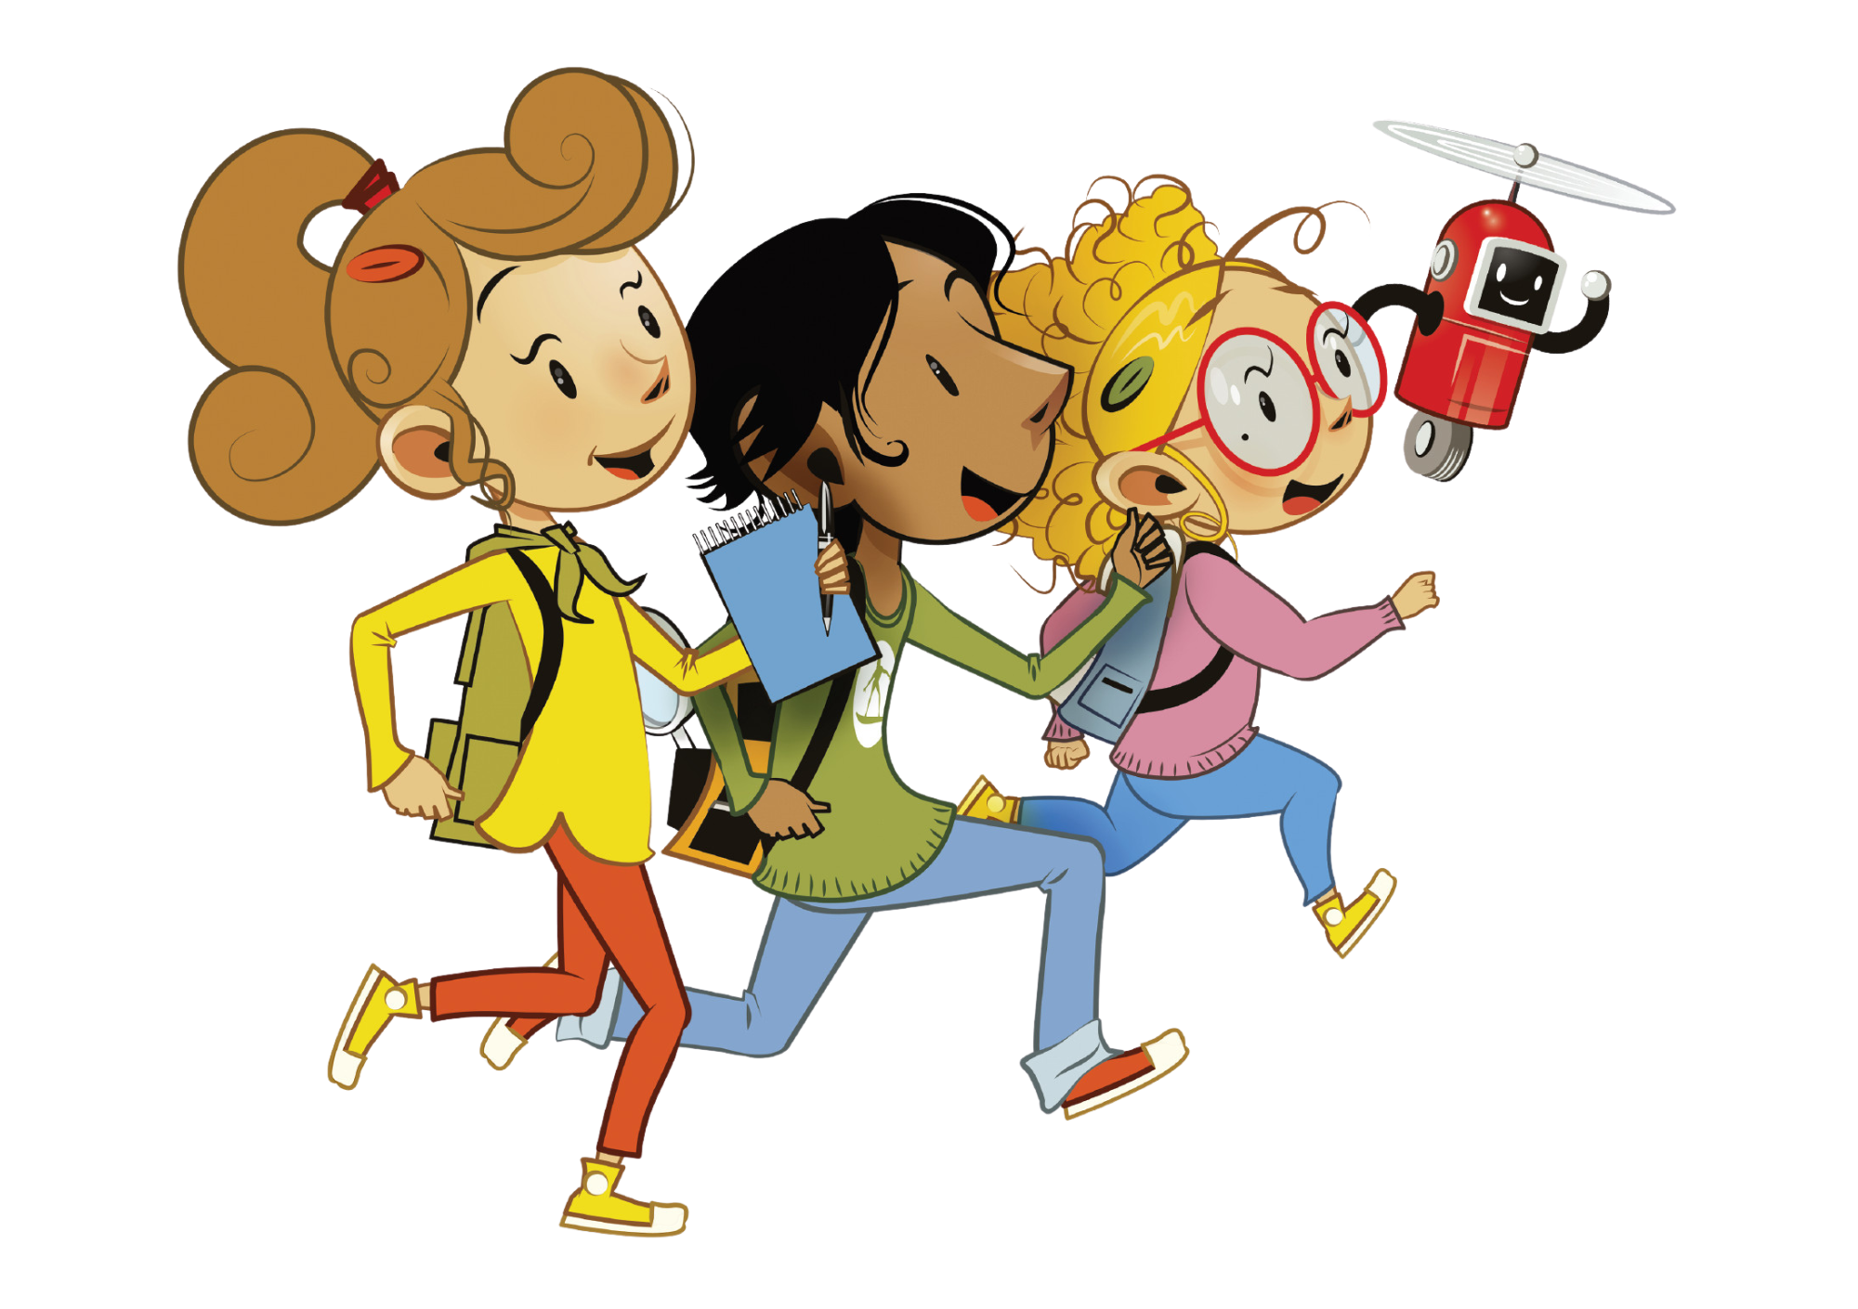

UNIT 7 – MY PARTY
Lesson 7A – Story

Slide 2
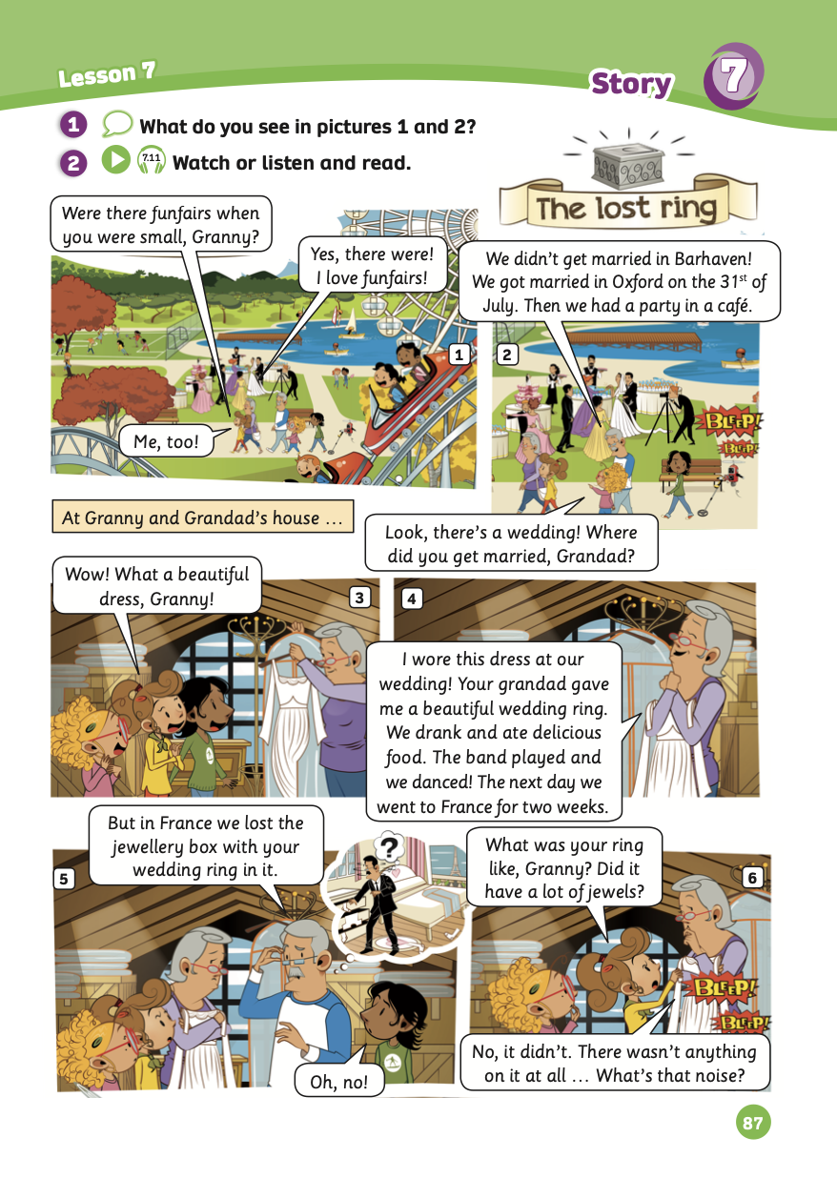
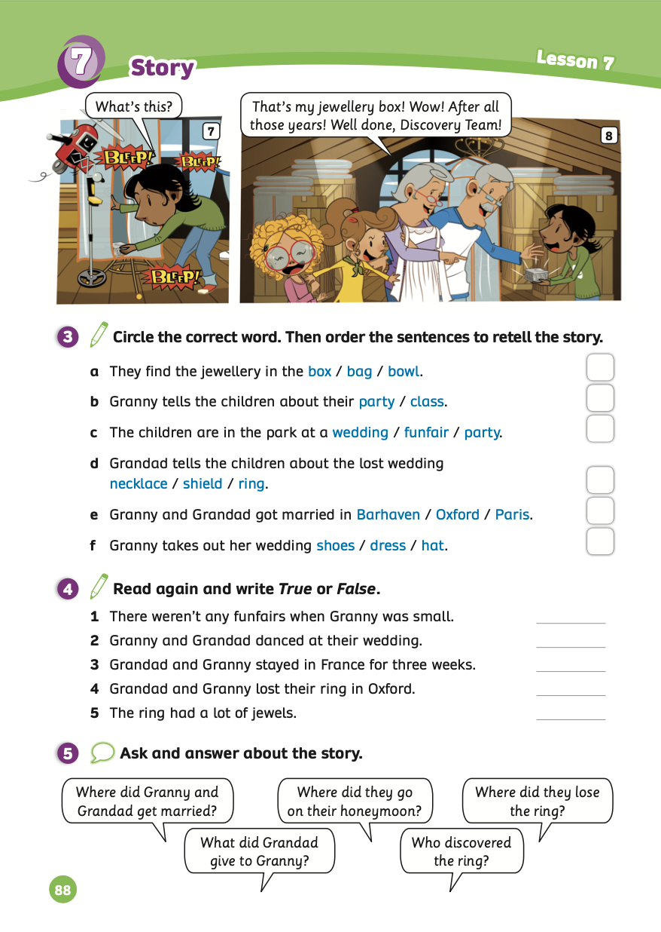
UNIT 7 – Lesson 7A
We’re learning…
- To review.
- To understand simple cartoon stories.
- PB p.87 & 88.
- AB p.68

Slide 3


WARM-UP ACTIVITY
Divide the class into groups of 4 to 5 students.
Each group takes out a mini-board.
They look at the questions with pictures and discuss to write down the answers on the boards.
After finishing, raise the boards to check.
The fastest group with all correct answers receives 2 points.

Slide 4












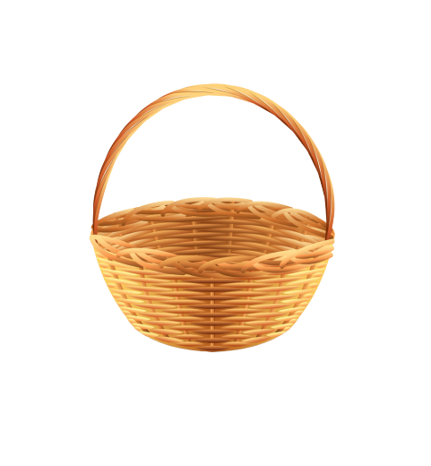
Picking
APPLE
Luật chơi:
Các đội lần lượt chọn các trái táo từ 1-5.
Trả lời đúng được cộng 1 điểm.
Click vào hình giỏ táo để nhận táo.
Đội nào nhiều táo hơn giành chiến thắng
1
2
3
0
1
2
3
4
5
0
6
1
2
3
4
5
0
6
PLAY
1
2
3
4
5
6

Slide 5


21st
A
What number comes after the 20th?
21th
B
21
C

Slide 6
get
A
She _____ married in London 20 years ago.
got
B
gotten
C

Slide 7
11
A
What number comes after the 10th?
11st
B
11th
C
Notes:
Ms Huyền Phạm - 0936.082.789 – YOUTUBE: MsPham. Facebook: Dạy và học cùng công nghệ.

Slide 8
wears
A
They _____ beautiful costumes at their wedding.
wear
B
wore
C
Notes:
Ms Huyền Phạm - 0936.082.789 – YOUTUBE: MsPham. Facebook: Dạy và học cùng công nghệ.

Slide 9
17
A
What number comes before the 18th?
17st
B
17th
C

Slide 10
have
A
He ______ a great honeymoon with his wife in Paris.
had
B
has
C

Slide 11
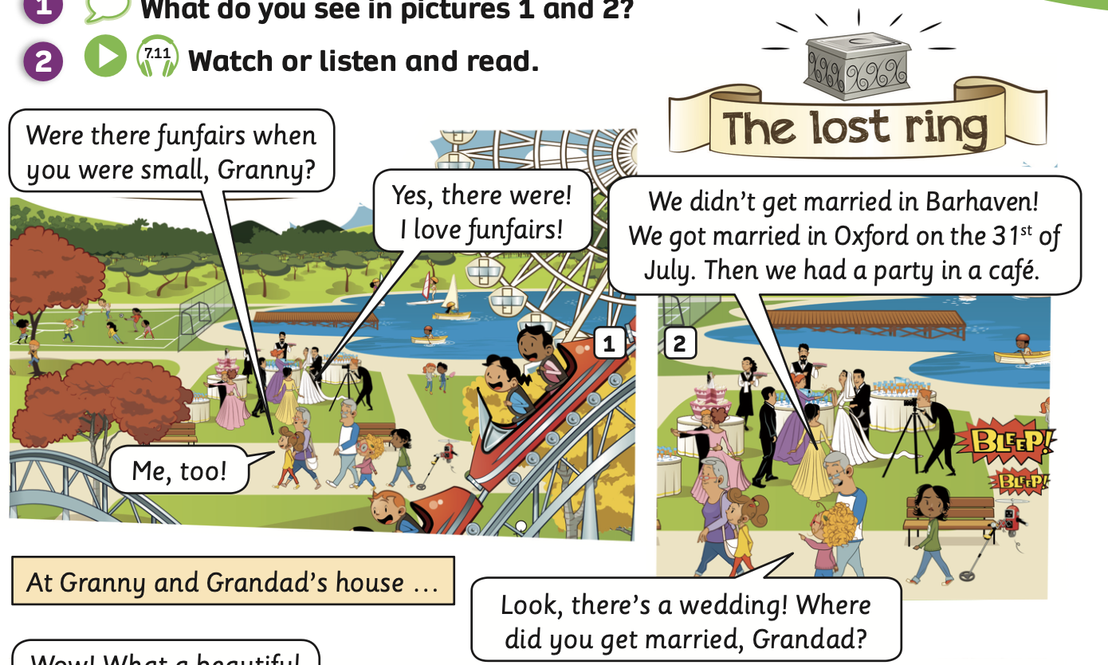
PUPIL’S BOOK p.87
I see big wheel
I see rollercoaster
I see a wedding
ANSWER
Have students open their books and look at the pictures 1 and 2 on page 87.
Then, students answer the question: “What do you see in it?”.
Click on “Answer” to check the answers.

Slide 12


STORY TIME

Slide 13
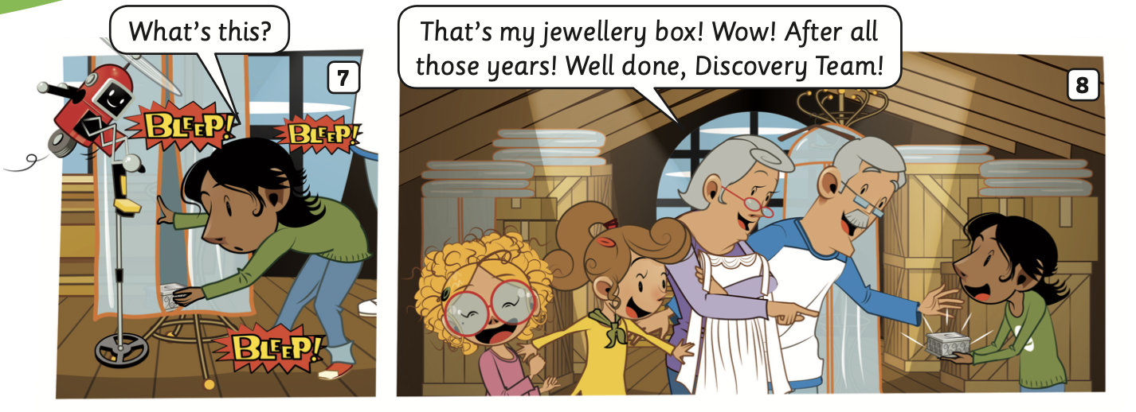

STORY TIME - INTRODUCTION
1. What’s the story title?
->
2. How many story frames?
->
3. How many characters?
->
The lost ring
8 frames
6 characters

Slide 14
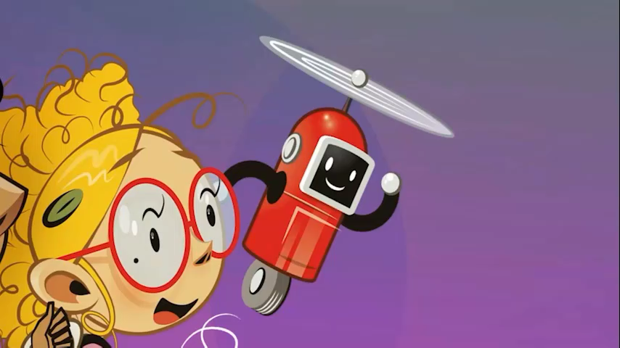
STORY TIME
Watch a video

Slide 15
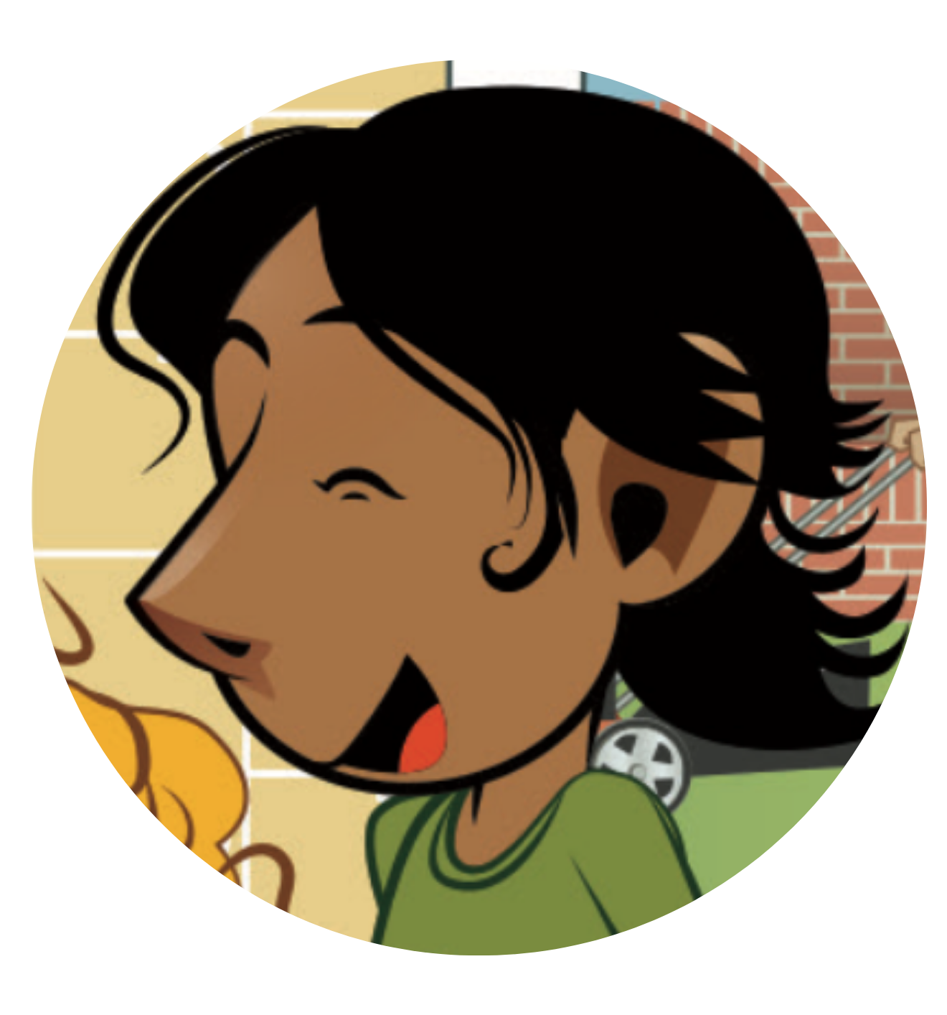

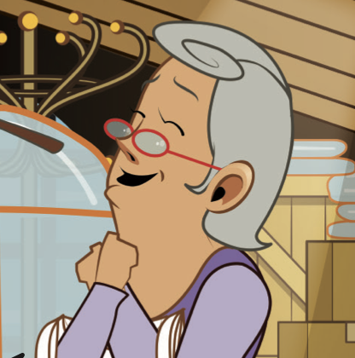
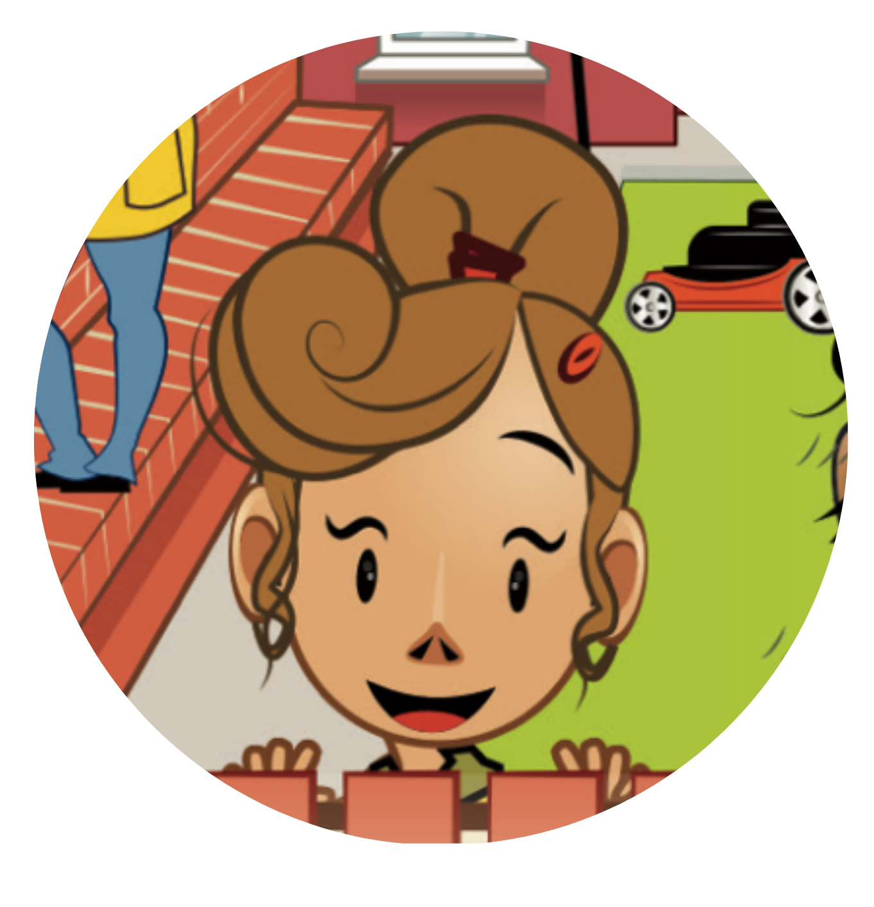

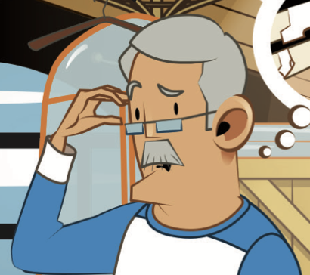
STORY TIME
CHARACTERS IN THE STORY
Ash
Lottie
Granny
Bo
Grandad
Lois

Slide 16

STORY TIME
Listen and point
Listen

Slide 17
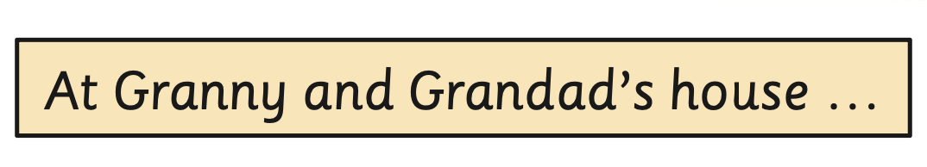
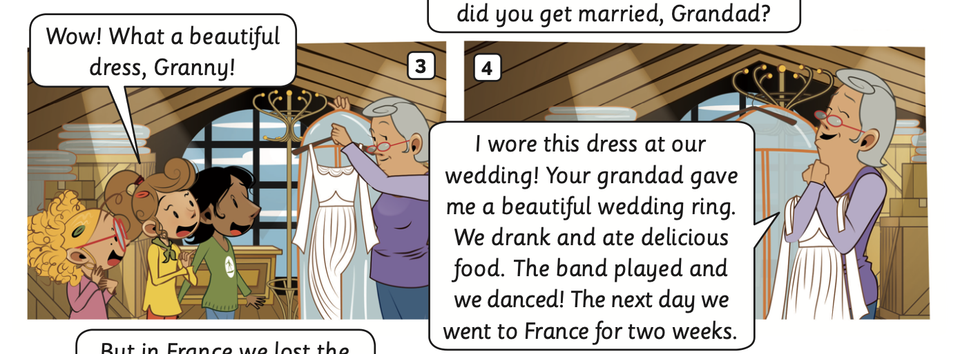
STORY TIME
Listen and point
Listen

Slide 18
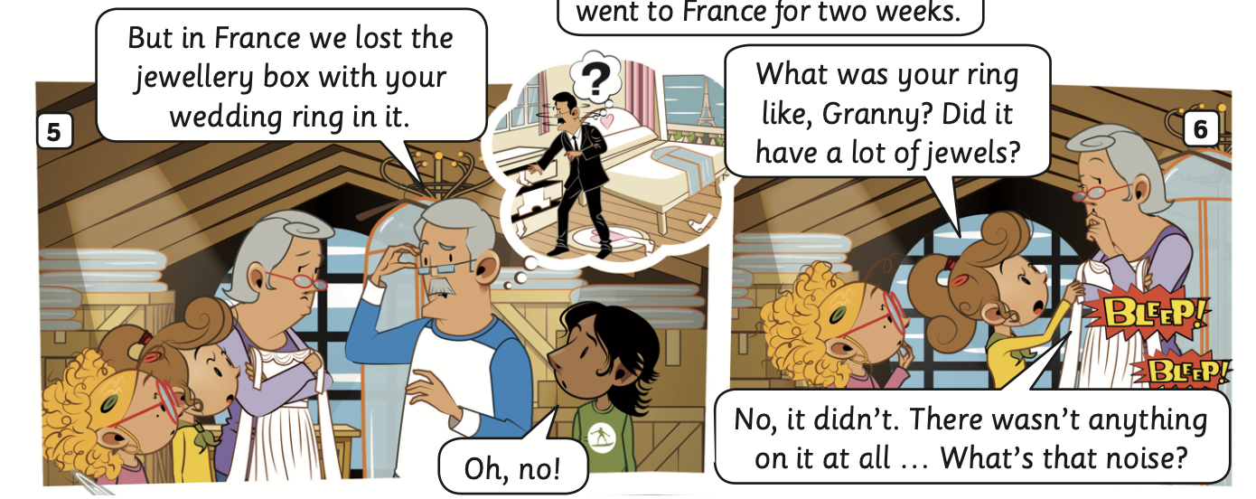
STORY TIME
Listen and point
Listen

Slide 19
STORY TIME
Listen and point
Listen

Slide 20
STORY TIME
Listen and read
1
1
2
2
5
3
4
3
5
4

Slide 21
STORY TIME
Listen and read
1
1
2
2
3
3

Slide 22
STORY TIME
Listen and read
1
1
3
2
3
4
4
2

Slide 23
STORY TIME
Listen and read
1
1
2
2

Slide 24
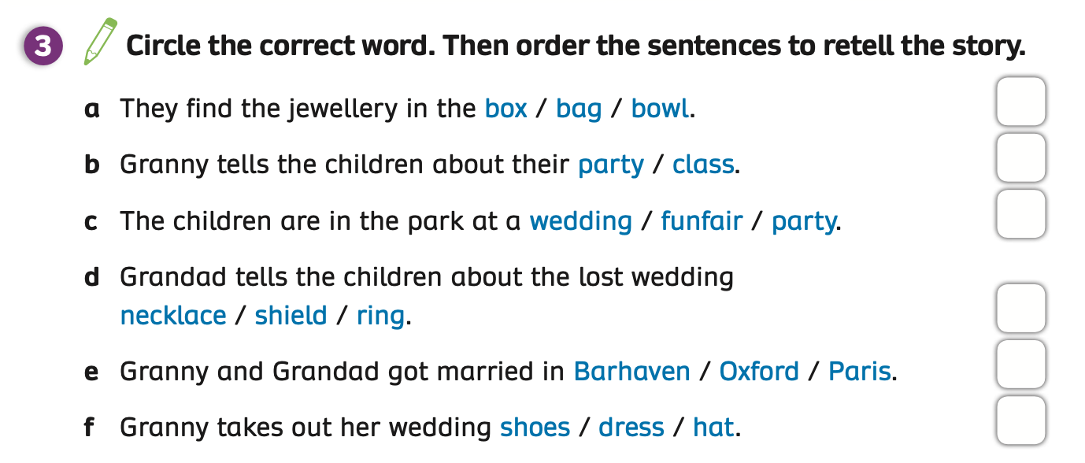
PUPIL’S BOOK p.88
ANSWER
Students read the story and write the correct words on the paper.
Click on “Answer” to check the answers.
Open their books to look at and circle the correct answers.

Slide 25
PUPIL’S BOOK p.88
6
4
1
5
2
3
ANSWER
Then, order the sentences to retell the story.
Click on “Answer” to check the answers.
Write the correct answers on the book

Slide 26
PUPIL’S BOOK p.88
Activity: TRUE OR FALSE
Divide the class into groups of 4 to 5 students.
Each group takes out a pen or pencil put in the middle of the table.
They look at the questions with pictures about the story and raise the pen or pencil to answer.
The fastest group with all correct answers receives 2 points.

Slide 27
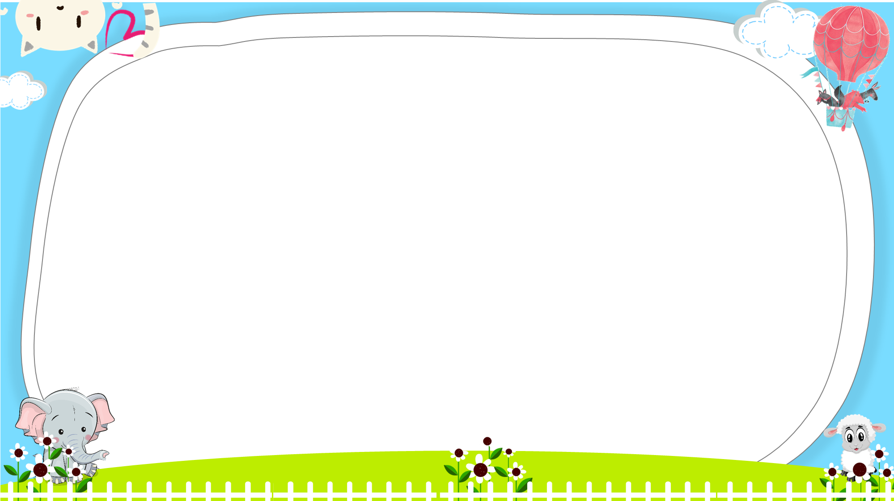



Ms Huyền Phạm - 0936.082.789

Slide 28






There were many funfairs when Granny was small.
Ms Huyền Phạm - 0936.082.789
True
False

Slide 29

They find the jewelry in the bag.
Ms Huyền Phạm - 0936.082.789
True
False

Slide 30


Granny tells the children about their party.
Ms Huyền Phạm - 0936.082.789
True
False

Slide 31
Granny and Grandad got married in Barhaven.
Ms Huyền Phạm - 0936.082.789
True
False

Slide 32
Granny takes out her
wedding dress.
Ms Huyền Phạm - 0936.082.789
True
False

Slide 33
The ring had a lot of jewels.
Ms Huyền Phạm - 0936.082.789
True
False

Slide 34

Ms Huyền Phạm - 0936.082.789

Slide 35
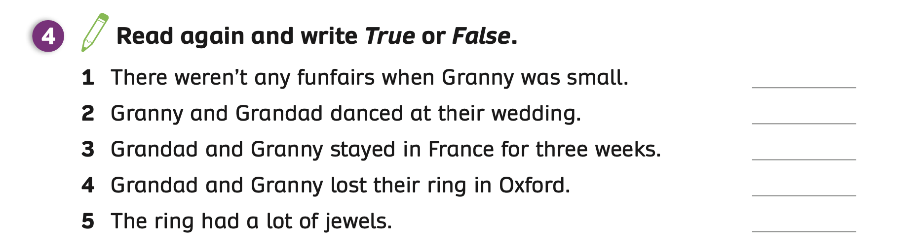
PUPILS’ BOOK p.88
False
True
False
False
False
ANSWER
Ask students to open their books and look at task 4 on page 88.
Students read the story again and write True or False.
Show the answers to check.

Slide 36
HOMEWORK
Review vocabulary and grammar.
Do exercises in the Activity Book (page 68).
Check answers in the Teacher’s Book (page 151) or Active Teach.

Slide 37
UNIT 7 – Lesson 7A
We’ve learned…
- To review.
- To understand simple cartoon stories.
- PB p.87 & 88.
- AB p.68

