Slide 1
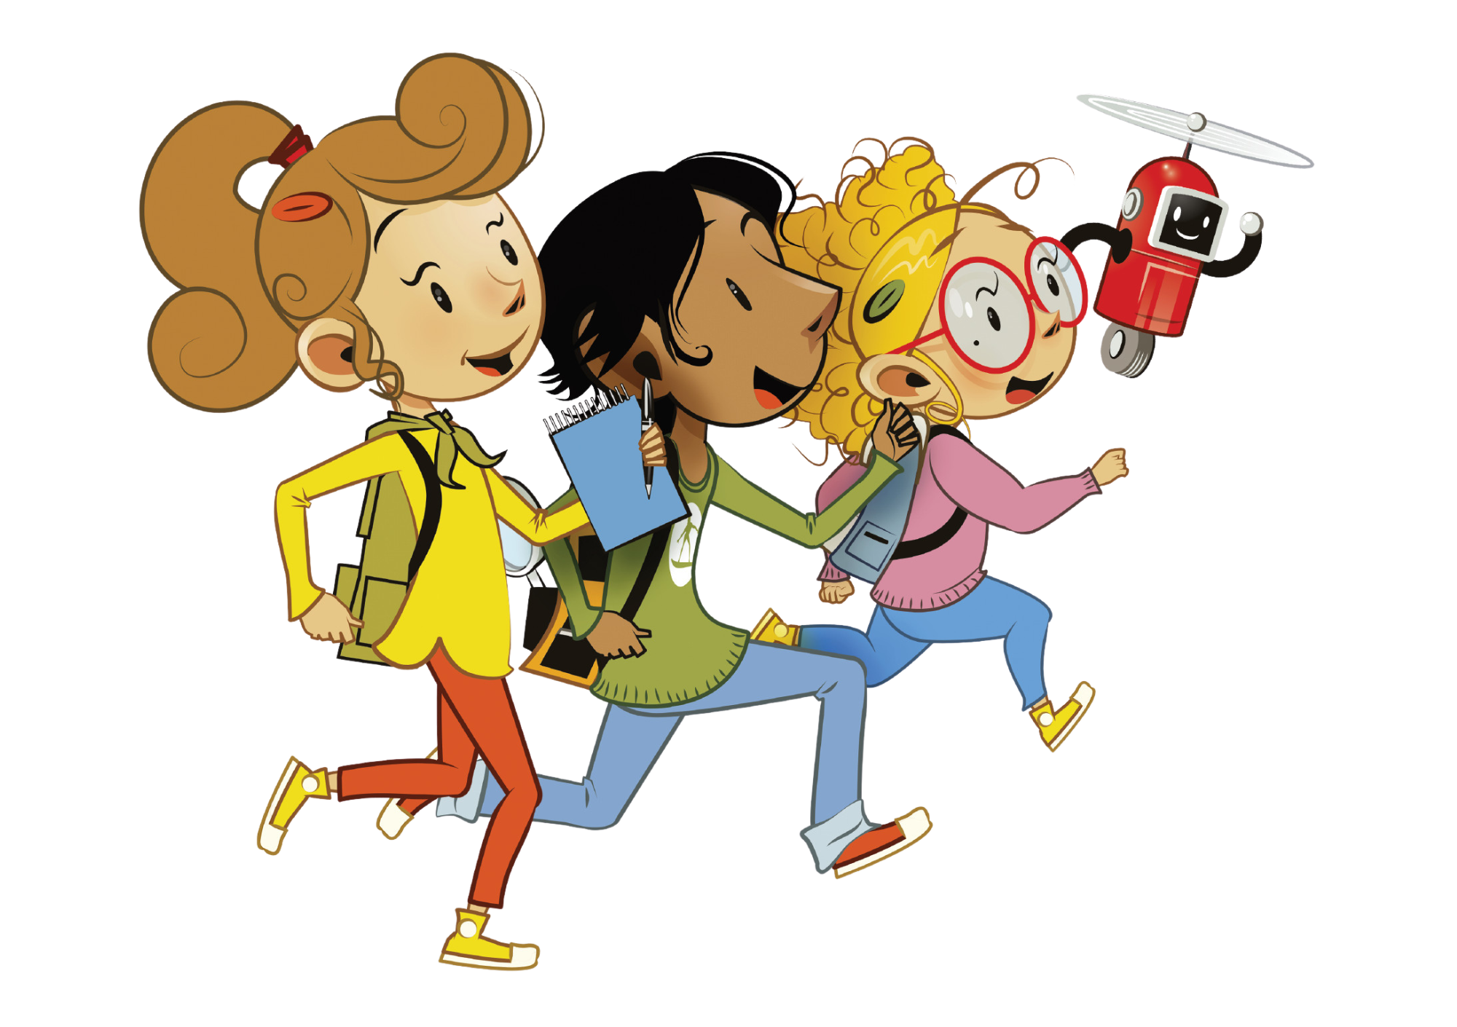
UNIT 8 – LET’S EXPLORE!
Lesson 1 – Vocabulary

Slide 2
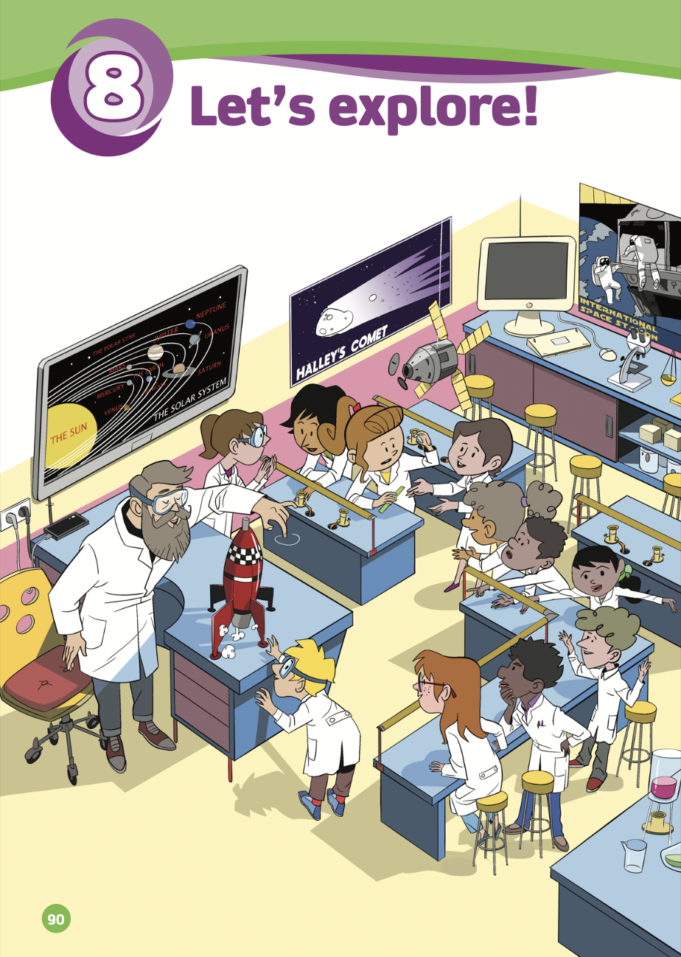
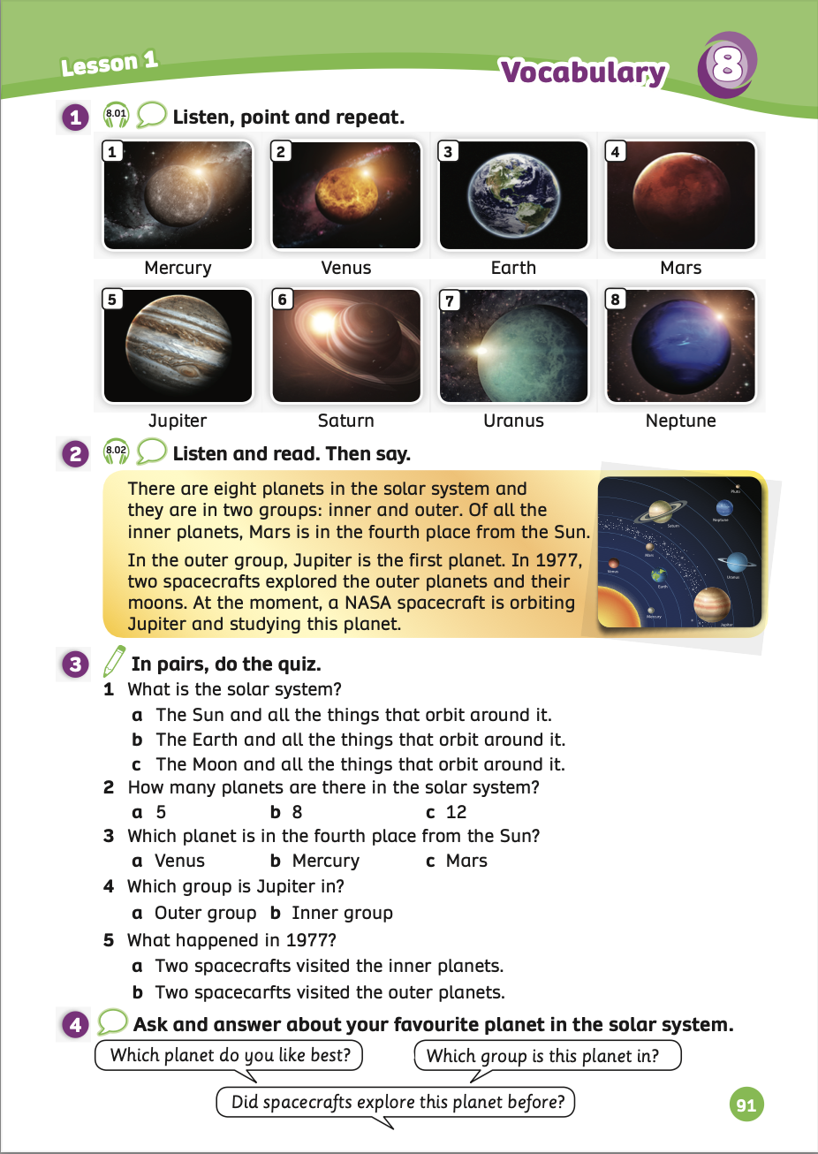
UNIT 8 – Lesson 1
We’re learning…
- To correctly read and pronounce the planets in the solar system.
- PB pp.90,91
- AB p.70

Slide 3
WARM-UP ACTIVITY
Ask students to work in groups of 3 or 4.
The teacher gives each group a sheet of word search.
Then, students will discuss and find the words from the hint line next to the table of words following the vertical, horizontal, and diagonal. They have 5 minutes to play.
The fastest group that finds all correct words will receive 2 points.

Slide 4
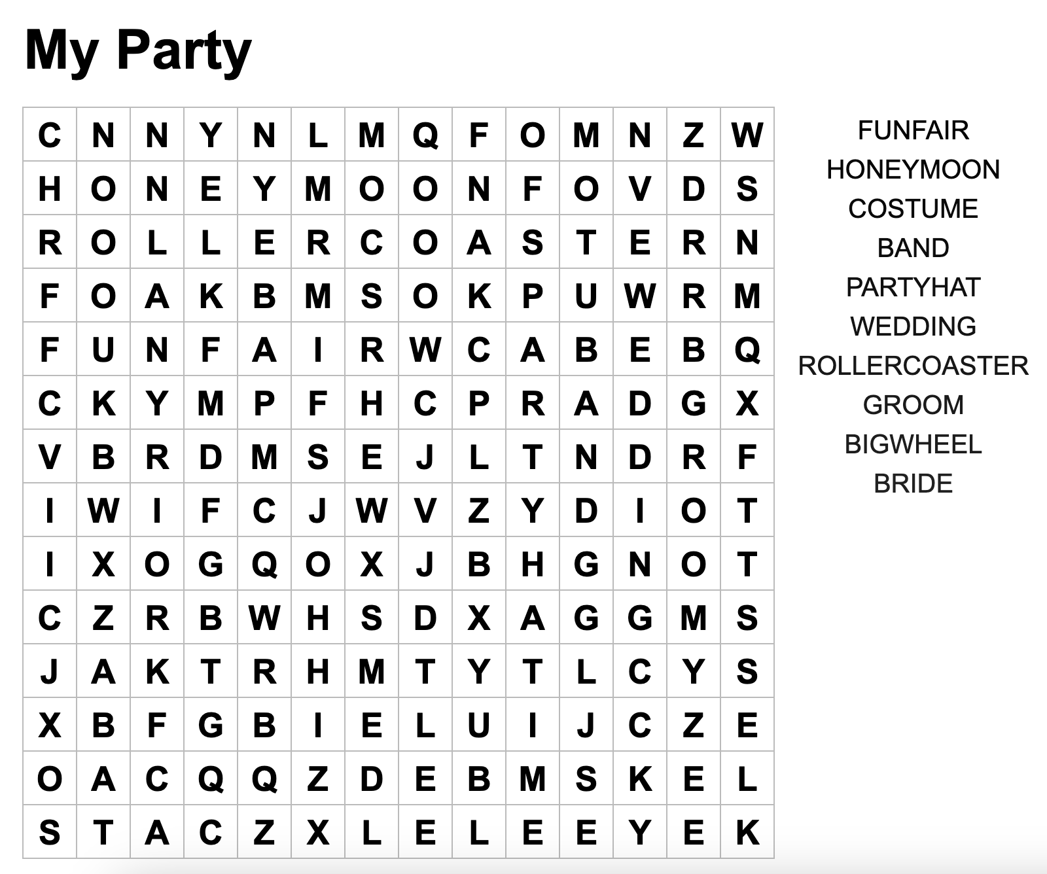
WARM-UP ACTIVITY
ANSWER
Notes:
Teacher can print out this word search for students.

Slide 5
LEAD-IN
1. Where are the students?
→ They are in the science room.
2. What are they doing?
→ They are studying science.
- Ask students to work in pairs. Use the stopwatch and explain that they have one minute to answer two questions:
1. Where are the students? 2. What are they doing?

Slide 6
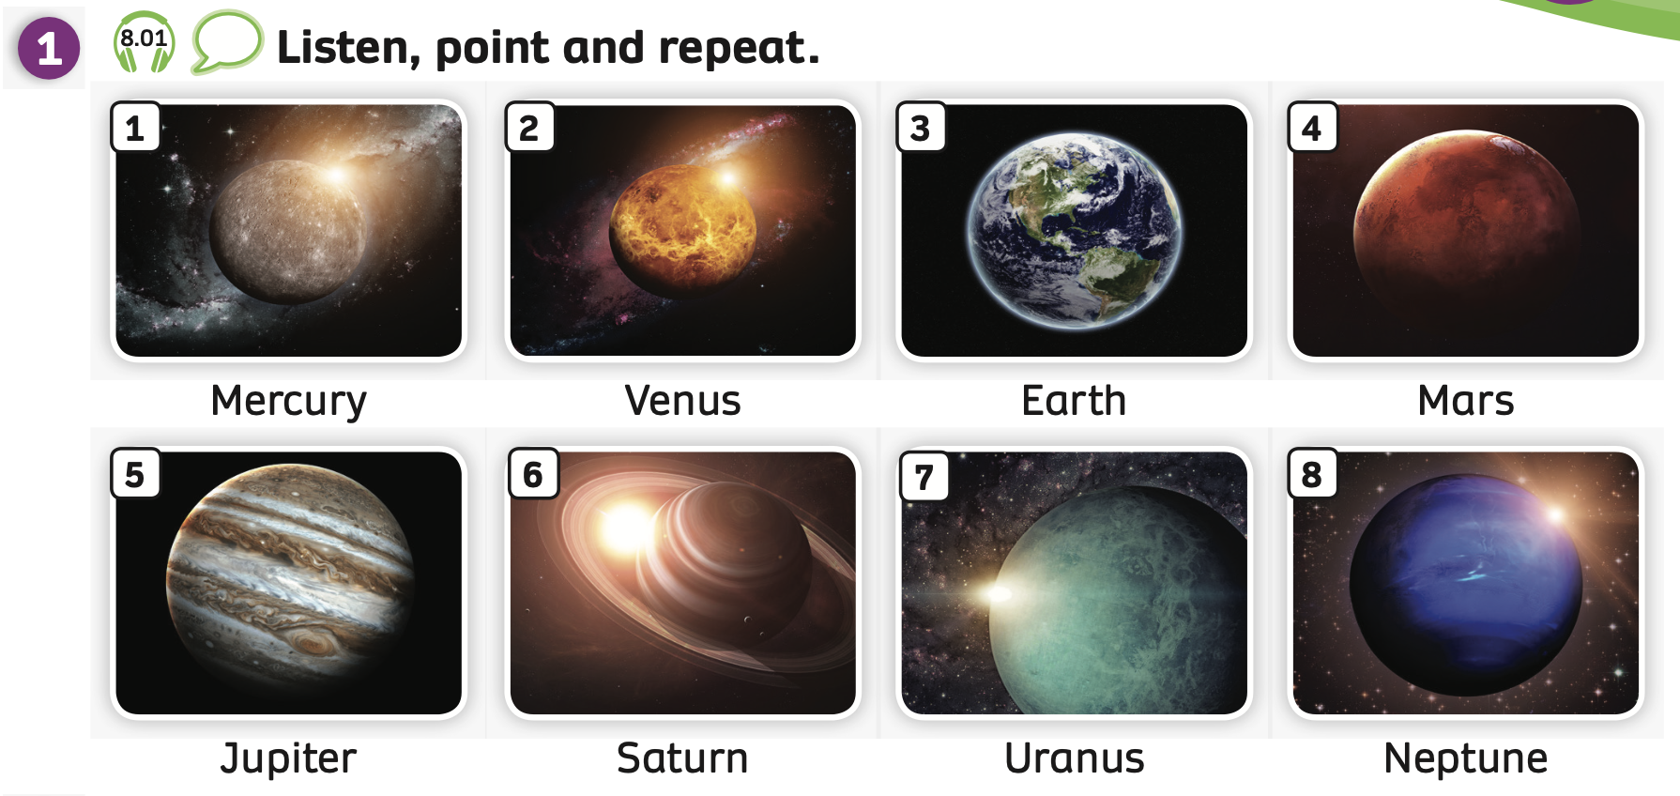
VOCABULARY – Let’s explore!
- Play the audio, students listen, point and repeat the words.

Slide 7
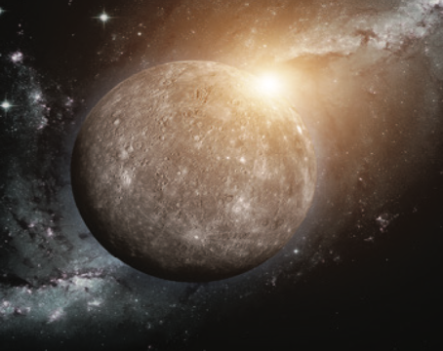
VOCABULARY – Let’s explore!
Let’s spell!
c
Mercury
M
e
r
c
u
r
y
Students listen and repeat the word.

Slide 8
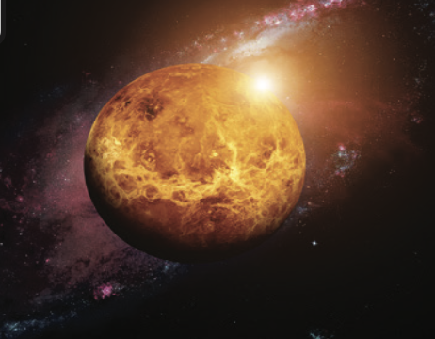
VOCABULARY – Let’s explore!
Let’s spell!
c
Venus
V
e
n
u
s
Students listen and repeat the word.

Slide 9
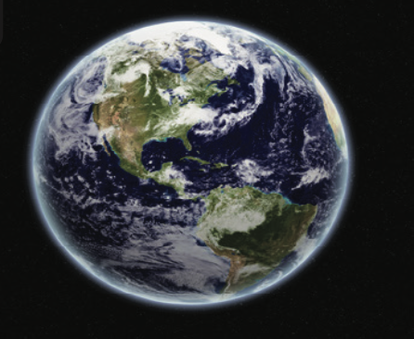
VOCABULARY – Let’s explore!
Let’s spell!
c
Earth
E
a
r
t
h
Students listen and repeat the word.

Slide 10
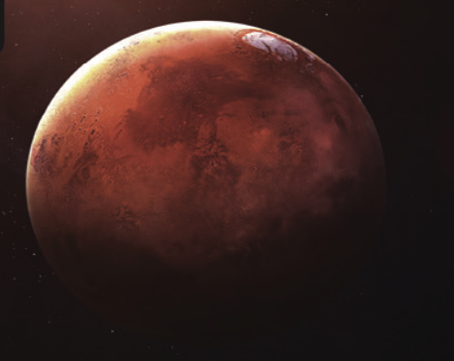
VOCABULARY – Let’s explore!
Let’s spell!
c
Mars
M
a
r
s
Students listen and repeat the word.

Slide 11
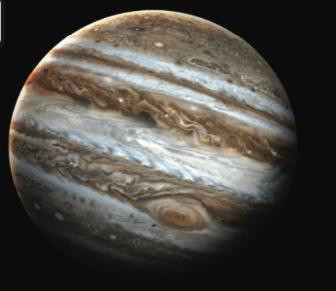
VOCABULARY – Let’s explore!
Let’s spell!
c
Jupiter
J
u
p
i
t
e
r
Students listen and repeat the word.

Slide 12
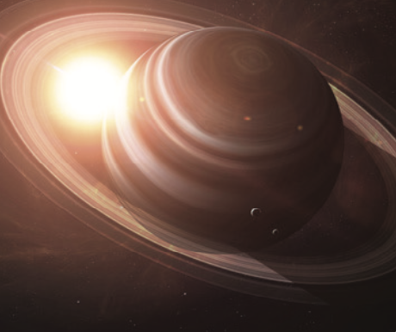
VOCABULARY – Let’s explore!
Let’s spell!
c
Saturn
S
a
t
u
r
n
Students listen and repeat the word.

Slide 13
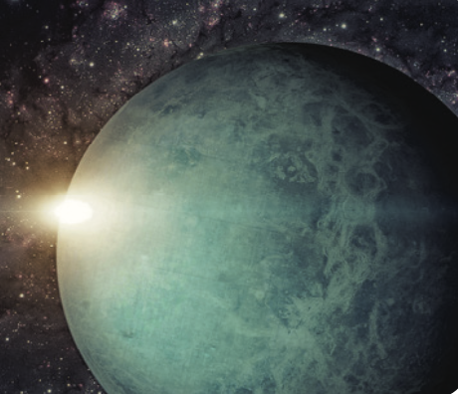
VOCABULARY – Let’s explore!
Let’s spell!
c
Uranus
U
r
a
n
u
s
Students listen and repeat the word.

Slide 14
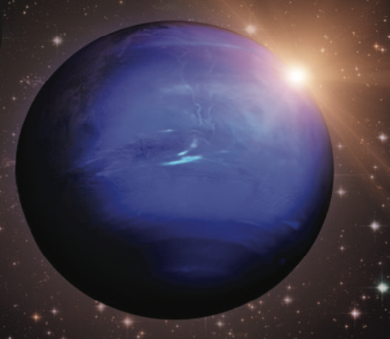
VOCABULARY – Let’s explore!
Let’s spell!
c
Neptune
N
e
p
t
u
n
e
Students listen and repeat the word.

Slide 15
VOCABULARY – Let’s explore!
REVIEW
1
2
3
4
Mercury
Venus
Earth
Mars
5
6
7
8
Jupiter
Saturn
Uranus
Neptune
- Show all the pictures; the teacher says the number, and students say the word.
- Click on each number to show the word, students spell it again.

Slide 16
VOCABULARY – Practice
Ask students to work in groups of 3 or 4.
The teacher shows the slide, and students look at the hidden picture and guess what it is.
Then, they raise their hands to check the answers.
The fastest group with all the correct answers receives a point.

Slide 17
I Spy
Today, the planets are hiding in the galaxy. Can you spot them?
We are flying to the galaxy. Can you tell which planet is hiding behind the bubble?

Slide 18
What’s hiding?
It’s Mercury!

Slide 19
What’s hiding?
It’s Earth!

Slide 20
What’s hiding?
It’s Saturn!

Slide 21
What’s hiding?
It’s Uranus!

Slide 22
What’s hiding?
It’s Venus!

Slide 23
What’s hiding?
It’s Neptune!

Slide 24
What’s hiding?
It’s Mars!

Slide 25
What’s hiding?
It’s Jupiter!

Slide 26
Well done!

Slide 27
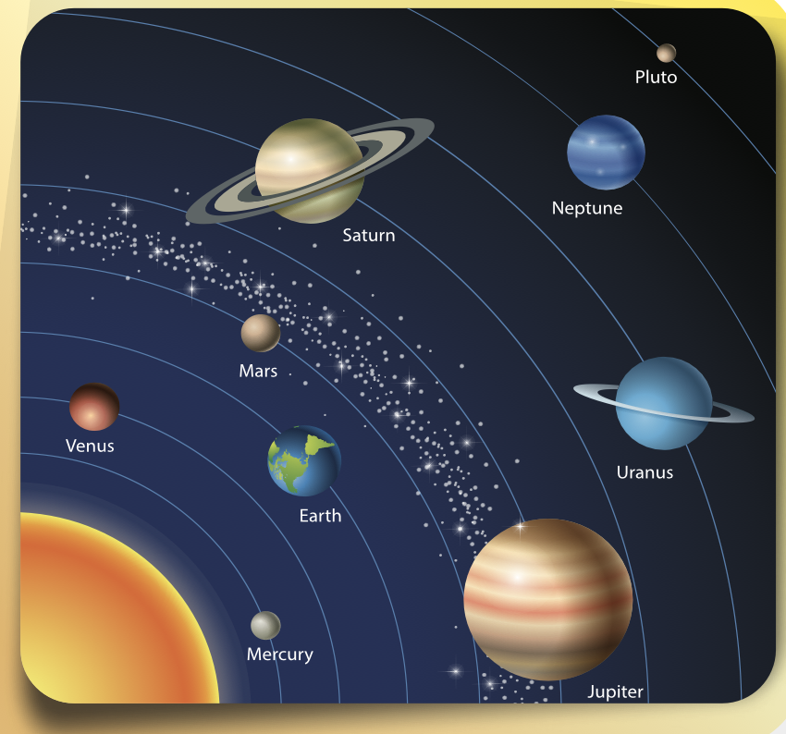
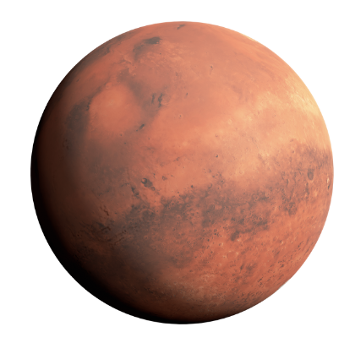
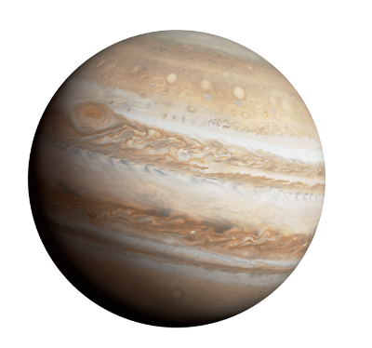
LISTENING – Pupils’ Book (p.91)
Listen and say
Mars
Jupiter
Example
1977
Ask students to close their books and look at the picture on the slide. Play the audio, students listen.
Ask some students to recall any details that they can remember, such as the names of planets, years, etc.
Click on “Example” to see some examples.

Slide 28
PRE-READING – Pupils’ Book (p.91)
Answer
Ask students to open their books. Play the audio, students listen and repeat what they hear.
Then, ask students to work in pairs to read and underline the names of planets which have in the text.
Show the answer to check.

Slide 29
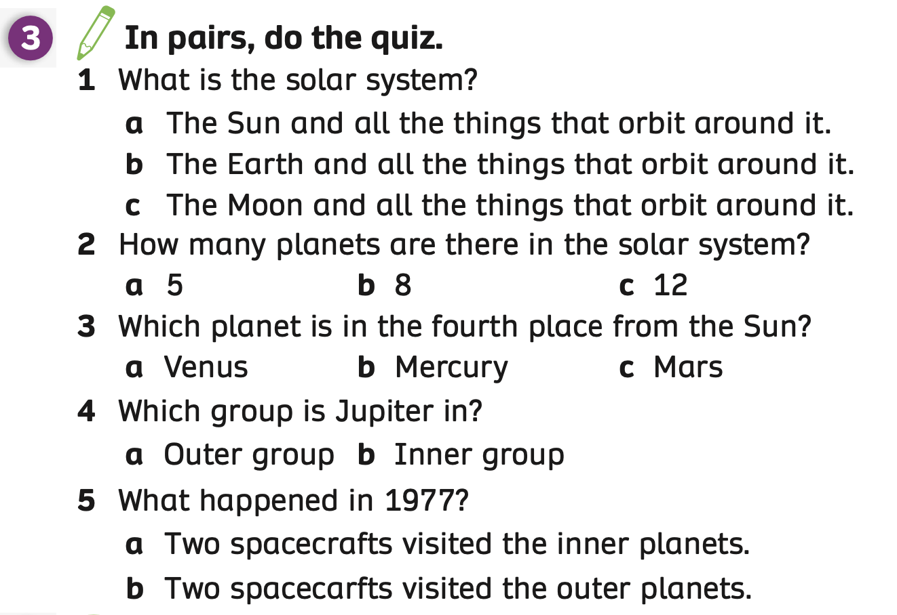
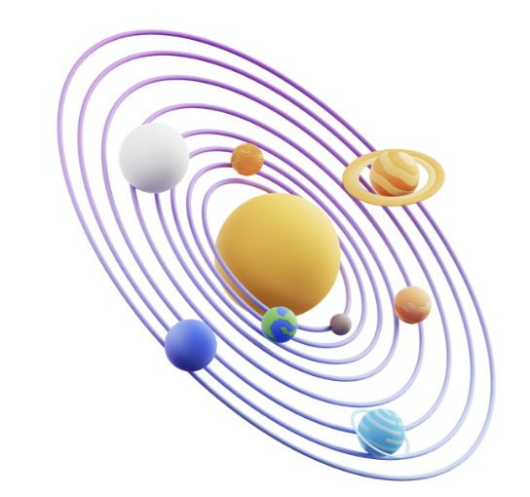
READING – Pupils’ Book (p.91)
Answer
- Ask students to read the text again and do the quiz.
- Ask students to work in pairs. Students share the answers with their partners.
- Then, the teacher shows the answers to check.

Slide 30
POST READING – Pupils’ Book (p.91)
Ask students to work in pairs and have them ask/answer the questions: “Which planet do you like best?”, “Did spacecrafts explore this planet before?” or “Which group is this planet in?” Then switch roles.
Invite some pairs to present in front of the class. Give points if they give a good dialogue.

Slide 31
POST READING – Pupils’ Book (p.91)
EXAMPLE
Which group are eight planets in?
They are in two groups: inner and outer.
My favourite planet is Uranus.
Which planet do you like best?
Invite some pairs to present in front of the class. Give points if they have good conversations.

Slide 32
PRODUCTION
Mercury
Venus
Earth
Mars
Jupiter
Saturn
Uranus
Neptune
Show the pictures, students look and say the words aloud.

Slide 33
HOMEWORK
Review vocabulary and grammar.
Do exercises in the Activity Book (page 70).
Check the answers in the Teacher’s Book (page 156) or Active Teach.

Slide 34
UNIT 8 – Lesson 1
We’ve learned…
- To correctly read and pronounce the planets in the solar system.
- PB pp.90,91
- AB p.70

