Slide 1
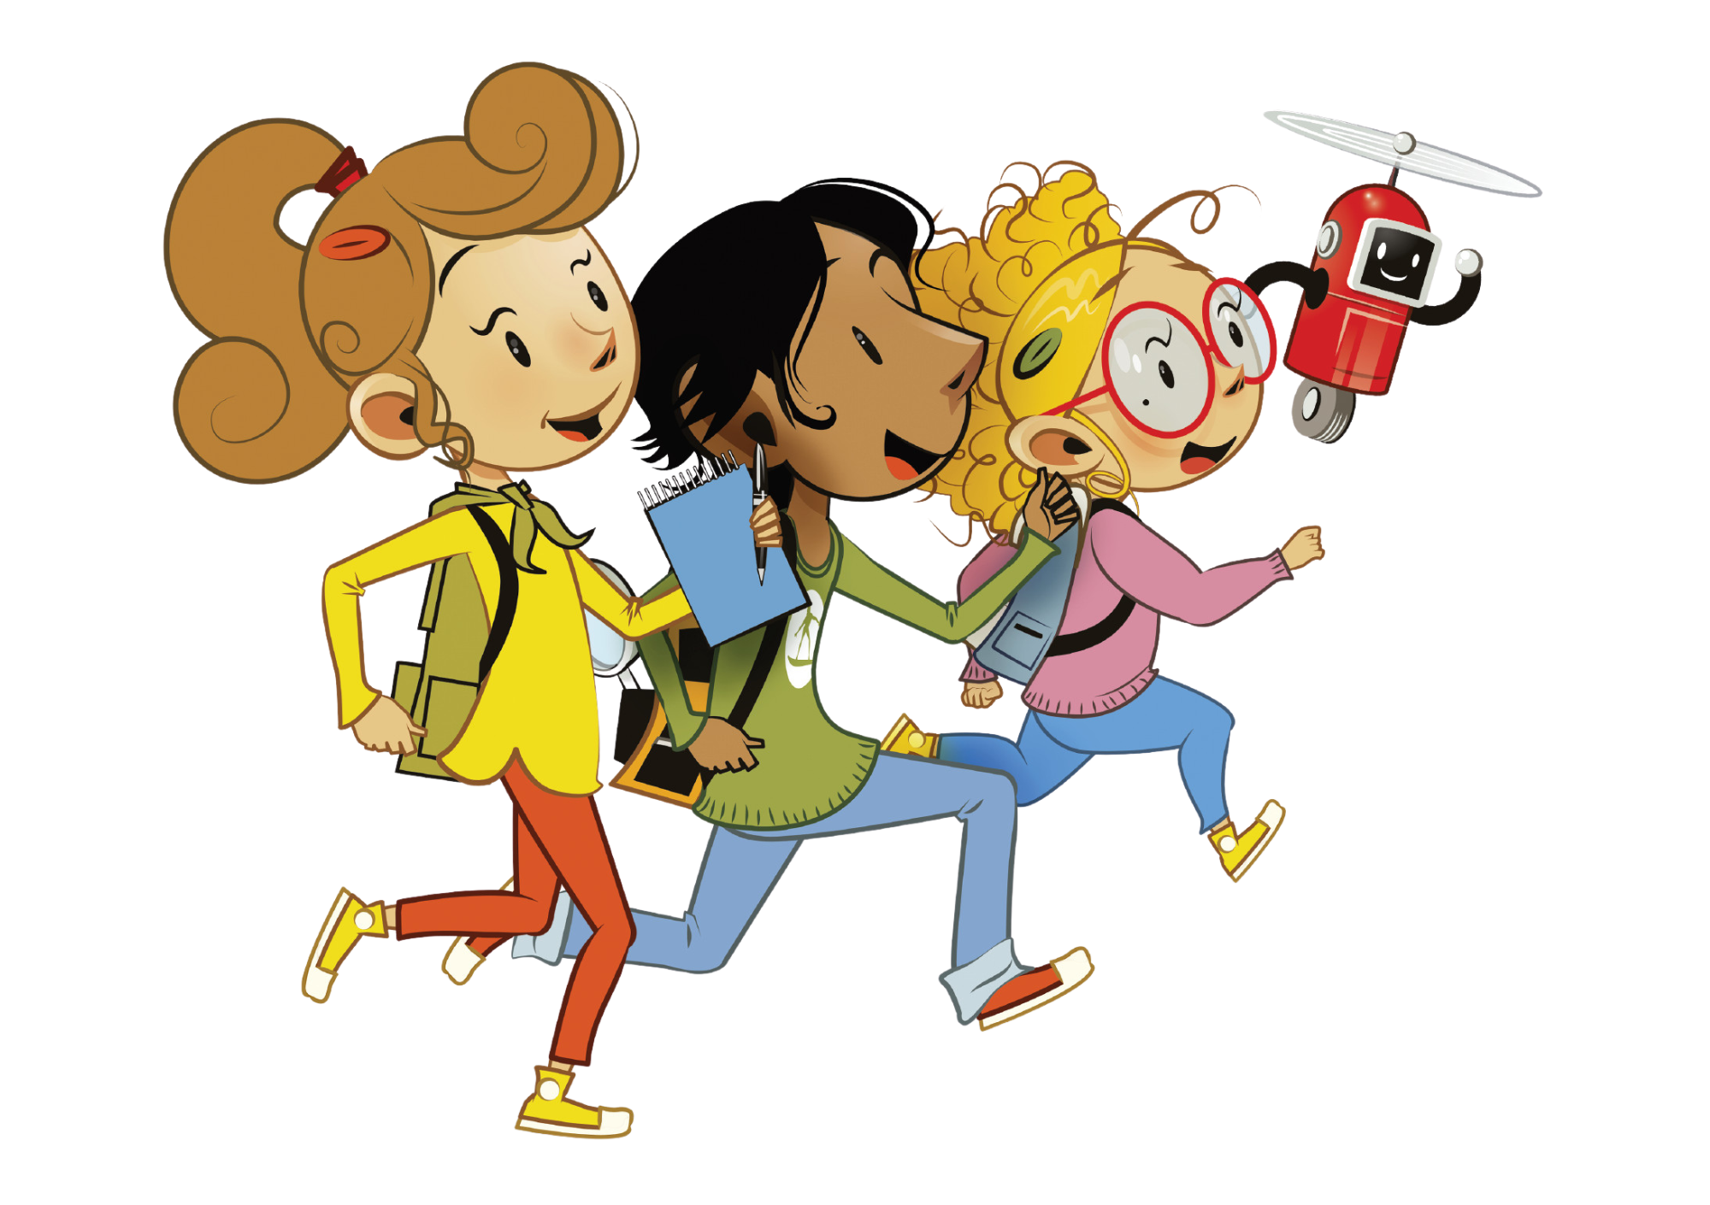
UNIT 8 – LET’S EXPLORE!
Lesson 2 – Review

Slide 2
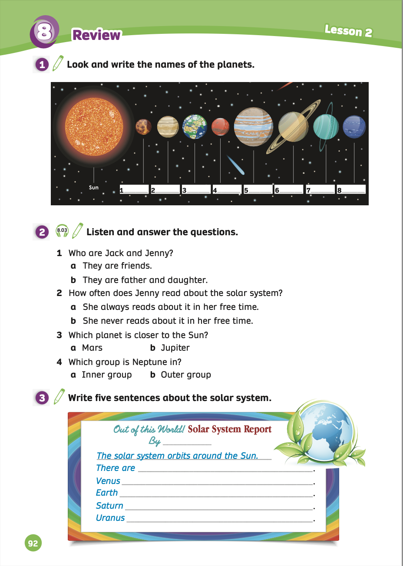
UNIT 8 – Lesson 2
We’re learning…
- To review vocabulary about the solar system.
- To write about the solar system.
- PB p.92
- AB p.71

Slide 3
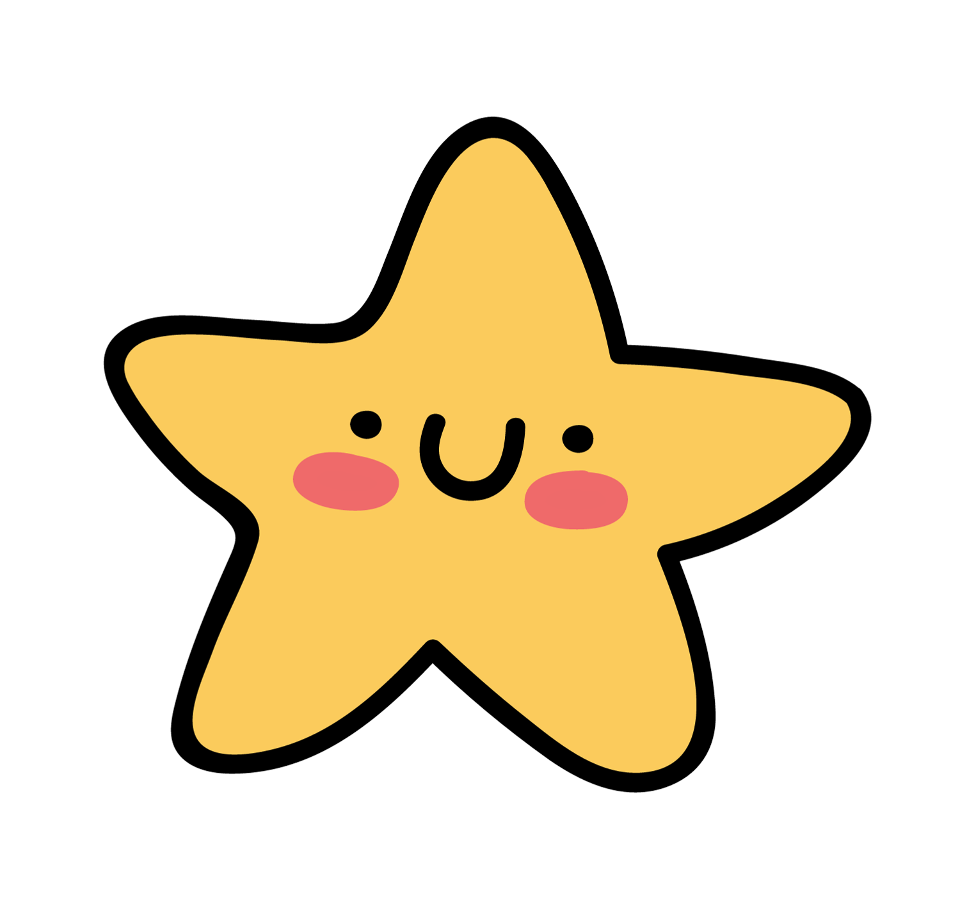
WARM-UP ACTIVITY
Activity: FIND THE LETTERS
Divide the class into pairs.
Each pair takes out a mini-board.
Show the words with blanks. Students look at them and write the missing letters.
After finishing, students raise their boards to check the answers.
The 3 first pairs with the correct answer receive a point.

Slide 4
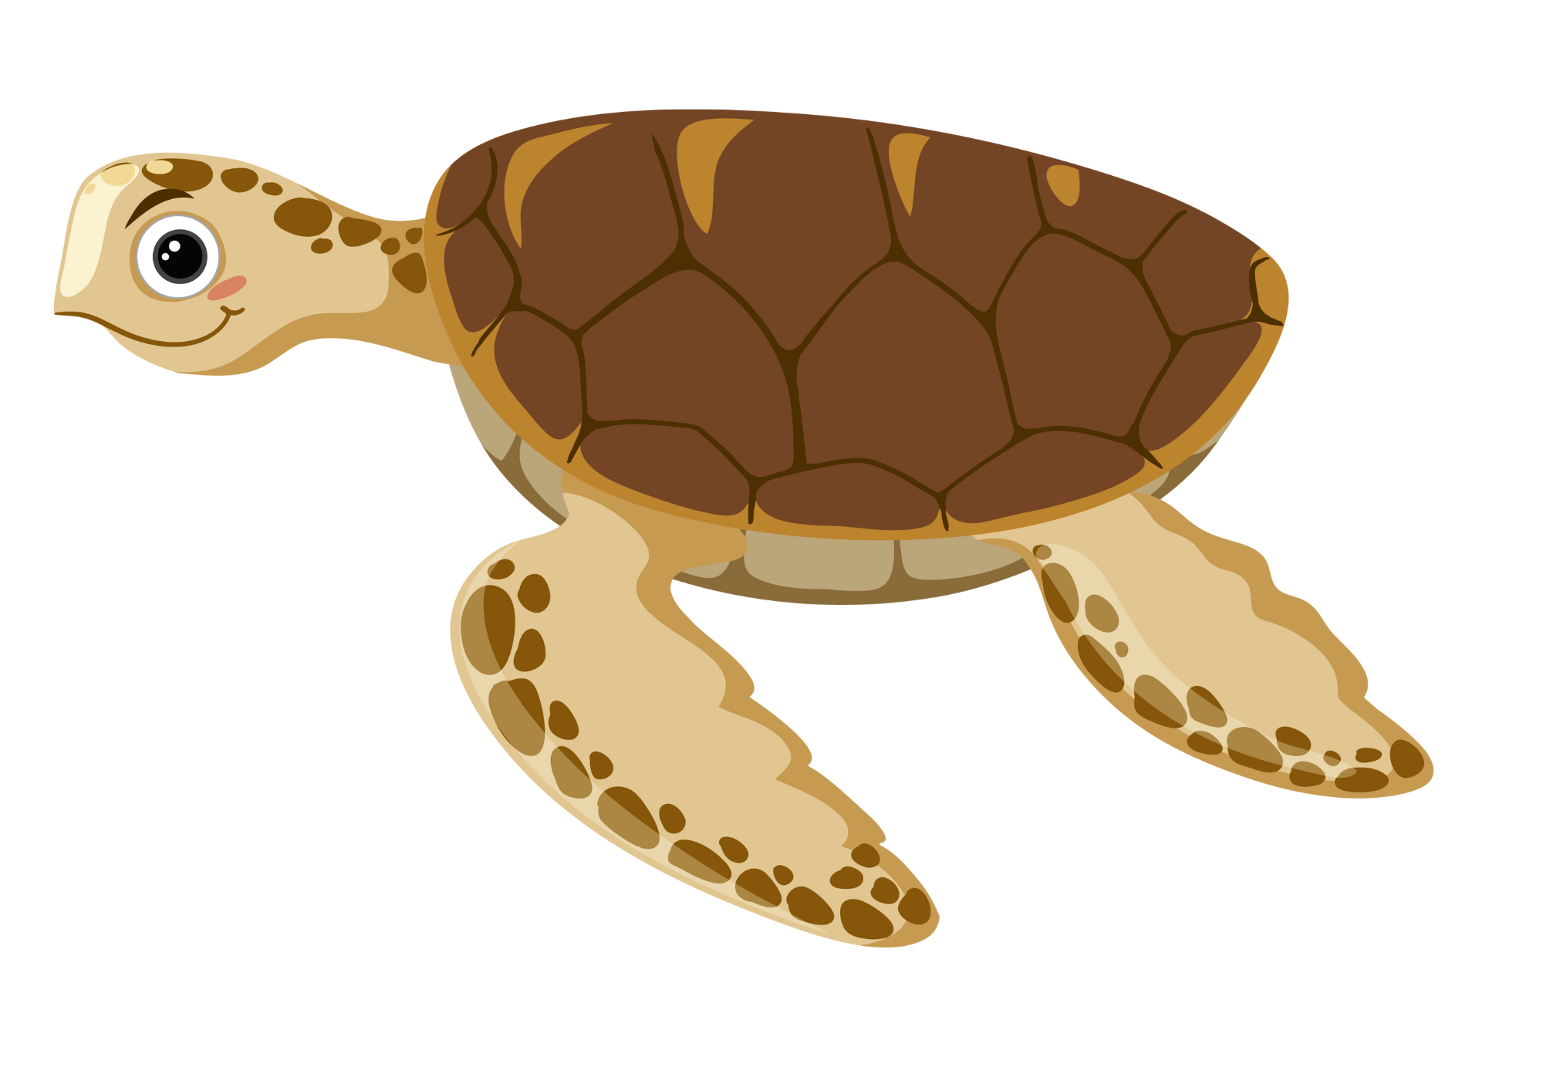
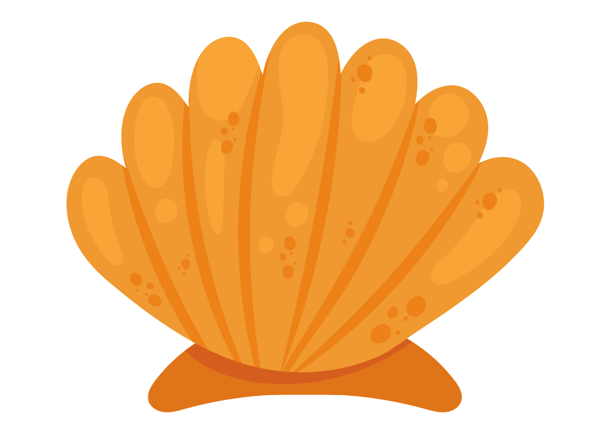
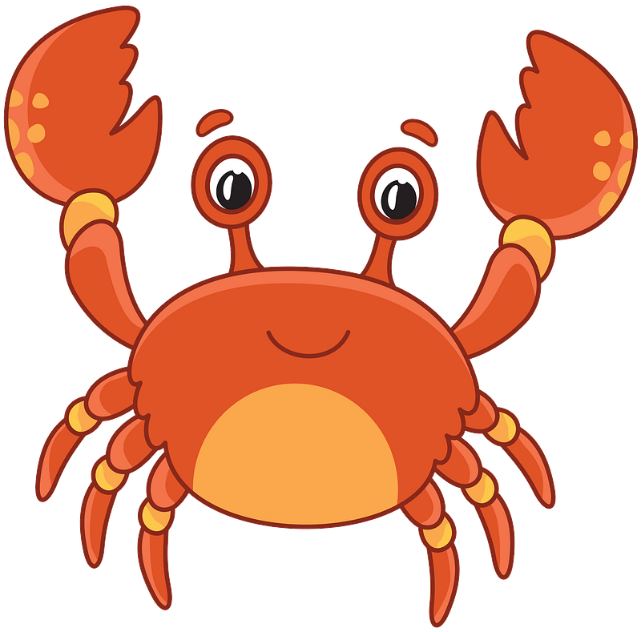
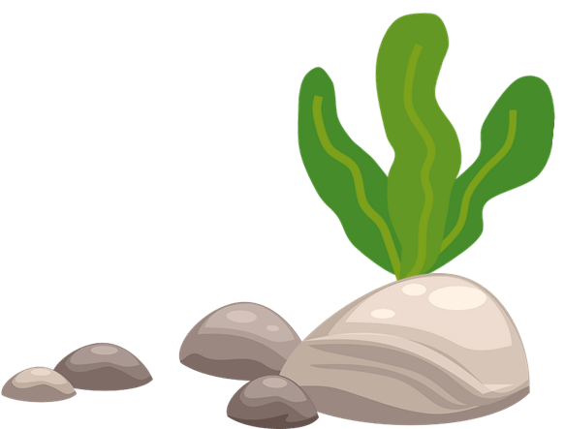
MsPham-0936082789
START

Slide 5
M_rc_r_
e
u
y
MsPham-0936082789
Check
Next

Slide 6
_atu_n
S
r
MsPham-0936082789
Check
Next

Slide 7
_e_t_ne
N
p
u
MsPham-0936082789
Check
Next

Slide 8
U_a_us
r
n
MsPham-0936082789
Check
Next

Slide 9
V_n_s
e
u
MsPham-0936082789
Check
Next

Slide 10
E__th
a
r
MsPham-0936082789
Check
Next

Slide 11
p
_u_i_er
J
t
MsPham-0936082789
Check
Next

Slide 12
Ma__
r
s
MsPham-0936082789
Check
Next

Slide 13
MsPham-0936082789
FINISH

Slide 14
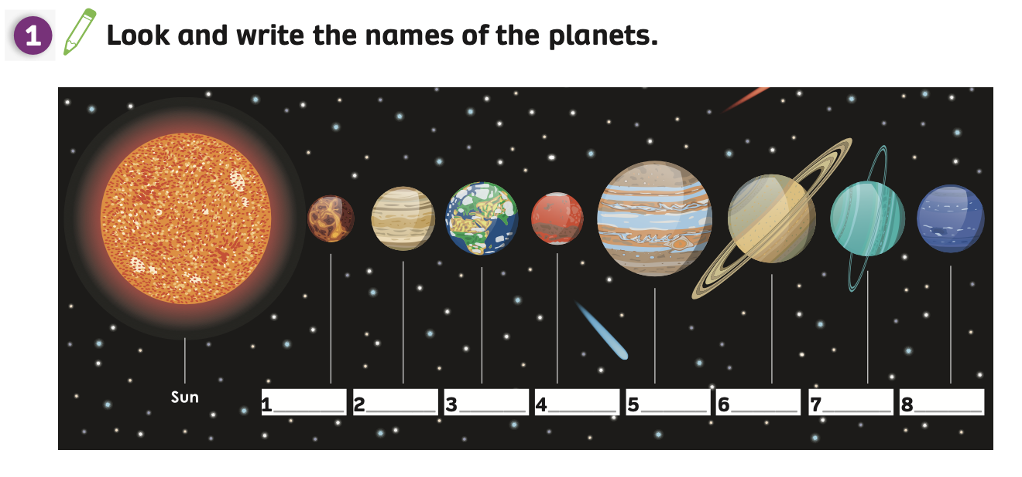
Pupils’ Book (p.92)
1. Mercury
2. Venus
3. Earth
4. Mars
5. Jupiter
6. Saturn
7. Uranus
Answer
8. Neptune
Ask students to look at Activity 1 on page 92.
Students work individually to do this task, then ask them to work in pairs to compare answers.
Teacher shows the answer to check with the whole class.

Slide 15
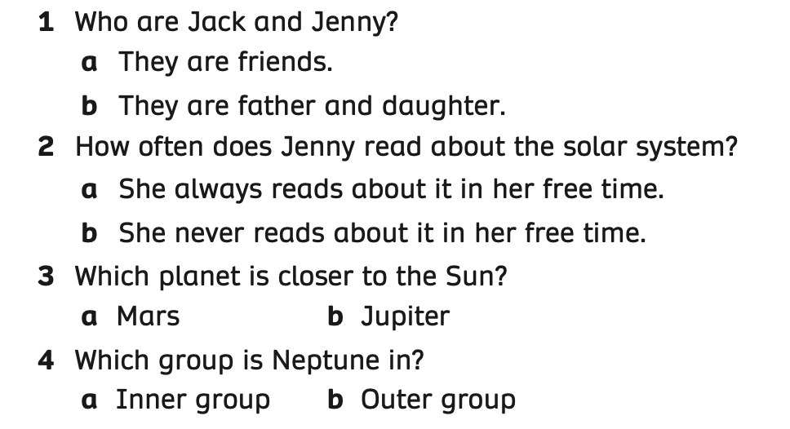
PRE-LISTENING – Pupils’ Book (p.92)
- Ask students to work in pairs. Students look at the questions and answer.
- One student asks the questions and one student guesses and says the answers.
- Then, they switch roles.

Slide 16
PRE-LISTENING – Pupils’ Book (p.92)
Who are Jack and Jenny?
They are father and daughter.
Example
- Ask students to work in pairs. Students look at the questions and answers.
- One student asks the questions and one student guesses and says the answers.
- Then, they switch roles.

Slide 17
PRE-LISTENING – Pupils’ Book (p.92)
How often does Jenny read about the solar system?
She always reads about it in her free time.
Example
- Ask students to work in pairs. Students look at the questions and answers.
- One student asks the questions and one student guesses and says the answers.
- Then, they switch roles.

Slide 18
PRE-LISTENING – Pupils’ Book (p.92)
Which planet is closer to the Sun?
Mars.
Example
- Ask students to work in pairs. Students look at the questions and answers.
- One student asks the questions and one student guesses and says the answers.
- Then, they switch roles.

Slide 19
PRE-LISTENING – Pupils’ Book (p.92)
Which group is Neptune in?
Inner group.
Example
- Ask students to work in pairs. Students look at the questions and answers.
- One student asks the questions and one student guesses and says the answers.
- Then, they switch roles.

Slide 20
LISTENING – Pupils’ book (p.92)
ANSWER
- Ask students to open their books and look at Activity 2.
- Play the audio, students listen and circle the answers.
- Play the audio again, students listen and check the answers.

Slide 21
Pupils’ book (p.92)
Ask students to work in groups of 3 or 4.
The teacher shows the slides, and students look at the pictures and choose any number.
Then, they discuss and raise their hands to check the answers.
The fastest group with all the correct answers receive 2 points.

Slide 22
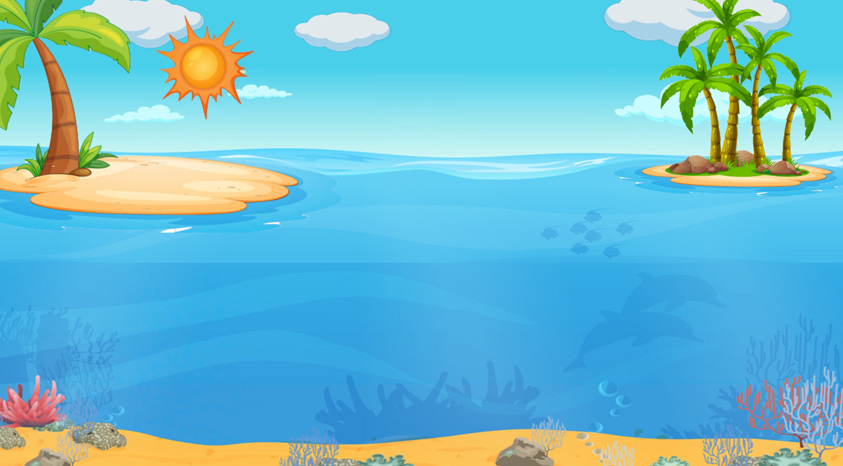
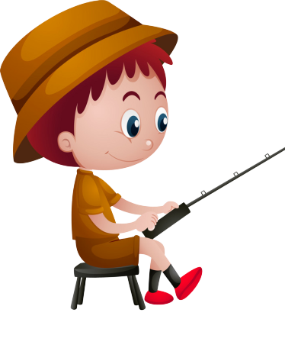
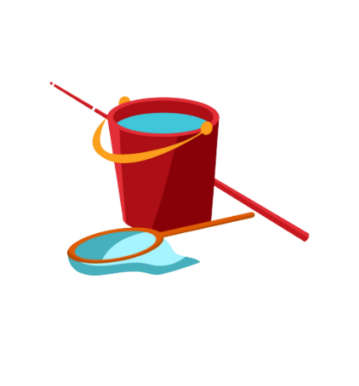
GO FISHING
Game
PLAY
EXIT

Slide 23
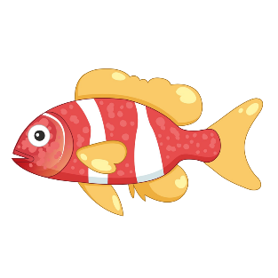
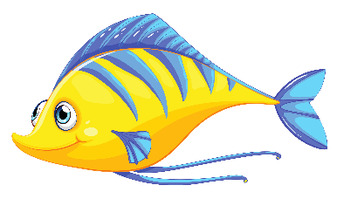
EXIT
7
6
9
2
4
1
13
12
11
14
15

Slide 24
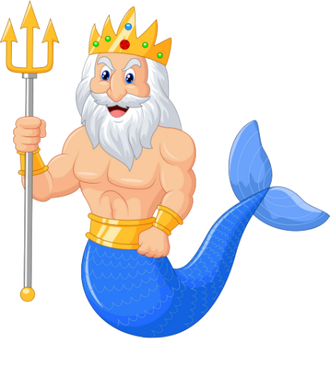
How many planets are there in the solar system?
A
eight
B
nine
C
seven
D
STOVE

Slide 25
What’s this?
A
It’s Mercury.
B
It’s Venus.
C
It’s Mars.
D
Climb

Slide 26
Which group is Jupiter in?
A
Outer group
B
Inner group
C
Solar system
D
May

Slide 27
Which planet is in the sixth place from the Sun?
A
Venus
B
Saturn
C
Jupiter
D
Watch

Slide 28
The last planet in the solar system is _______ .
A
Mercury
Neptune
B
Uranus
C
Neptune
D
Next to

Slide 29
Which group is Mercury in?
A
Inner group
B
Outer group
C
Solar system
D
Next to

Slide 30
Well done!
D
She plays chess
in his free time.
NEXT

Slide 31
PRE-WRITING – Pupils’ Book (p.92)
Brainstorm
Ask students to work in pairs to look at five sentences in Activity 3.
Then, brainstorm and answer these questions about the solar system, such as how many planets and the order of planets.

Slide 32
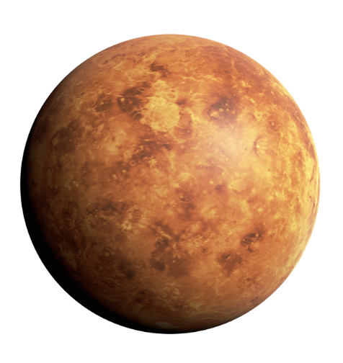
PRE-WRITING – Pupils’ Book (p.92)
Example
How many planets are there in the solar system?
There are eight planets.
Which planet is in the second place from the Sun?
It’s Venus.
Ask students to work in pairs to ask and answer about these questions.
Invite some pairs to present in front of the class and give them 2 points.

Slide 33
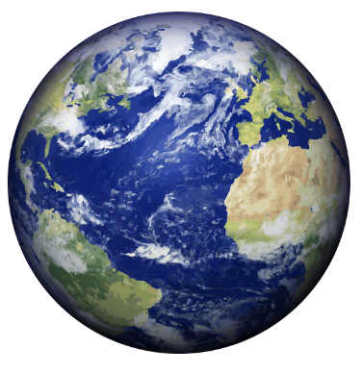
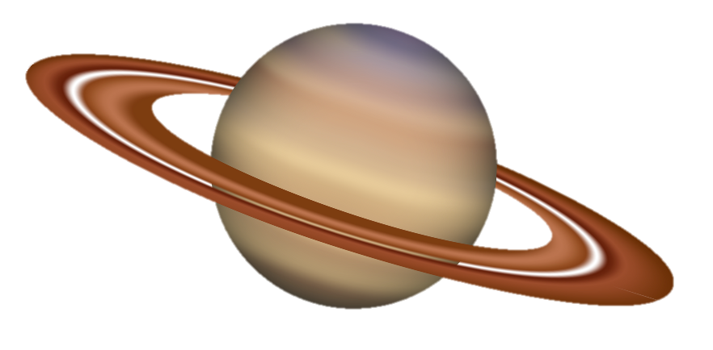
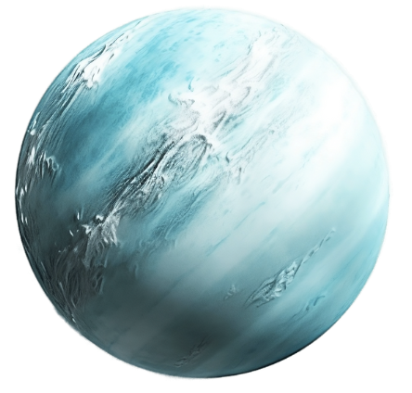
PRE-WRITING – Pupils’ Book (p.92)
Example
Which planet is in the third place from the Sun?
It’s Earth.
Which planet is in the sixth place from the Sun?
It’s Saturn.
It’s Uranus.
Which planet is in the seventh place from the Sun?
Ask students to work in pairs to ask and answer about these questions.
Invite some pairs to present in front of the class and give them 2 points.

Slide 34
WRITING – Pupils’ Book (p.92)
eight planets in the solar system.
is the second planet.
is the third planet.
is the sixth planet.
is the seventh planet.
Answer
Ask students to open their notebooks and write five sentences about the solar system.
Then, ask students to wok in pairs to talk about the solar system.
Then, the teacher shows the answer to check with the whole class.

Slide 35
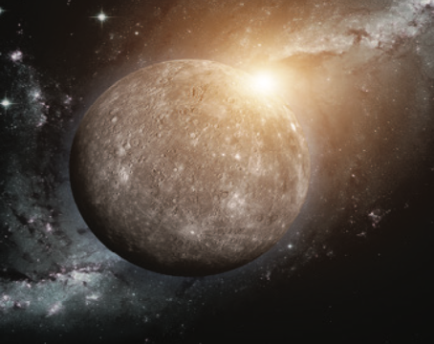
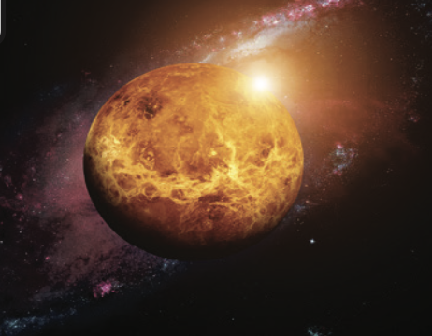
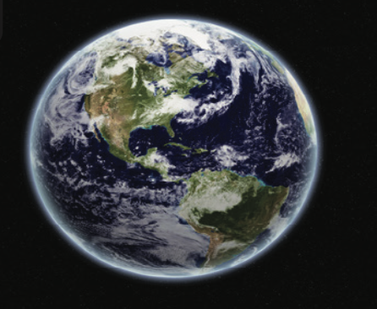
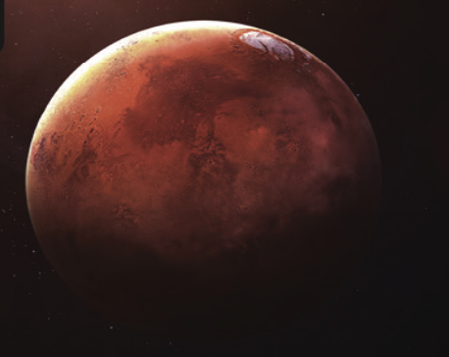
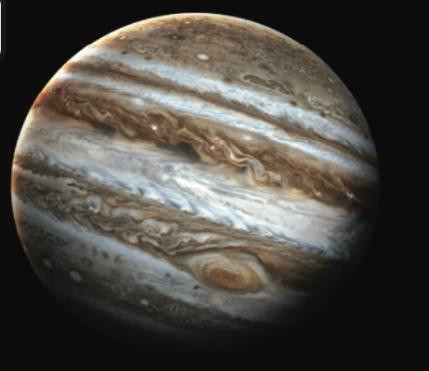
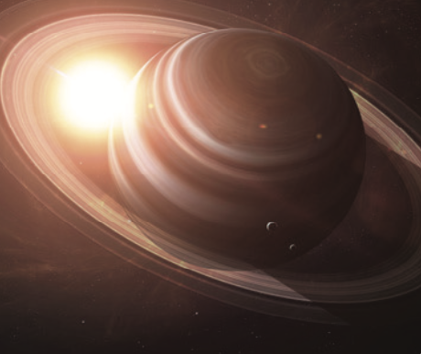
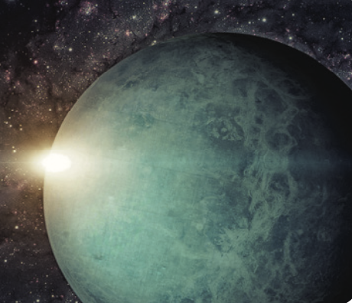
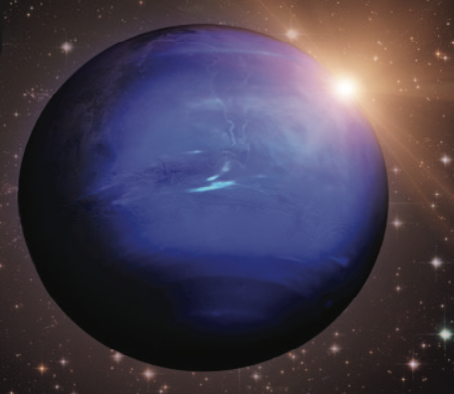
PRODUCTION
Mercury
Venus
Earth
Mars
Jupiter
Saturn
Uranus
Neptune
- Divide the class into groups of 4 to 5 students. Each group takes out a sheet of paper and writes down the names of planets in English as they can.
- After finishing the lists, they say “Bingo”, and the teacher checks the list and gives points.

Slide 36
HOMEWORK
Review vocabulary and grammar.
Do exercises in the Activity Book (page 71).
Check the answers in the Teacher’s Book (page 159) or Active Teach.

Slide 37
UNIT 8 – Lesson 2
We’ve learned…
- To review vocabulary about the solar system.
- To write about the solar system.
- PB p.92
- AB p.71

