Slide 1
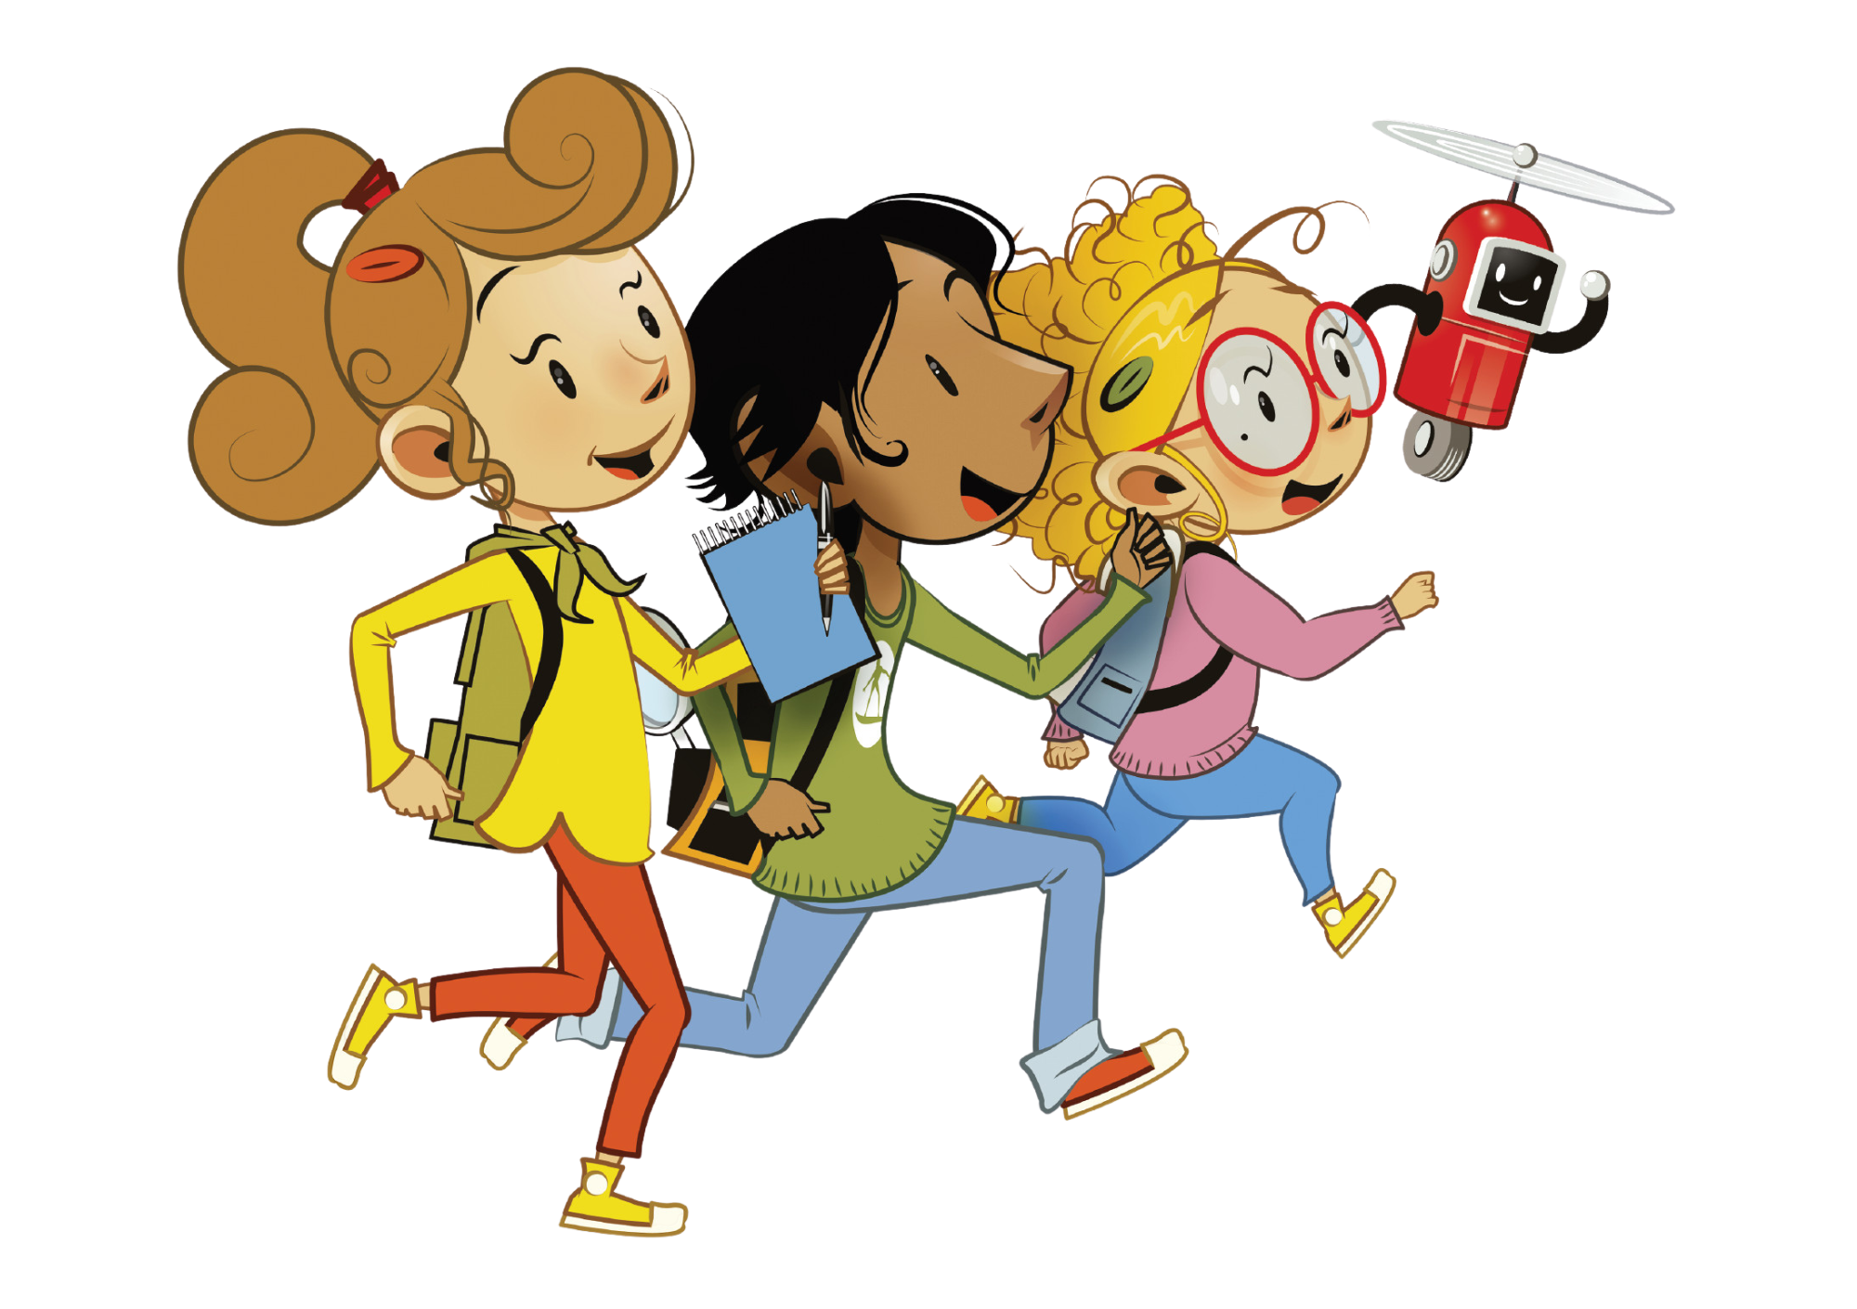
UNIT 8 – LET’S EXPLORE!
Lesson 4 – Phonics

Slide 2
UNIT 8 – Lesson 4
We’re learning…
- To correctly read and pronounce falling intonation in Wh-questions.
- PB p.94
- AB p.73

Slide 3
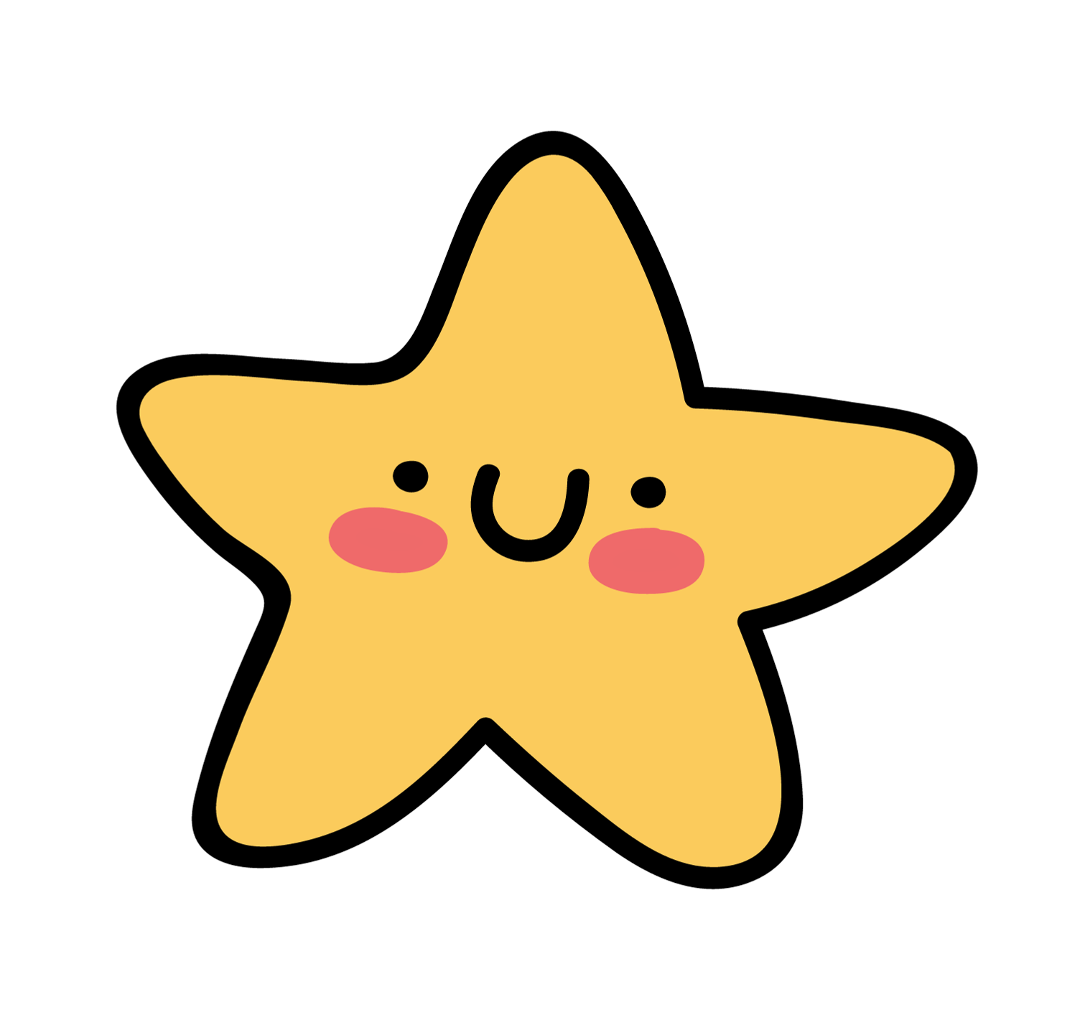
WARM-UP ACTIVITY
Activity: UNSCRAMBLED WORDS
Divide the class into groups of 4 to 5 students.
Each group takes out a mini-board. Students in the group will take turns writing down the answers.
Show unscrambled letters on each slide, students look and write them into the correct word.
Students raise the boards after finishing the word. The teacher looks and checks the answers.
The first group with the correct answer receives 2 points.

Slide 4
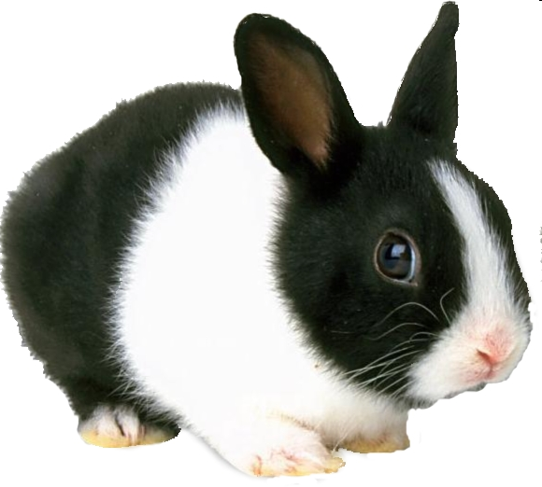
WARM-UP ACTIVITY
UNSCRAMBLE
b
R
b
a
i
t
GAME!

Slide 5
scopetele
Ready?
GO!
telescope

Slide 6
mteoc
Ready?
GO!
comet

Slide 7
tekorc
Ready?
GO!
rocket

Slide 8
cespa iontsta
Ready?
GO!
space station

Slide 9
uitspaces
Ready?
GO!
spacesuit

Slide 10
llittesae
Ready?
GO!
satellite

Slide 11
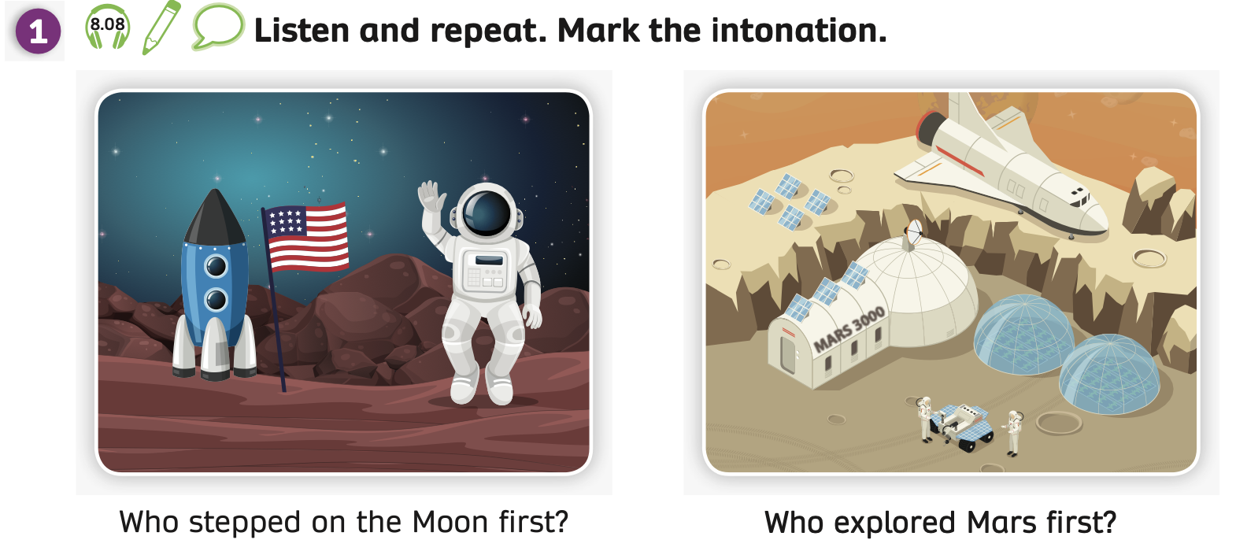
PUPILS’ BOOK p.94
Have students look at Activity 1 on page 94.
The teacher elicits the type of questions: wh-questions
Play the audio, students listen and focus on the intonation at the end of the questions.
Play the audio again, students listen and repeat.

Slide 12
PUPILS’ BOOK p.94
Who stepped on the Moon first?
INTONATION
Students listen again to each question.
Then, the teacher explains that they will learn about the intonation in Wh-questions.
Students listen to the teacher’s guide and mark the correct intonation at the end of the two questions.

Slide 13
PUPILS’ BOOK p.94
Who explored Mars first?
INTONATION
Students listen again to each question.
Then, the teacher explains that they will learn about the intonation in Wh-questions.
Students listen to the teacher’s guide and mark the correct intonation at the end of the two questions.

Slide 14
PUPILS’ BOOK p.94
Who stepped on the Moon first?
Who explored Mars first?
Work in pairs.
Students look at Activity 1, then switch roles to read each question.
After finishing, teacher invites some students to call out the questions.

Slide 15
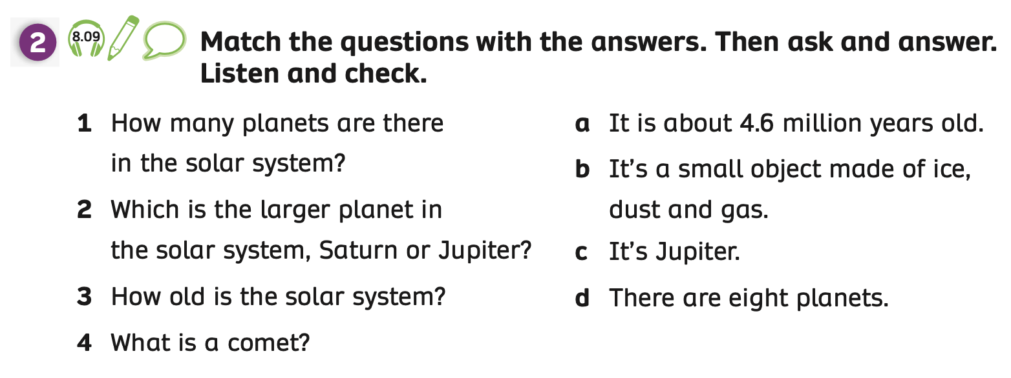
PRE-LISTENING – Pupils’ Book (p.94)
Students work individually, look at Activity 2 and guess the answers for question 1 to 4.
Then, work in pairs to check the answers together.

Slide 16
LISTENING – Pupils’ Book (p.94)
Listen and check
Answer
Play the audio, students listen and check.
Play the audio again, students listen and mark the intonation.

Slide 17
POST LISTENING – Pupils’ Book (p.94)
After listening, ask students to work in pairs to read and pronounce the falling intonation of each question in Activity 2.
Students switch roles to practice together.
Ask some students to present in front of the class and give them 2 points.

Slide 18
POST LISTENING – Pupils’ Book (p.94)
How many planets are there in the solar system?
There are eight planets.
Which is the larger planet in the solar system, Saturn or Jupiter?
It’s Jupiter.
- Work in pairs. Students switch roles to ask and answer.

Slide 19
POST LISTENING – Pupils’ Book (p.94)
How old is the solar system?
It is about 4.6 million years old.
It’s a small object made of ice, dust and gas.
What is a comet?
- Work in pairs. Students switch roles to ask and answer.

Slide 20
PUPILS’ BOOK p.94
I’m Neptune.
Have students look at Activity 3.
Then, put students in pairs to ask and answer about Neptune.
The example is on the next slide.

Slide 21
PUPILS’ BOOK p.94
How + an adjective
How far is your home from school?
How many people live in your home?
How big is your house?
How long does it take you to walk home?
How high is your house?
The teacher elicits the class how to form questions with How + an adjective.

Slide 22
PUPILS’ BOOK p.94
How far is Neptune
from the Sun?
Put students in pairs to use how far/ how big/ how high/ how many/ how long for each sentence from Facts about Neptune to make the corresponding questions.

Slide 23
PUPILS’ BOOK p.94
How big is Neptune?
Put students in pairs to use how far/ how big/ how high/ how many/ how long for each sentence from Facts about Neptune to make the corresponding questions.

Slide 24
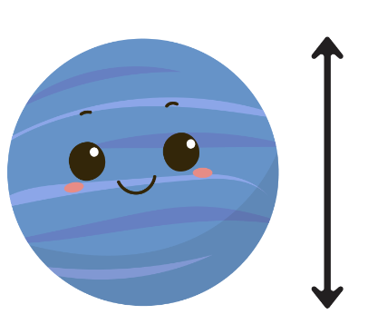
PUPILS’ BOOK p.94
How high are the clouds on Neptune?
Put students in pairs to use how far/ how big/ how high/ how many/ how long for each sentence from Facts about Neptune to make the corresponding questions.

Slide 25
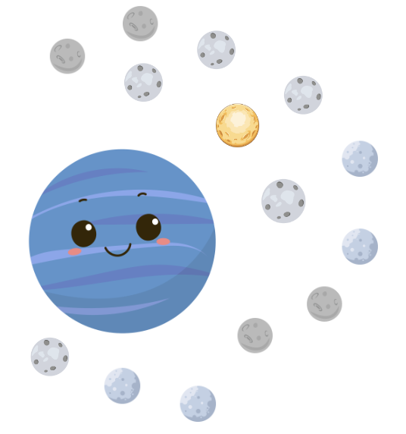
PUPILS’ BOOK p.94
How many known moons does Neptune have?
Put students in pairs to use how far/ how big/ how high/ how many/ how long for each sentence from Facts about Neptune to make the corresponding questions.

Slide 26
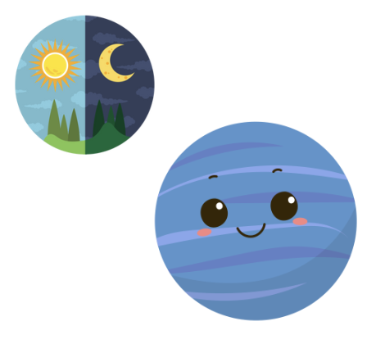
PUPILS’ BOOK p.94
How long is a day on Neptune?
Put students in pairs to use how far/ how big/ how high/ how many/ how long for each sentence from Facts about Neptune to make the corresponding questions.

Slide 27
PRODUCTION
Neptune is about 4.5 billion kilometres from the Sun on average.
How far is Neptune from the Sun?
Neptune has 14 known moons.
How many known moons does Neptune have?
…..?
….
Put students in pairs and switch roles to ask and answer about Neptune.
The teacher goes around to check the right intonation for questions.
Then, invite some pairs present in front of the whole class and give them a point.

Slide 28
HOMEWORK
Review vocabulary and grammar.
Do exercises in the Activity Book (page 73).
Check answers in the Teacher’s Book (page 163) or Active Teach.

Slide 29
UNIT 8 – Lesson 4
We’ve learned…
- To correctly read and pronounce falling intonation in wh-questions.
- PB p.94
- AB p.73

