Slide 1
UNIT 8 – LET’S EXPLORE!
Lesson 5A – Vocabulary and Grammar 2

Slide 2
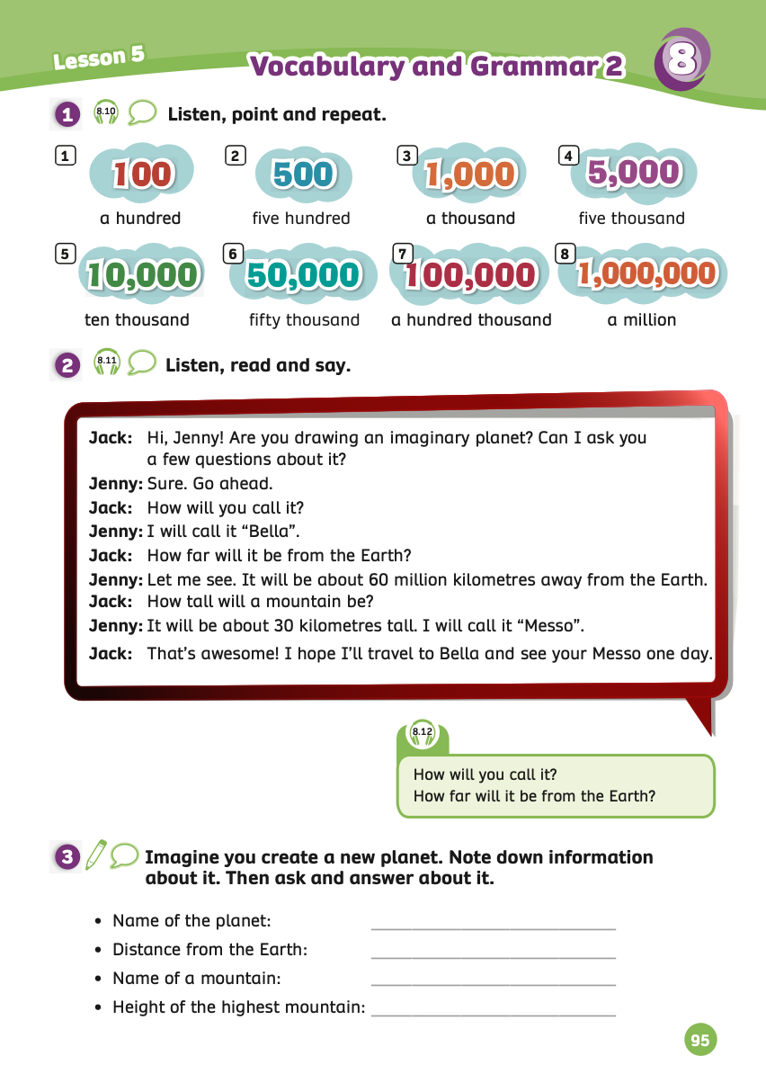
UNIT 8 – Lesson 5A
We’re learning…
To correctly make Wh-questions with How. Eg: How far…? How tall …? How deep …?
To use the large numbers: one hundred, five hundred, a thousand, etc.
- PB p.95
- AB p.74

Slide 3
WARM-UP ACTIVITY
Activity: WHO CAN REPEAT?
Ask students to work in groups of 3 or 4.
Write questions on the board and ask: “What will you do in space?”, “Who will explore the Jupiter?”, “When will we be able to travel to the moon?”
Then, students listen and choose any question to tell with intonation at the end.
The fastest group that can tell the correctly intonation will receive 2 points.

Slide 4
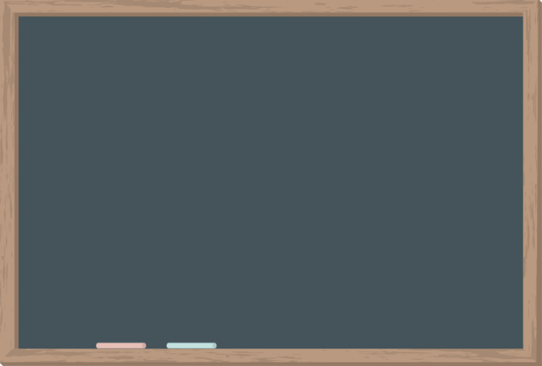
WARM-UP ACTIVITY
1. What will you do in space?
2. Who will explore the Jupiter?
3. When will we be able to travel to the moon?

Slide 5
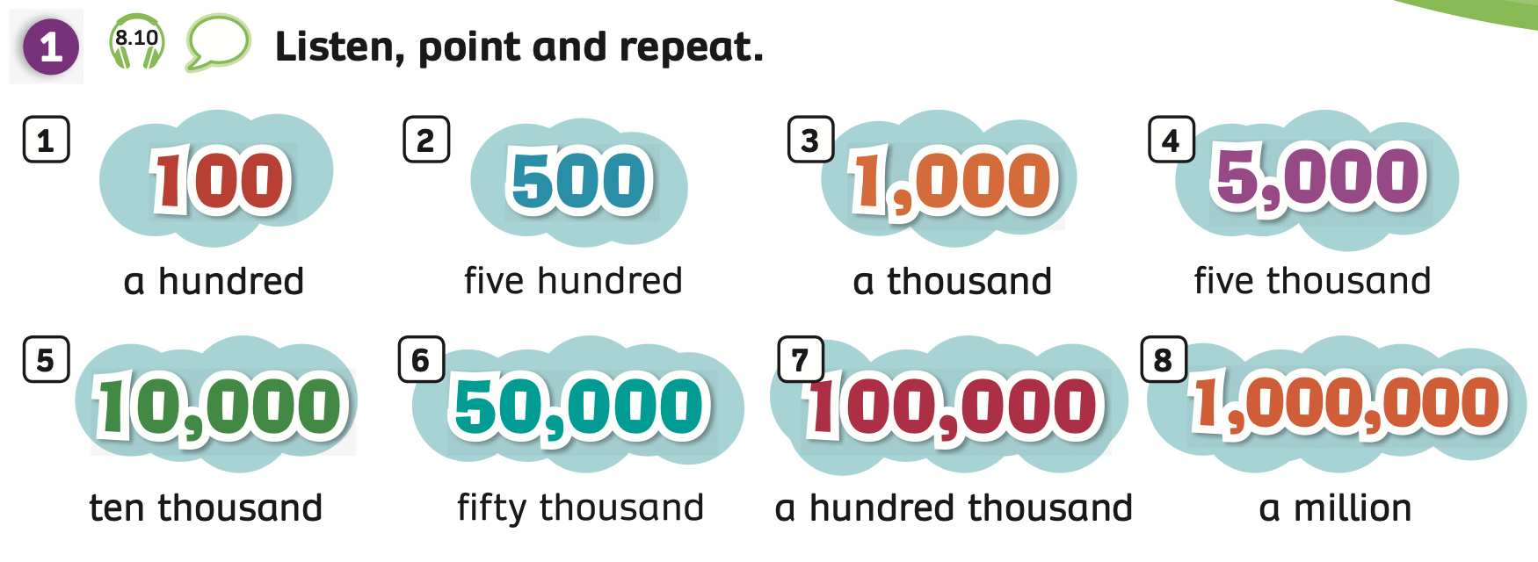
VOCABULARY – Let’s explore!
Have students look at the pictures and explain that in this lesson they will learn how to say simple large numbers in English.
Students listen and point to each picture.

Slide 6
VOCABULARY – Let’s explore!
Let’s spell!
c
a hundred
a
h
u
n
d
r
e
d
Students listen and repeat the word.

Slide 7
VOCABULARY – Let’s explore!
c
Let’s spell!
five hundred
f
i
v
e
h
u
n
d
r
e
d
Students listen and repeat the word.

Slide 8
VOCABULARY – Let’s explore!
c
Let’s spell!
a thousand
a
t
h
o
u
s
a
n
d
Students listen and repeat the word.

Slide 9
VOCABULARY – Let’s explore!
c
Let’s spell!
five thousand
f
i
v
e
t
h
o
u
s
a
n
d
Students listen and repeat the word.

Slide 10
VOCABULARY – Let’s explore!
c
Let’s spell!
ten thousand
t
e
n
t
h
o
u
s
a
n
d
Students listen and repeat the word.

Slide 11
VOCABULARY – Let’s explore!
c
Let’s spell!
fifty thousand
f
i
f
t
y
t
h
o
u
s
a
n
d
Students listen and repeat the word.

Slide 12
VOCABULARY – Let’s explore!
c
Let’s spell!
a hundred thousand
a
h
u
n
d
r
e
d
t
h
o
u
s
a
n
d
Students listen and repeat the word.

Slide 13
VOCABULARY – Let’s explore!
c
Let’s spell!
a million
a
m
i
l
l
i
o
n
Students listen and repeat the word.

Slide 14
VOCABULARY – Let’s explore!
REVIEW
a hundred
five hundred
a thousand
five thousand
ten thousand
fifty thousand
a hundred thousand
a million
Show one by one picture, students look and say the word aloud.

Slide 15
VOCABULARY – Practice
Activity: DORA THE EXPLORER
Put students work in groups of 4.
Each group takes out a sheet of paper.
Students look at the slide and discuss to choose the correct word, then write it on the paper.
After finishing, they raise their paper to check the answers.
The fastest student with the correct word receives 2 points for the team.

Slide 16
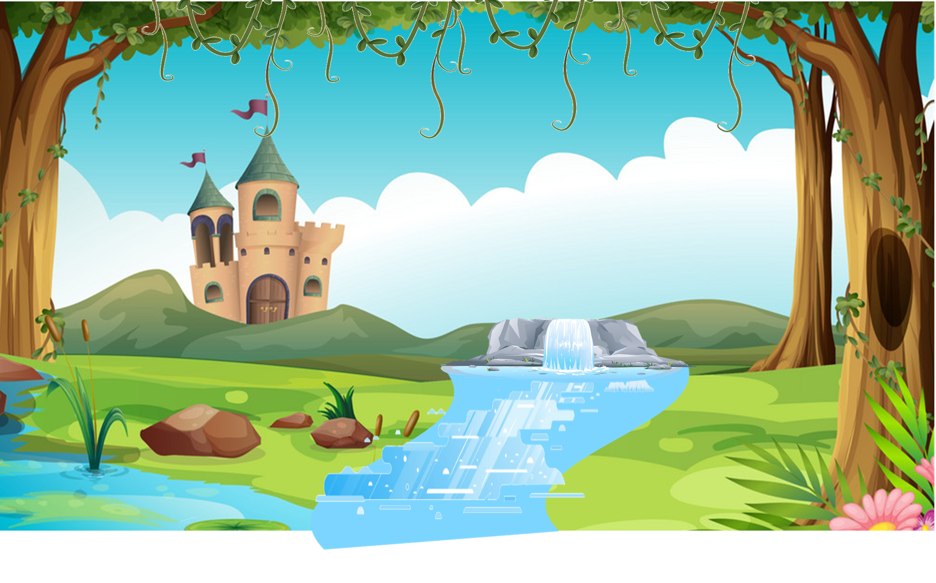
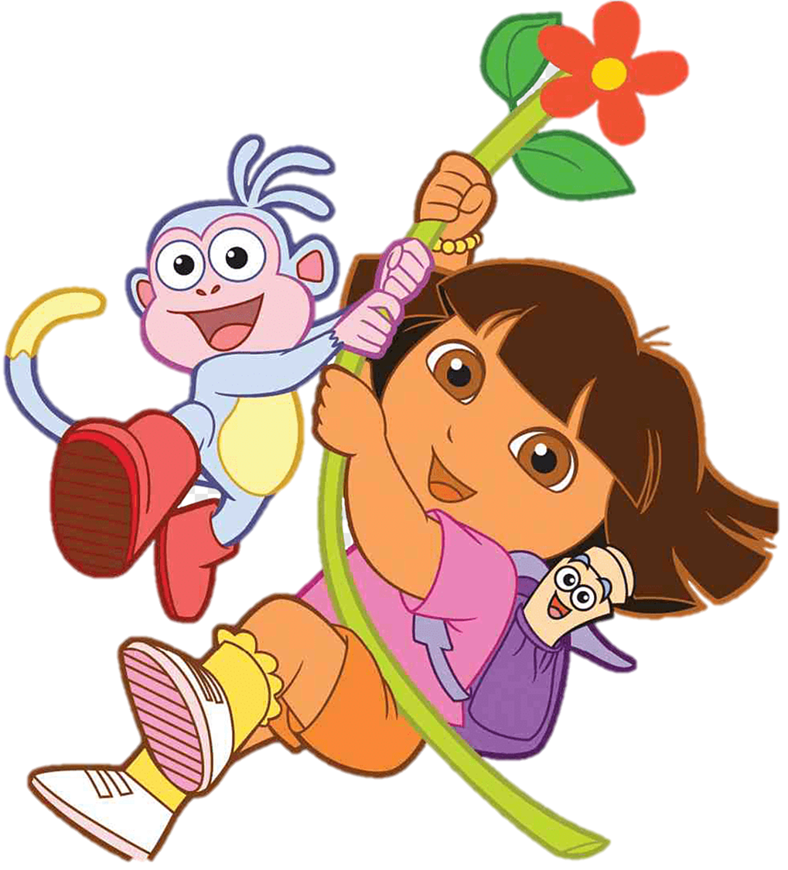
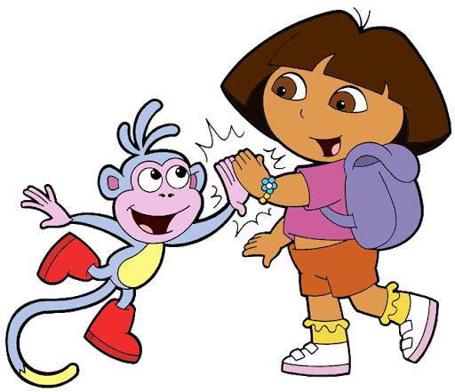
START
Notes:
Ms Huyền Phạm - 0936.082.789 – YOUTUBE: MsPham. Facebook: Dạy và học cùng công nghệ.

Slide 17
ten hundred
an hundred
a hundred
Notes:
Ms Huyền Phạm - 0936.082.789 – YOUTUBE: MsPham. Facebook: Dạy và học cùng công nghệ.

Slide 18
five hundred
five thousand
five
Notes:
Ms Huyền Phạm - 0936.082.789 – YOUTUBE: MsPham. Facebook: Dạy và học cùng công nghệ.

Slide 19
a hundred
a thousand
a million
Notes:
Ms Huyền Phạm - 0936.082.789 – YOUTUBE: MsPham. Facebook: Dạy và học cùng công nghệ.

Slide 20
five thousand
five hundred
five million
Notes:
Ms Huyền Phạm - 0936.082.789 – YOUTUBE: MsPham. Facebook: Dạy và học cùng công nghệ.

Slide 21
ten hundred
ten thousand
ten
Notes:
Ms Huyền Phạm - 0936.082.789 – YOUTUBE: MsPham. Facebook: Dạy và học cùng công nghệ.

Slide 22
fifteen thousand
fifty thousand
fifty hundred
Notes:
Ms Huyền Phạm - 0936.082.789 – YOUTUBE: MsPham. Facebook: Dạy và học cùng công nghệ.

Slide 23
a hundred
a thousand
a hundred thousand
Notes:
Ms Huyền Phạm - 0936.082.789 – YOUTUBE: MsPham. Facebook: Dạy và học cùng công nghệ.

Slide 24
a hundred thousand
a thousand
a million
Notes:
Ms Huyền Phạm - 0936.082.789 – YOUTUBE: MsPham. Facebook: Dạy và học cùng công nghệ.

Slide 25
END
START
Notes:
Ms Huyền Phạm - 0936.082.789 – YOUTUBE: MsPham. Facebook: Dạy và học cùng công nghệ.

Slide 26
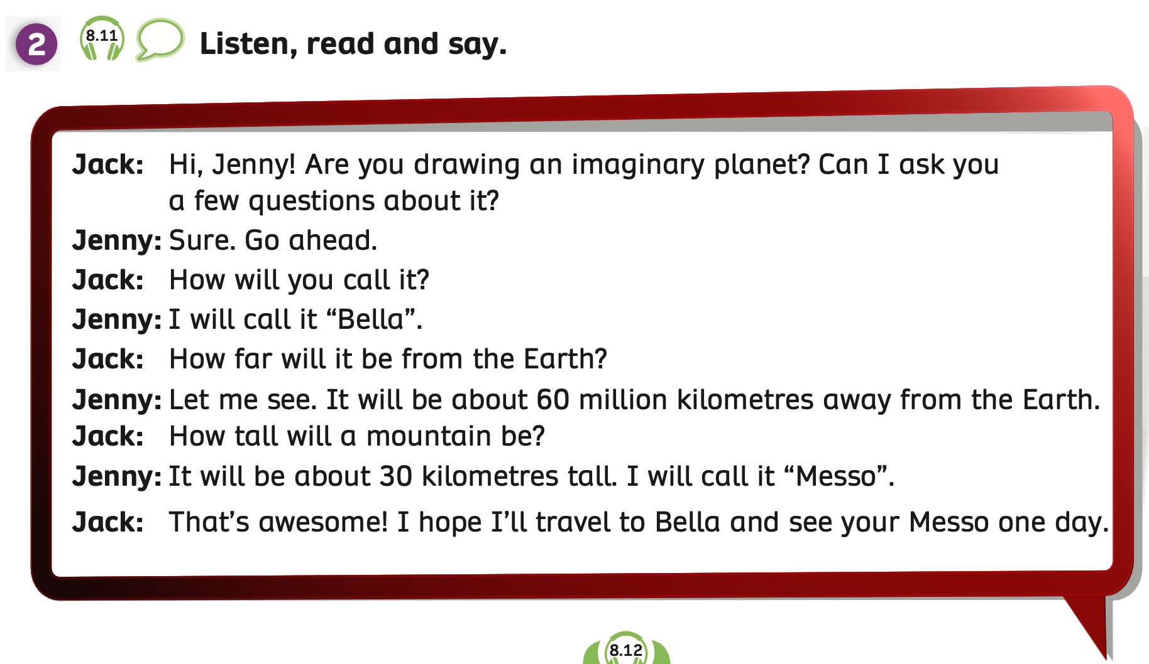
GRAMMAR – Pupils’ Book (p.95)
Have students look at the dialogue in Activity 2.
Play the audio, students listen to the dialogue.

Slide 27
GRAMMAR – Pupils’ Book (p.95)
Hi Jenny! Are you drawing an imaginary planet?
Sure. Go ahead.
Can I ask you a few questions about it?
Have students look at the example bubbles.
Students listen and read.

Slide 28
GRAMMAR – Pupils’ Book (p.95)
How will you call it?
How far will it be from
the Earth?
I call it “Bella”.
Let me see. It will be about 60 million kilometres away from the Earth.
Have students look at the example bubbles.
Students listen and read.

Slide 29
GRAMMAR – Pupils’ Book (p.95)
How tall will a mountain be?
It will be about 30 kilometres tall. I will call
it “Messo”.
That’s awesome! I hope I’ll travel to Bella and see your Messo one day.
Have students look at the example bubbles.
Students listen and read.

Slide 30
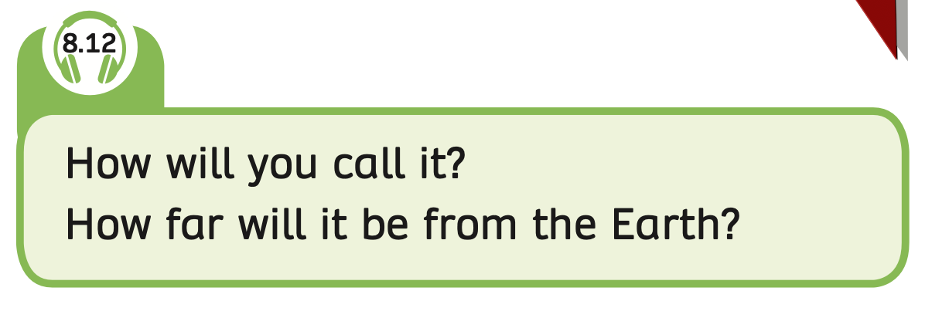
GRAMMAR – Pupils’ Book (p.95)
Have students look at the box.
Play the audio, students listen.

Slide 31
GRAMMAR – Pupils’ Book (p.95)
STRUCTURE – SENTENCES
Make Wh-questions with How.
Use the structures How far…? How tall…? How deep…?
How will + S + V_inf ?
How + adjective + will + S + V_inf?

Slide 32
GRAMMAR – Pupils’ Book (p.95)
ADJECTIVE
How far …?
far
How tall …?
tall
+
How high …?
How
high
How long …?
long
How deep …?
deep
big
How big …?

Slide 33
GRAMMAR PRACTICE
How will you stay in
space station?
I will eat some food and read books.
you/ stay/ space station
Have students look at the picture and prompt words.
Then, ask the students to work in pairs to make a question with How and answer.
Invite some pairs to present in front of the class and give them 2 points if they have a good dialogue.

Slide 34
GRAMMAR PRACTICE
How far will Bella be from the Sun?
Bella will be about 60 million kilometres away from the Sun on average.
far/ Bella
Have students look at the picture and prompt words.
Then, ask the students to work in pairs to make a question with How and answer.
Invite some pairs to present in front of the class and give them 2 points if they have a good dialogue.

Slide 35
PRODUCTION
a hundred
five hundred
a thousand
five thousand
ten thousand
fifty thousand
a hundred thousand
a million
Show one by one picture, students look and say the word aloud.

Slide 36
HOMEWORK
Review Vocabulary and Grammar.
Do exercises in the Activity Book (page 74).
Check answers in the Teacher’s Book (page 164) or Active Teach.

Slide 37
UNIT 8 – Lesson 5A
We’ve learned…
to correctly make Wh-questions with How.
to use the patterns: How far…? How tall …? How deep …?
- PB p.95
- AB p.74

