Slide 1

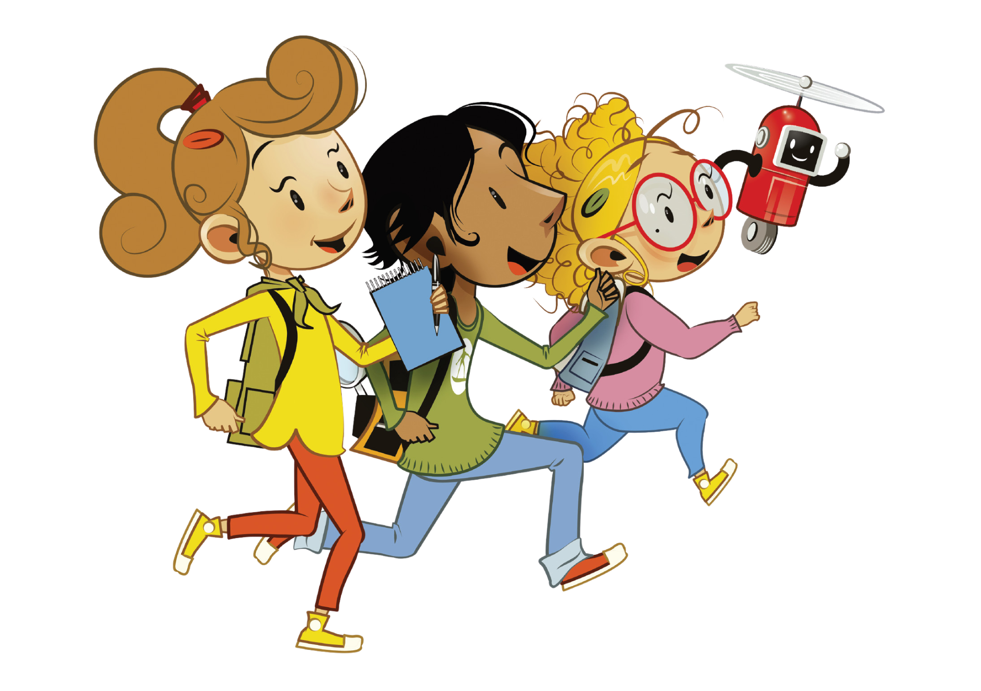

UNIT 8 – LET’S EXPLORE!
Lesson 7A – Story

Slide 2
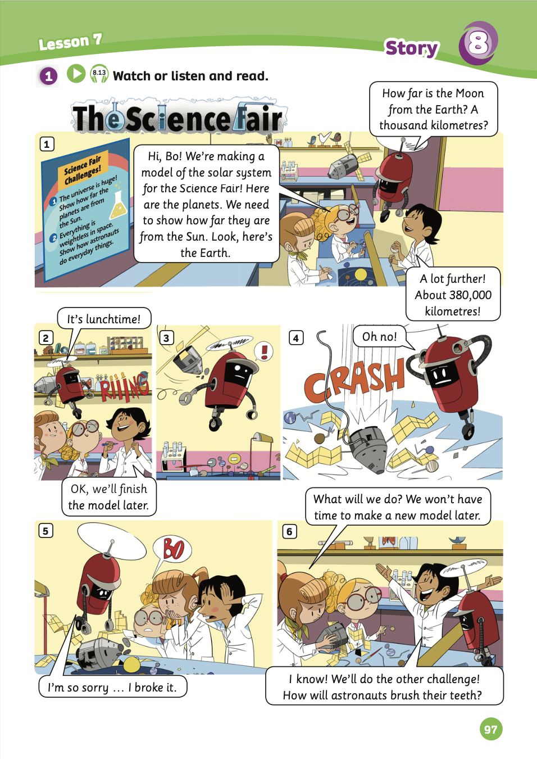
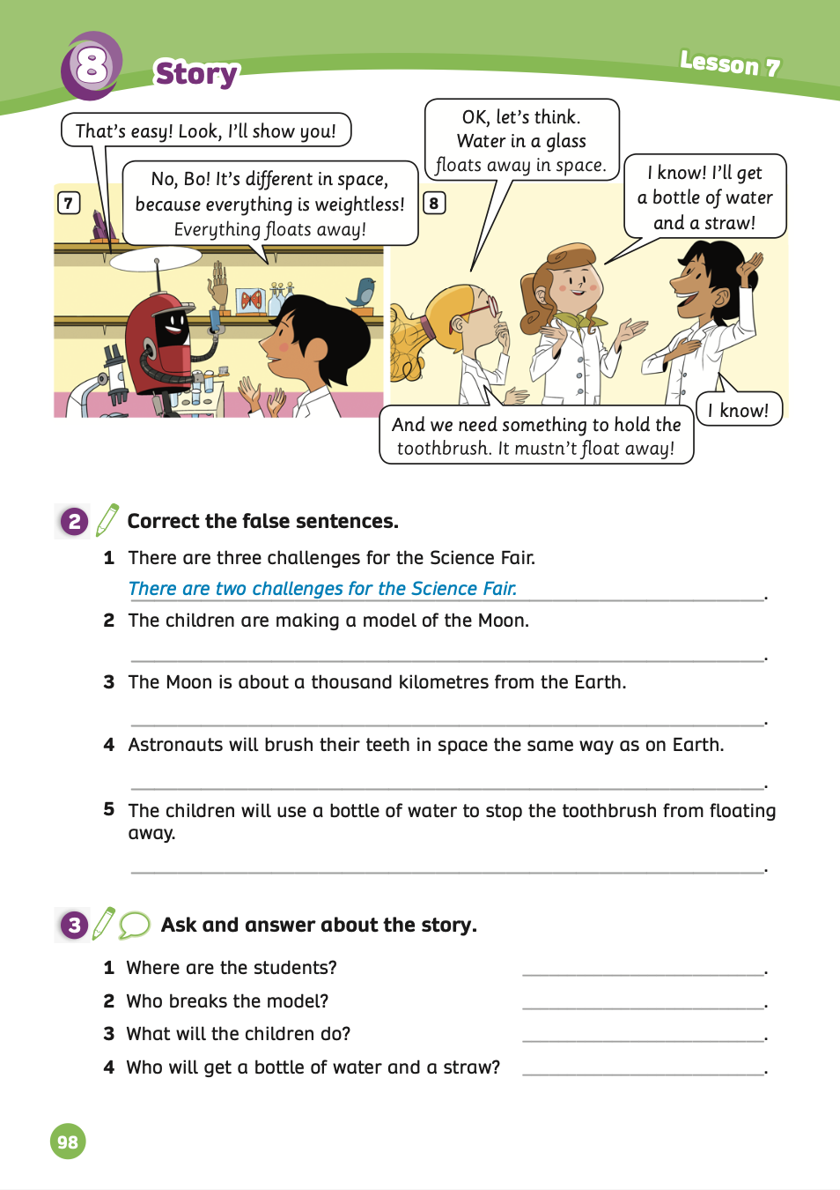
UNIT 8 – Lesson 7A
We’re learning…
- To understand simple cartoon stories.
- To review.
- PB p.97 & 98.
- AB p.76

Slide 3


WARM-UP ACTIVITY
Divide the class into groups of 3 or 4.
Each group takes out a mini-board or a sheet of paper.
The teacher writes on the board each pair of space words.
Then, students look at and choose any pair of space words to make a sentence.
E.g. Jupiter / telescope → I can see Jupiter with a telescope.
After finishing, they raise the boards or paper to check the answers.
The fastest group with all the correct answers receives 2 points.

Slide 4



WARM-UP ACTIVITY
1. space station/spacesuit
2. satellite/rocket
3. comet/Jupiter
4. Mars/Uranus
5. Mercury/Sun
1. I will wear a spacesuit and stay in the space station.

Slide 5


STORY TIME

Slide 6
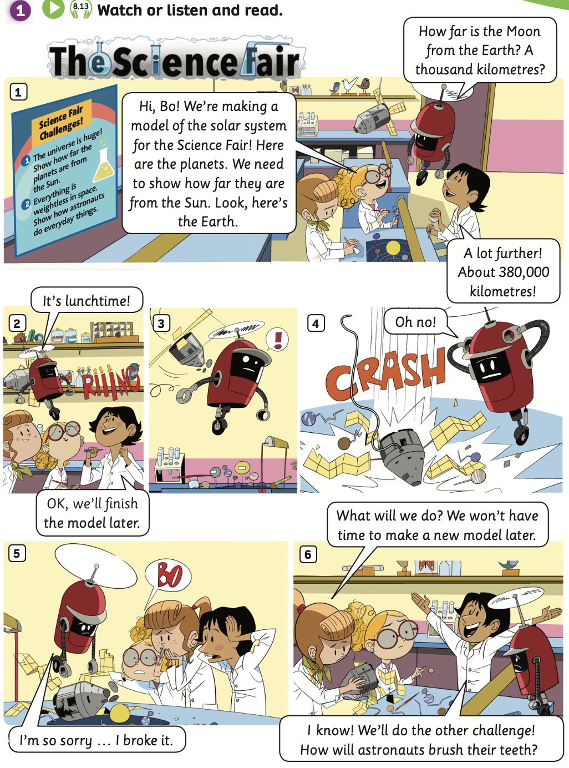
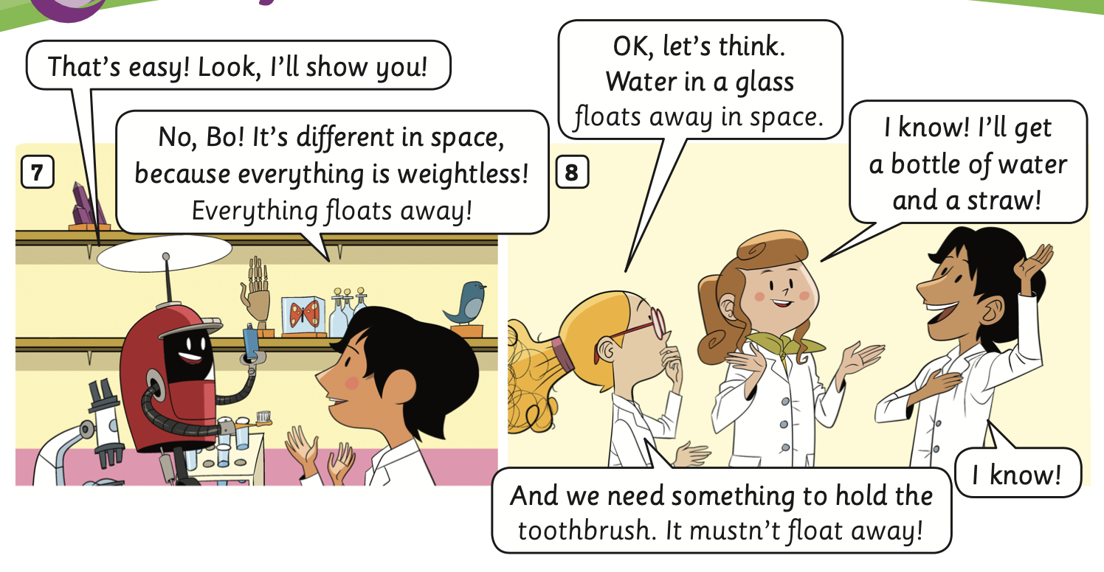

STORY TIME - INTRODUCTION
1. What’s the story title?
->
2. How many story frames?
->
3. How many characters?
->
The Science Fair
8 frames
4 characters

Slide 7
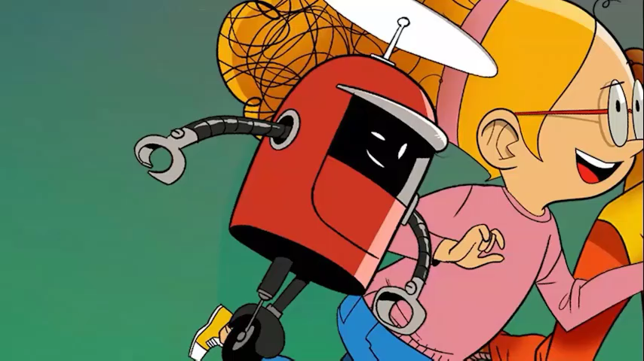
STORY TIME
Watch a video

Slide 8
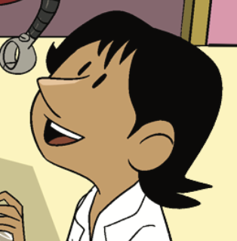
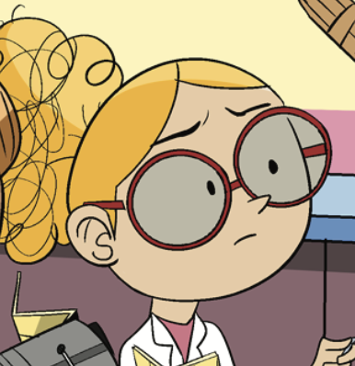
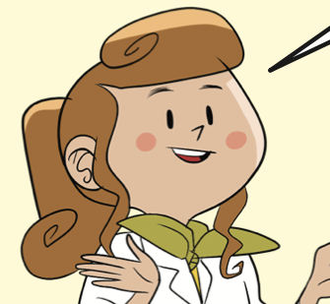
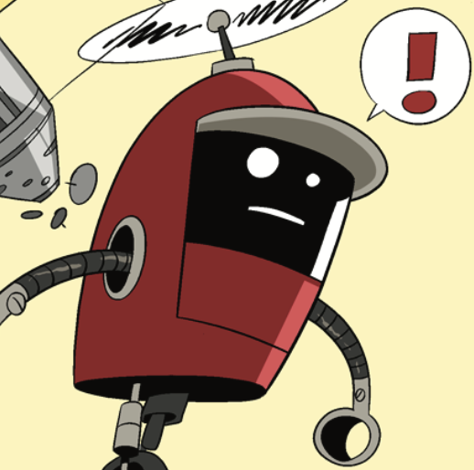
STORY TIME
CHARACTERS IN THE STORY
Ash
Lottie
Bo
Lois

Slide 9
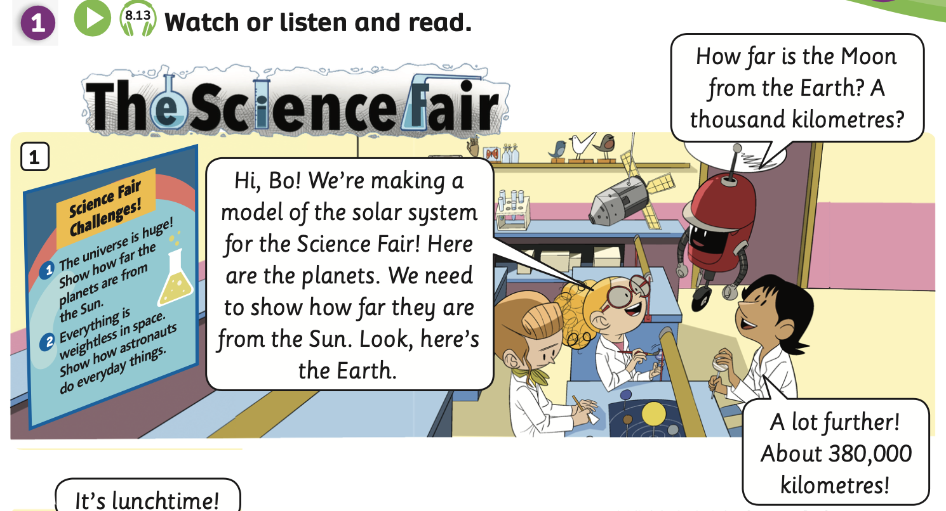

STORY TIME
Listen and point
Listen

Slide 10
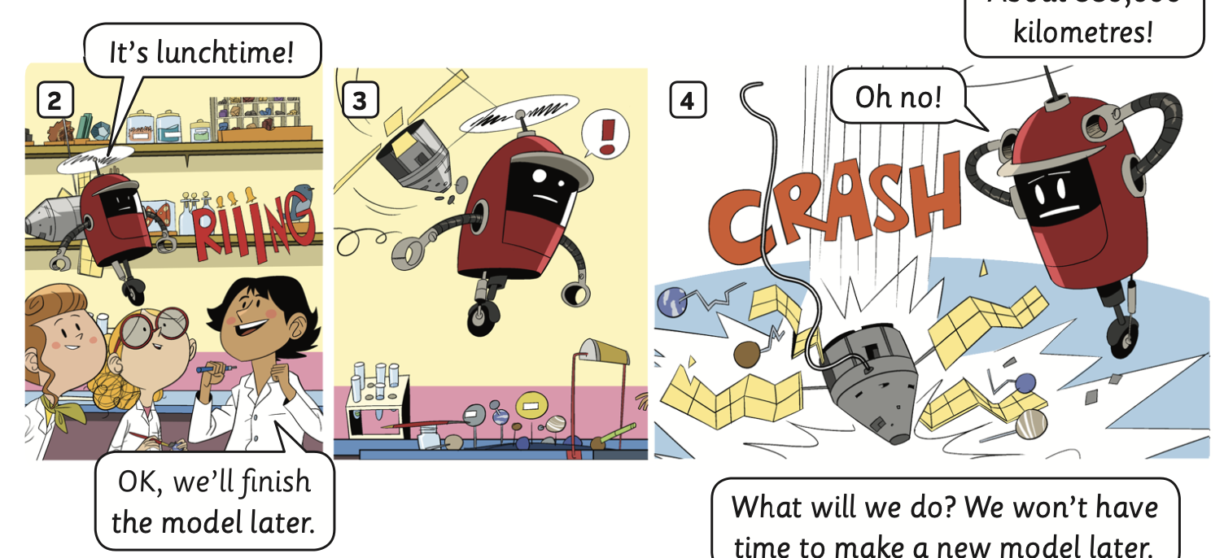
STORY TIME
Listen and point
Listen

Slide 11
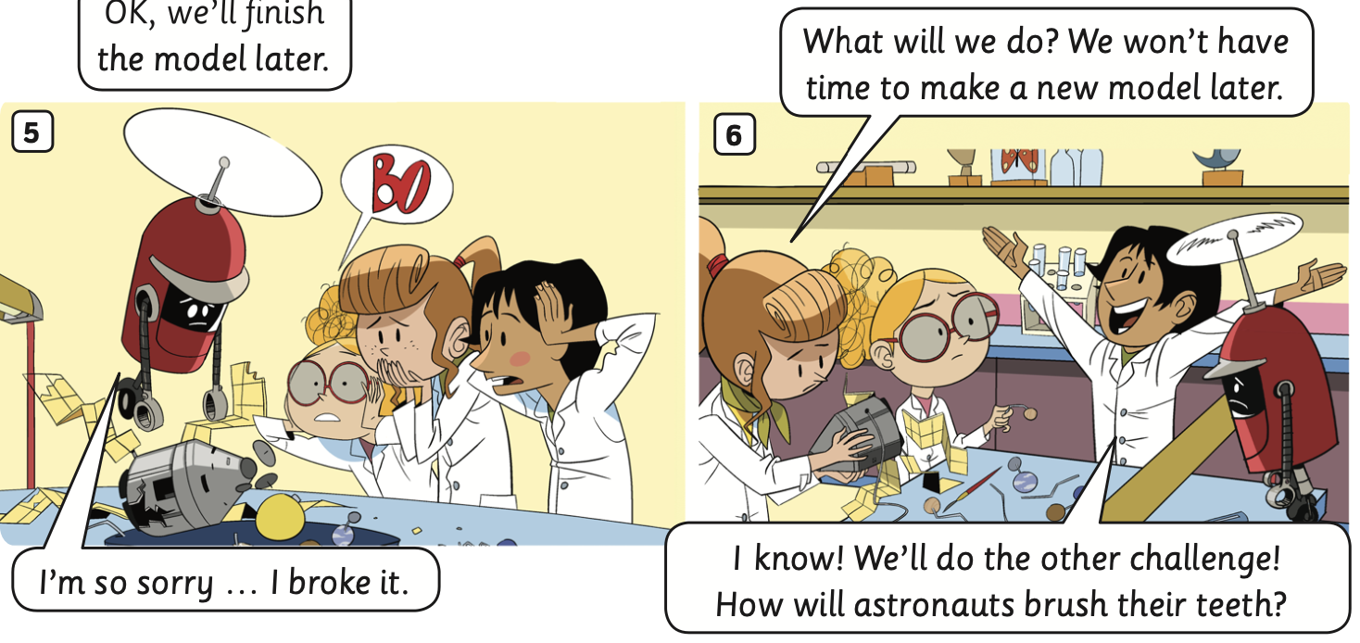
STORY TIME
Listen and point
Listen

Slide 12
STORY TIME
Listen and point
Listen

Slide 13
STORY TIME
Listen and read
2
1
1
2
3
3

Slide 14
STORY TIME
Listen and read
1
1
3
2
3
2

Slide 15
STORY TIME
Listen and read
1
2
2
3
3
1

Slide 16
STORY TIME
Listen and read
1
5
1
3
2
6
2
4
3
4
6
5

Slide 17
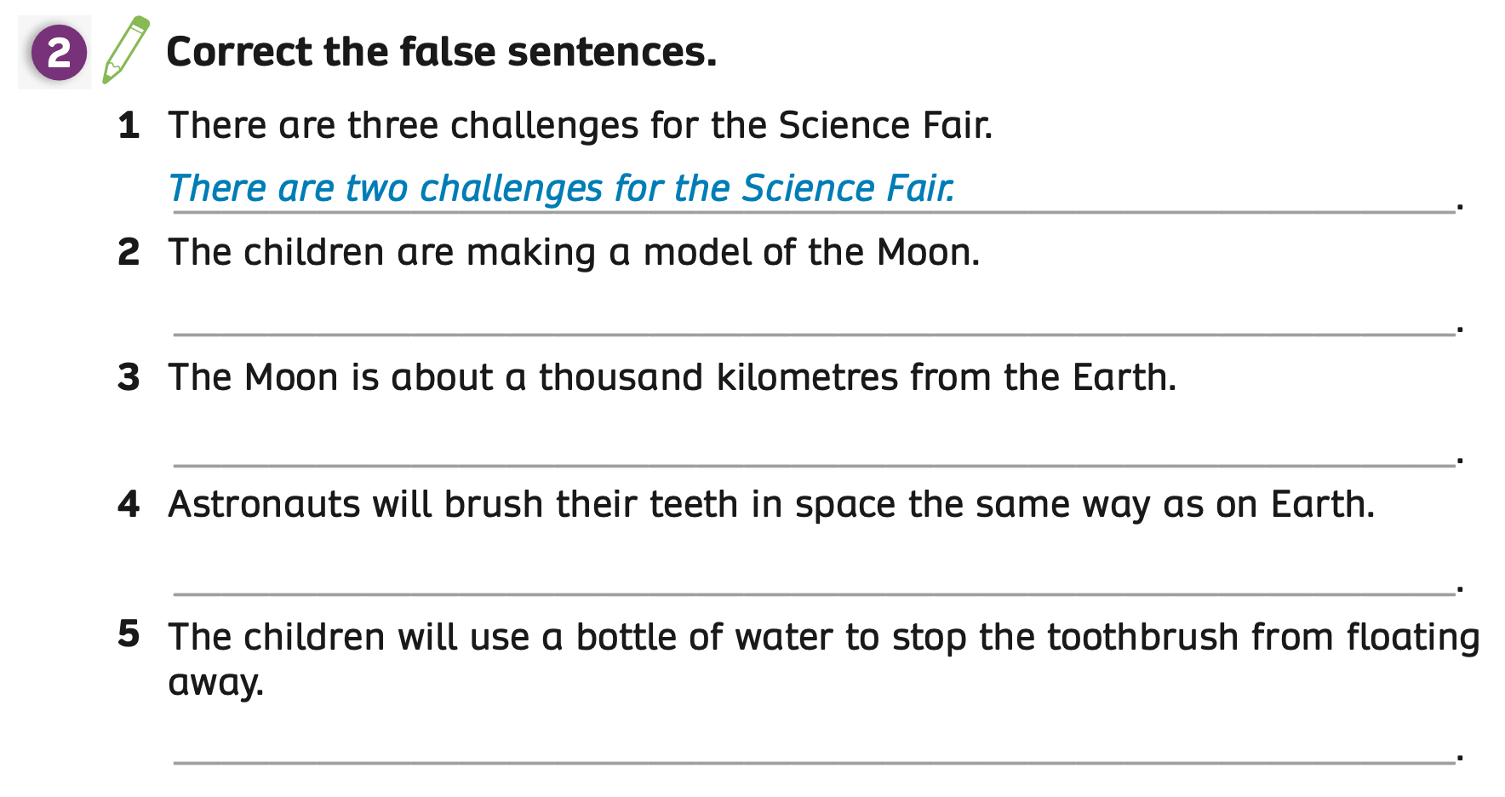
PUPILS’ BOOK p.98
ANSWER
correct
The teacher asks students how to rewrite the sentence to make it correct and points out the blue answer.
Have students in pairs to find the false point in each sentence.
The teacher checks the answers with the whole class.

Slide 18
PUPILS’ BOOK p.98
The children are making a model of the solar system.
The Moon is about 380,000 kilometres from the Earth.
Brushing your teeth in space is different from brushing your teeth on Earth.
correct
ANSWER
Students work individually to read the story, then correct the false sentences in Activity 2.
Put students in groups of 3 to compare their answers.
The teacher checks the answers with the whole class.

Slide 19
PUPILS’ BOOK p.98
Divide the class into groups of 4.
Read the sentences and discuss them with your teammates to choose the correct characters who say those sentences.
Show the finger to choose the correct answers (all members of the team).
The faster team with the correct answer can get 2 points.
Note: Click on the letters to check the answers.

Slide 20



Choose the correct character
Hi Bo! We’re making a model of the solar system for the Science Fair!
1
2
3
Notes:
Click on the letters to check the answers.

Slide 21
Choose the correct character
Oh no!
a
b
c
Notes:
Click on the letters to check the answers.

Slide 22
Choose the correct character
I know! I’ll get a bottle of water and a straw!
a
b
c
Notes:
Click on the letters to check the answers.

Slide 23
Choose the correct character
A lot further! About 380,000 kilometres!
a
b
c
Notes:
Click on the letters to check the answers.

Slide 24
Choose the correct character
What will we do? We won’t have time to make a new model later.
a
b
c
Notes:
Click on the letters to check the answers.

Slide 25
Choose the correct character
OK, we’ll finish the model later.
a
b
c
Notes:
Click on the letters to check the answers.

Slide 26
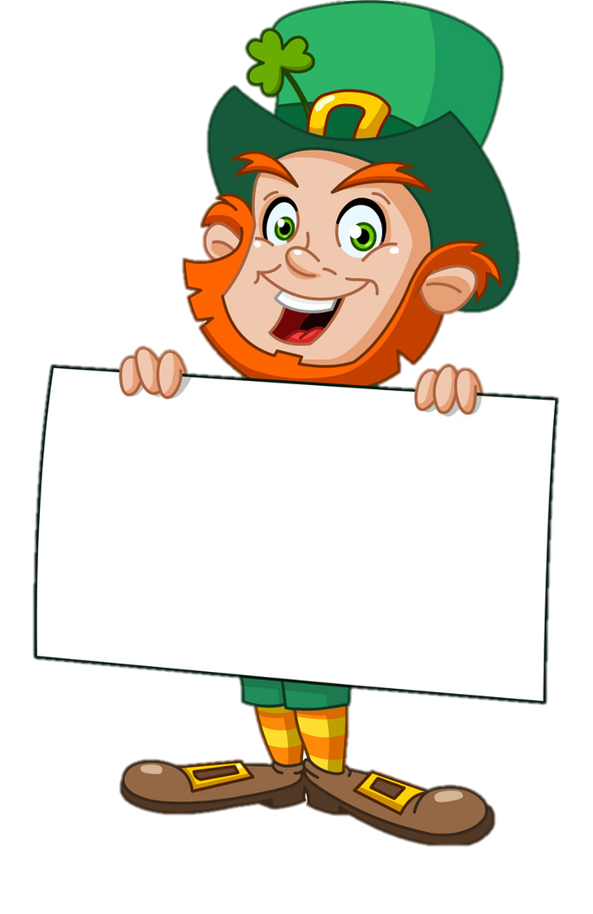
Well-done

Slide 27
STORY – Wrap-up
1. What’s the story title?
->
2. How many story frames?
->
3. How many characters?
->
The Science Fair
8 frames
4 characters
The teacher asks the questions, students point and answer.

Slide 28
HOMEWORK
Review vocabulary and grammar.
Do exercises in the Activity Book (page 76).
Check the answers in the Teacher’s Book (page 169) or Active Teach.

Slide 29
UNIT 8 – Lesson 7A
We’ve learned…
- To understand simple cartoon stories.
- To review.
- PB p.97 & 98.
- AB p.76

