Slide 1



UNIT 8 – LET’S EXPLORE!
Lesson 7B – Story

Slide 2
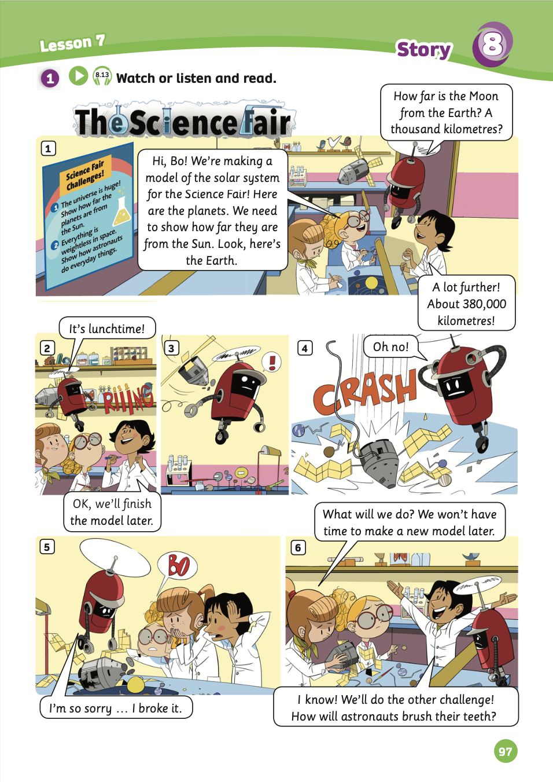
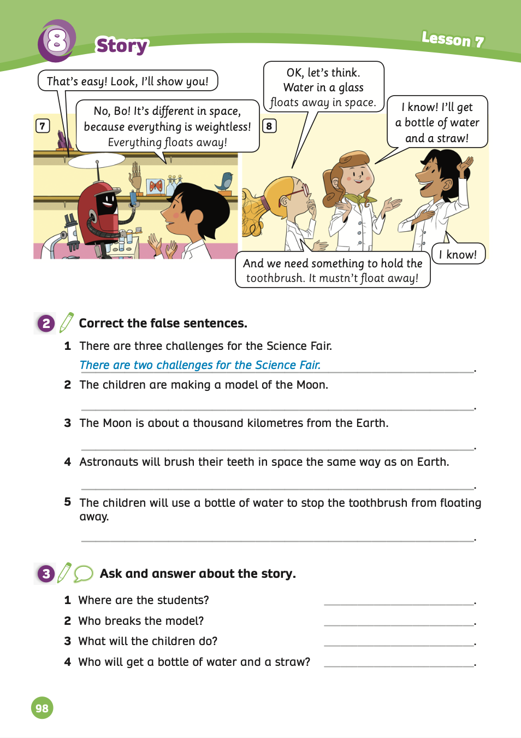
UNIT 8 – Lesson 7B
We’re learning…
- To understand simple cartoon stories.
- To review.
- PB p.97 & 98.
- AB p.76

Slide 3

WARM-UP ACTIVITY
Activity: FIND THE PICTURE
Put students into groups of 4. Each group takes out a pen or a ruler and puts it in the middle of each group.
Show a sentence in the story, students discuss and choose the correct answer A, B, or C for the correct scene of that sentence.
Students raise their pens or rulers to get a chance to say the answers.
The fastest group with the correct answer receives 2 points.

Slide 4







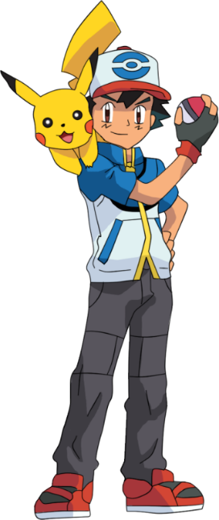



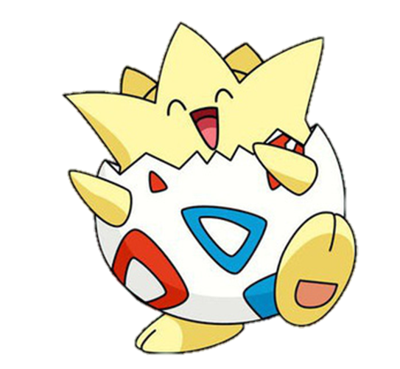


MsPham-0936082789
MsPham-0936082789
MsPham-0936082789
Find the picture
MsPham-0936082789
Notes:
Liên hệ: Ms Huyền Phạm - 0936.082.789 Nếu thầy cô muốn:
- Tham gia Khóa học làm powerpoint chuyên nghiệp
Học Tin học văn phòng từ cơ bản đến nâng cao
Đặt hàng thiết kế, soạn giáo án theo yêu cầu
Sở hữu các bộ giáo án powerpoint môn tiếng anh Mầm non và tiểu học.

Slide 5
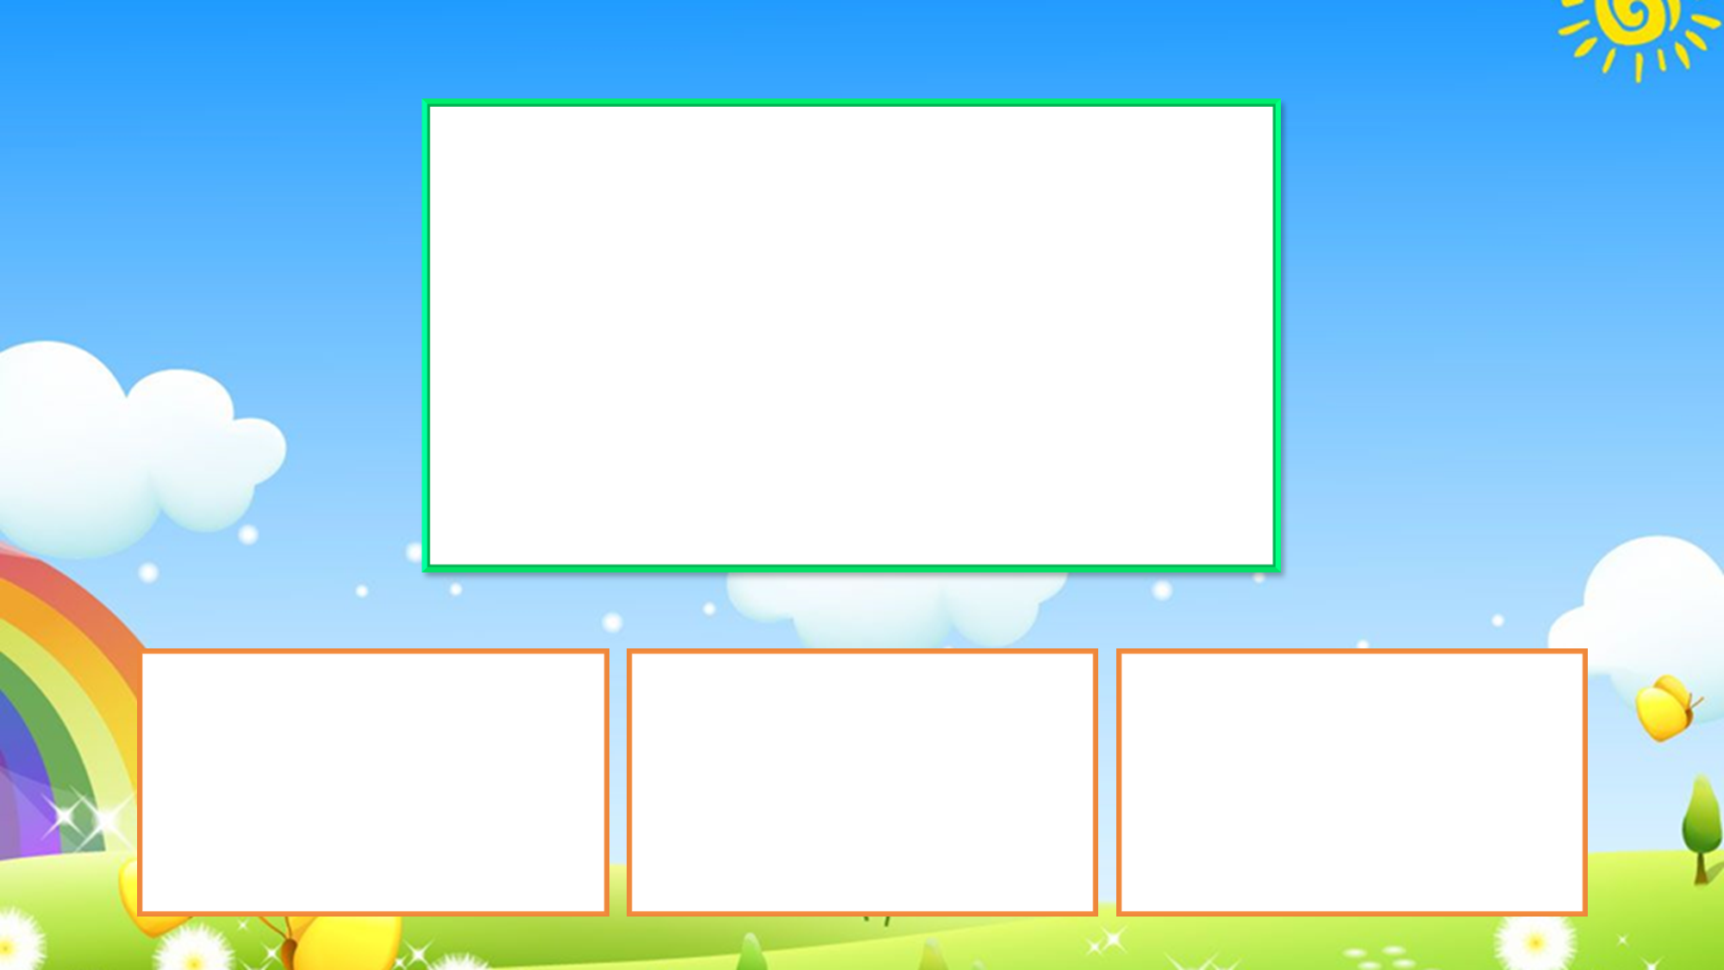



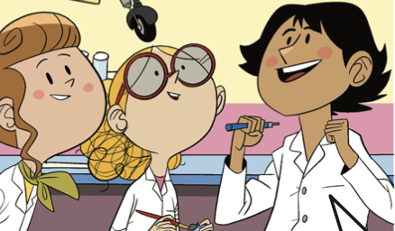
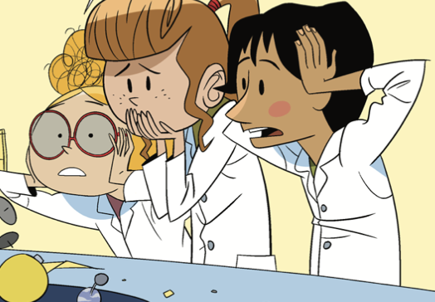
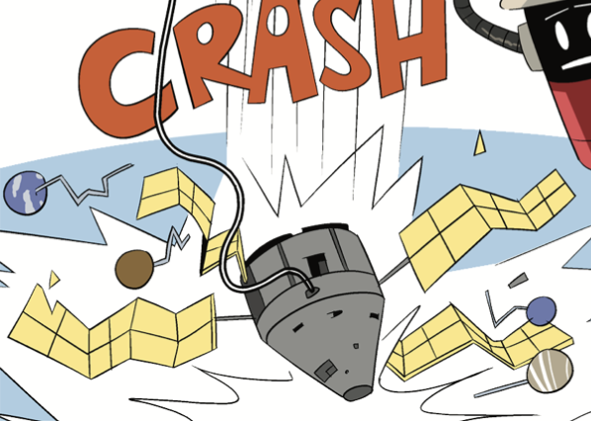
I’m so sorry … I broke it.
B
C
A
Notes:
Liên hệ: Ms Huyền Phạm - 0936.082.789 Nếu thầy cô muốn:
- Tham gia Khóa học làm powerpoint chuyên nghiệp
Học Tin học văn phòng từ cơ bản đến nâng cao
Đặt hàng thiết kế, soạn giáo án theo yêu cầu
Sở hữu các bộ giáo án powerpoint môn tiếng anh Mầm non và tiểu học.

Slide 6

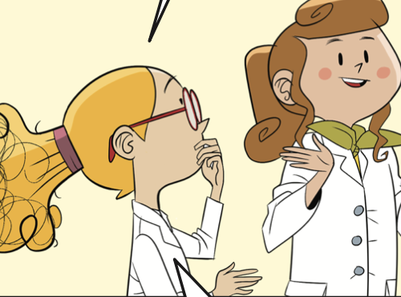
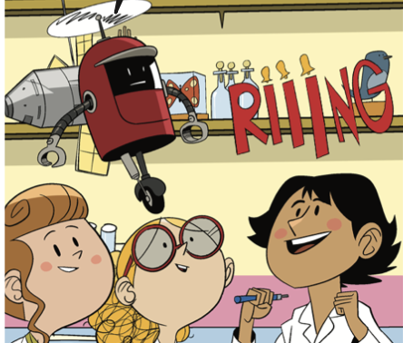
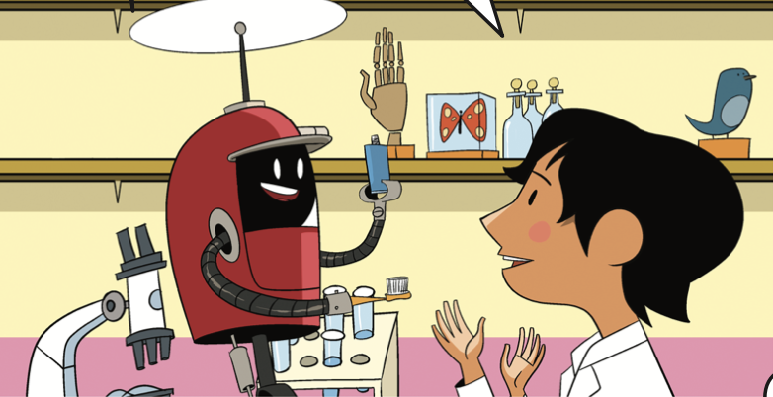
It’s lunch time!
A
B
C
Notes:
Liên hệ: Ms Huyền Phạm - 0936.082.789 Nếu thầy cô muốn:
- Tham gia Khóa học làm powerpoint chuyên nghiệp
Học Tin học văn phòng từ cơ bản đến nâng cao
Đặt hàng thiết kế, soạn giáo án theo yêu cầu
Sở hữu các bộ giáo án powerpoint môn tiếng anh Mầm non và tiểu học.

Slide 7
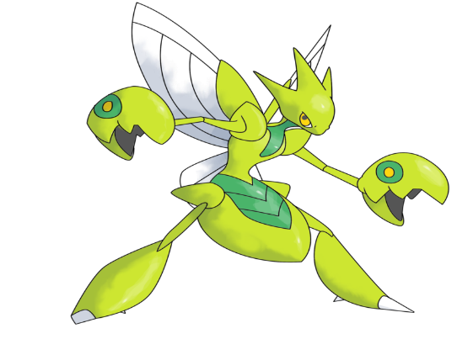
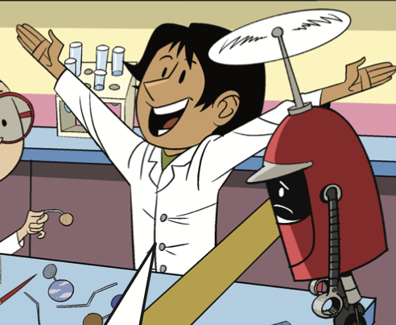
OK, let’s think. Water in a glass floats away in space.
A
B
C
Notes:
Liên hệ: Ms Huyền Phạm - 0936.082.789 Nếu thầy cô muốn:
- Tham gia Khóa học làm powerpoint chuyên nghiệp
Học Tin học văn phòng từ cơ bản đến nâng cao
Đặt hàng thiết kế, soạn giáo án theo yêu cầu
Sở hữu các bộ giáo án powerpoint môn tiếng anh Mầm non và tiểu học.

Slide 8
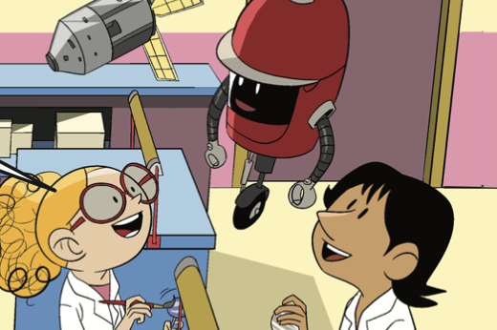
How far is the Moon from the Earth? A thousand kilometres?
A
B
C
Notes:
Liên hệ: Ms Huyền Phạm - 0936.082.789 Nếu thầy cô muốn:
- Tham gia Khóa học làm powerpoint chuyên nghiệp
Học Tin học văn phòng từ cơ bản đến nâng cao
Đặt hàng thiết kế, soạn giáo án theo yêu cầu
Sở hữu các bộ giáo án powerpoint môn tiếng anh Mầm non và tiểu học.

Slide 9
That’s easy! Look, I’ll show you!
A
B
C
Notes:
Liên hệ: Ms Huyền Phạm - 0936.082.789 Nếu thầy cô muốn:
- Tham gia Khóa học làm powerpoint chuyên nghiệp
Học Tin học văn phòng từ cơ bản đến nâng cao
Đặt hàng thiết kế, soạn giáo án theo yêu cầu
Sở hữu các bộ giáo án powerpoint môn tiếng anh Mầm non và tiểu học.

Slide 10


Well done!
Notes:
Liên hệ: Ms Huyền Phạm - 0936.082.789 Nếu thầy cô muốn:
- Tham gia Khóa học làm powerpoint chuyên nghiệp
Học Tin học văn phòng từ cơ bản đến nâng cao
Đặt hàng thiết kế, soạn giáo án theo yêu cầu
Sở hữu các bộ giáo án powerpoint môn tiếng anh Mầm non và tiểu học.

Slide 11


STORY TIME

Slide 12
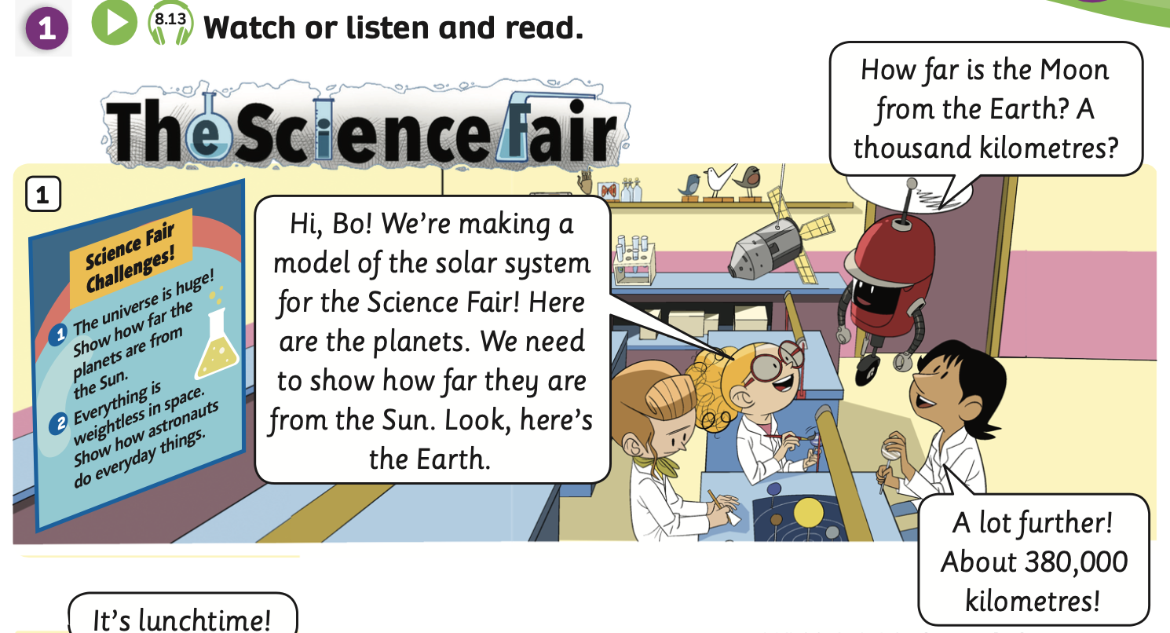

STORY TIME
Listen and read
Listen

Slide 13
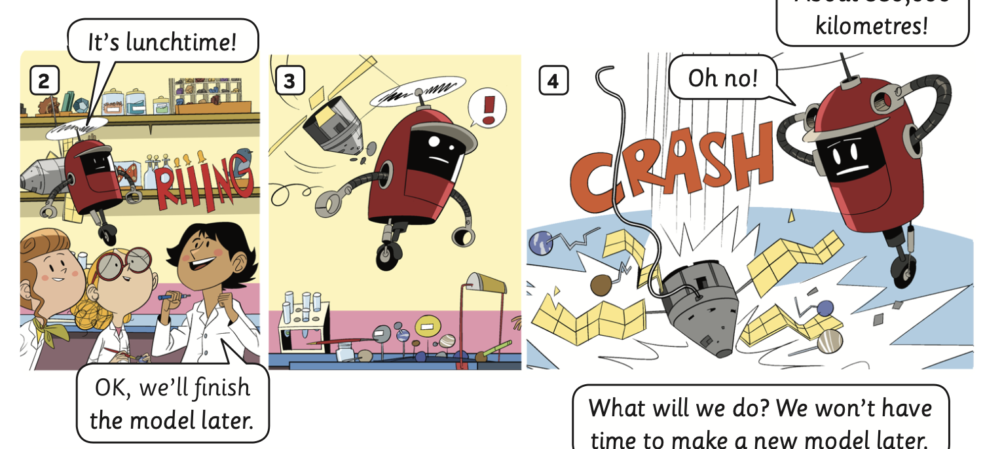
STORY TIME
Listen and read
Listen

Slide 14
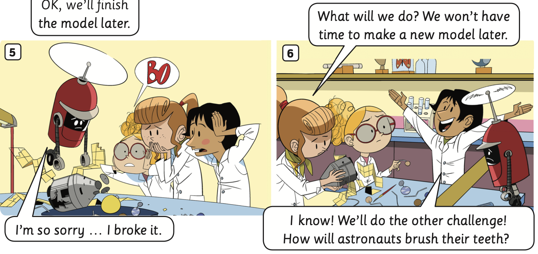
STORY TIME
Listen and read
Listen

Slide 15
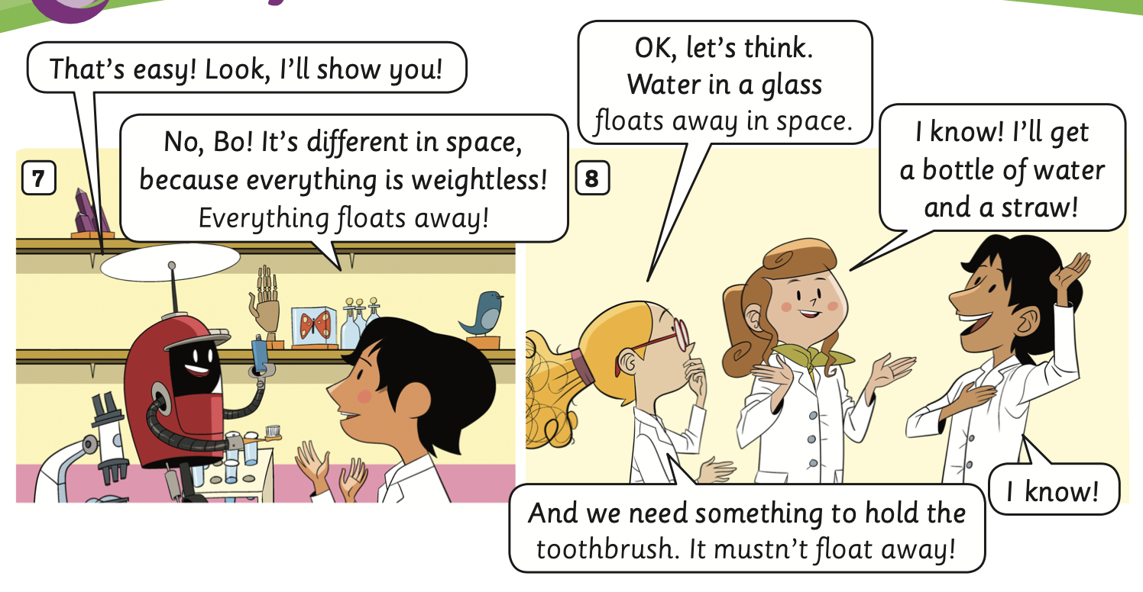
STORY TIME
Listen and read
Listen

Slide 16
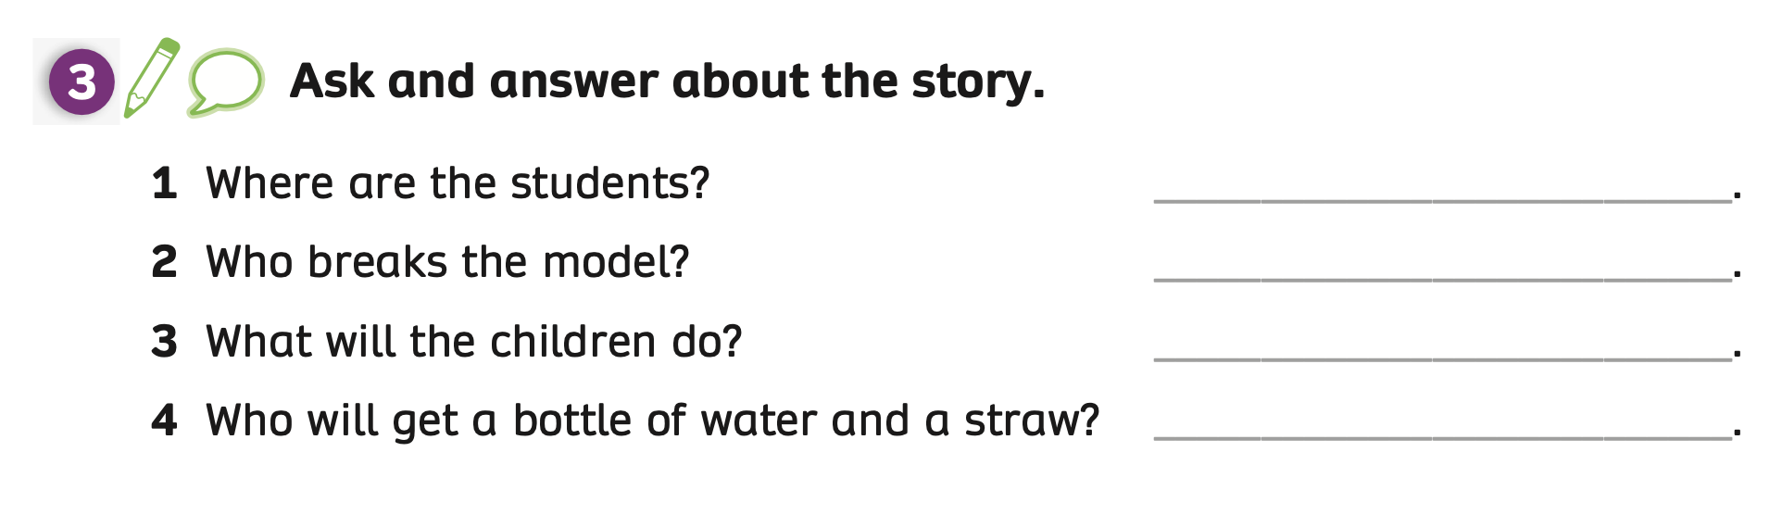
PUPILS’ BOOK p.98
They are at the lab.
Bo breaks the model.
They will do the other challenge.
Ash will get a bottle of water and a straw.
ANSWER
Ask students to open their books and look at Activity 3 on page 98.
Students read the story again and answer the questions.
Show the answers to check.

Slide 17
PRACTICE ACTIVITY
Activity: TRUE or FALSE
Put the class into pairs. Each pair takes out 2 pieces of paper.
Students write True and False for each piece.
Show a sentence, students look at, choose and raise their answers: True or False.
The fastest pair with the correct answer receives 2 points.

Slide 18
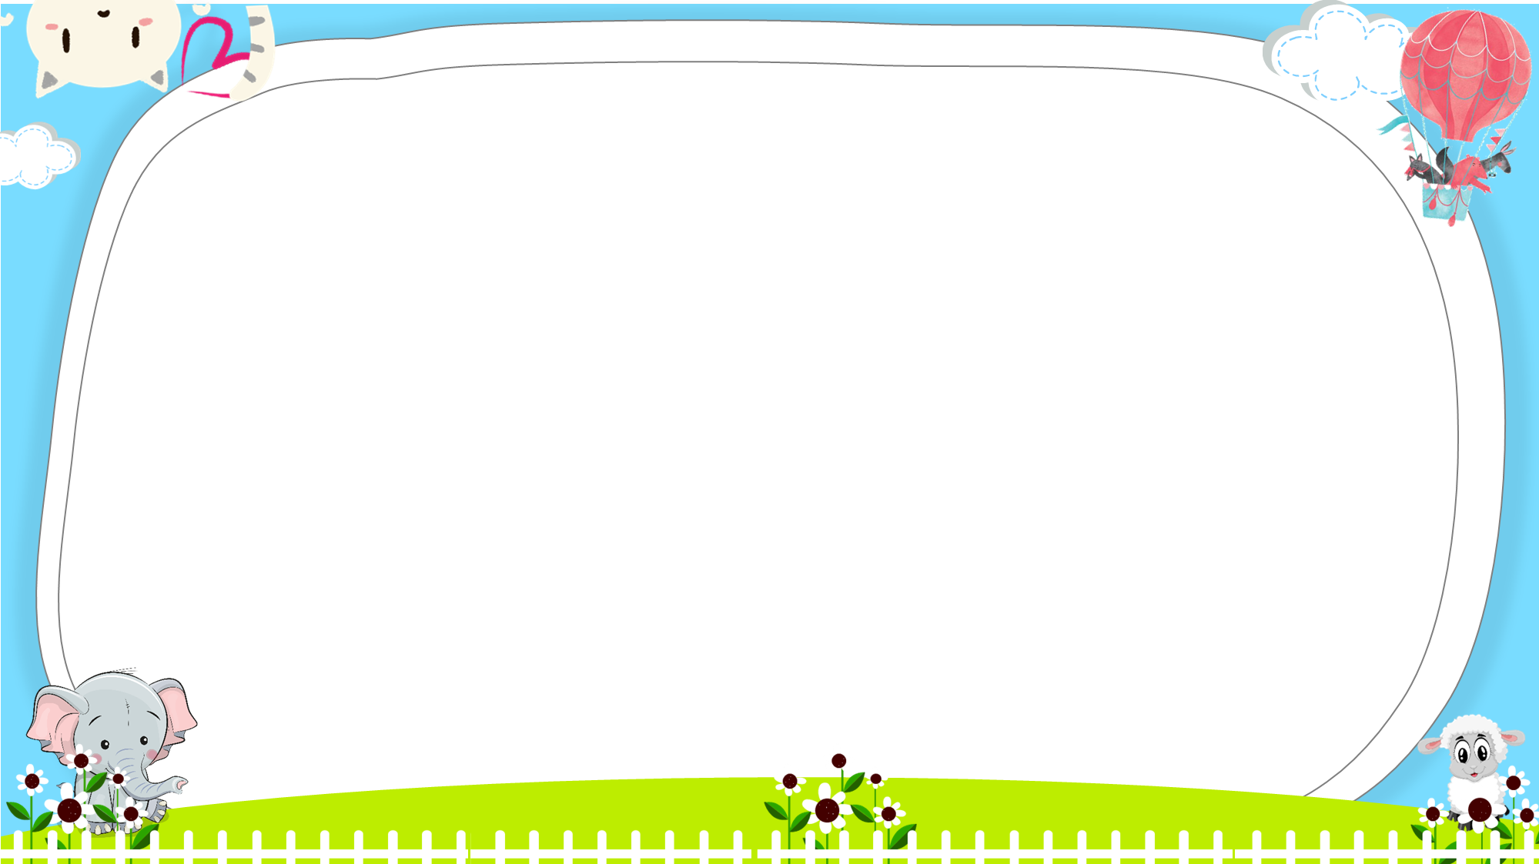



Ms Huyền Phạm - 0936.082.789
Notes:
Ms Huyền Phạm - 0936.082.789

Slide 19





1. The children are making a model of the solar system.
Ms Huyền Phạm - 0936.082.789
TRUE
FALSE
Notes:
Ms Huyền Phạm - 0936.082.789

Slide 20
2. Ash breaks the model.
Ms Huyền Phạm - 0936.082.789
TRUE
FALSE
Notes:
Ms Huyền Phạm - 0936.082.789

Slide 21
3. The distance from the Moon to the Earth is about 80,000 kilometres.
Ms Huyền Phạm - 0936.082.789
TRUE
FALSE
Notes:
Ms Huyền Phạm - 0936.082.789

Slide 22
4. Lottie said: “We won’t have time to make a new model later.
Ms Huyền Phạm - 0936.082.789
TRUE
FALSE
Notes:
Ms Huyền Phạm - 0936.082.789

Slide 23
5. Lottie’ll get a bottle of water and a straw.
Ms Huyền Phạm - 0936.082.789
TRUE
FALSE
Notes:
Ms Huyền Phạm - 0936.082.789

Slide 24

Ms Huyền Phạm - 0936.082.789
Notes:
Ms Huyền Phạm - 0936.082.789

Slide 25
PRODUCTION
Activity: Dub Out The Story
Divide students into small groups.
Tell them to choose the characters and act out the story.
Give students a little time to practice.
Have groups perform in front of the class without the audio.

Slide 26
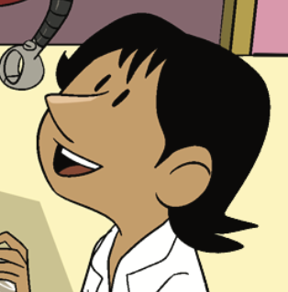
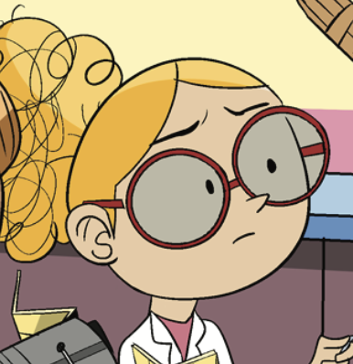
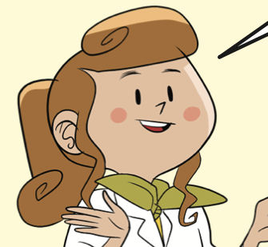

PRODUCTION
CHARACTERS IN THE STORY
Ash
Lottie
Bo
Lois

Slide 27
PRODUCTION
SHOW TIME!

Slide 28
HOMEWORK
Review vocabulary and grammar.
Do exercises in the Activity Book (page 76).
Check the answers in the Teacher’s Book (page 169) or Active Teach.

Slide 29
UNIT 8 – Lesson 7B
We’ve learned…
- To understand simple cartoon stories.
- To review.
- PB p.97 & 98.
- AB p.76

