Slide 1
UNIT 9 – HOLIDAY TIME!
Lesson 2 – Review

Slide 2
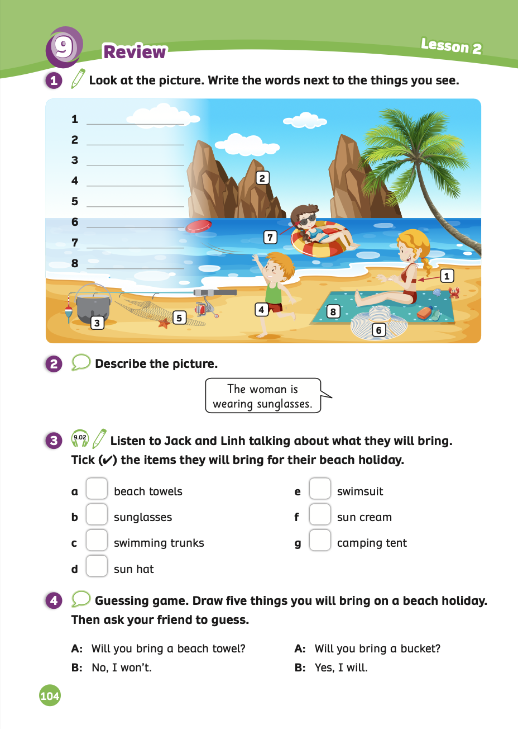
UNIT 9 – Lesson 2
We’re learning…
- To spell words related to beach equipment and clothes.
- To use the sentence patterns: What will you bring to the beach?
I will bring a …
- To use present continuous for describing scenes.
- PB p.104
- AB p.81

Slide 3
WARM-UP ACTIVITY
Divide the class into 2 teams.
Put all the flashcards from Lesson 1 on the board.
Call on one team member from each group to come to the front of the class.
Name one of the pictures, and the two students compete to be the first to touch and say it aloud. Award a point to the winning team.
Both players sit down and are replaced by two new players, who continue with another word.
The team with the most points at the end wins.

Slide 4
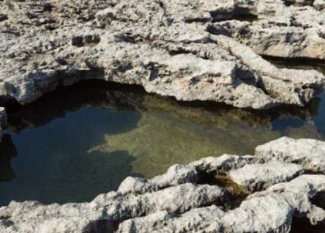
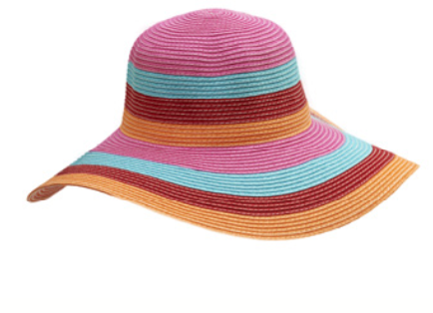
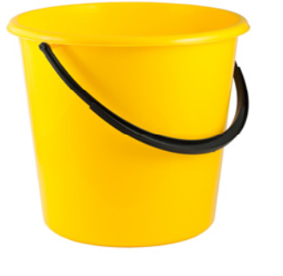
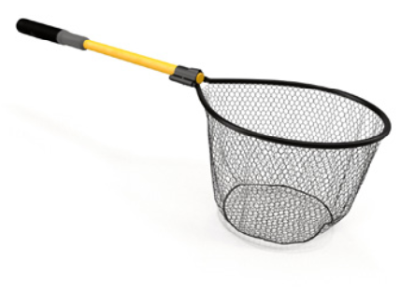
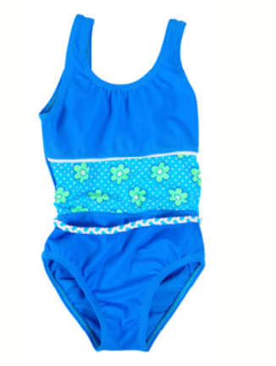
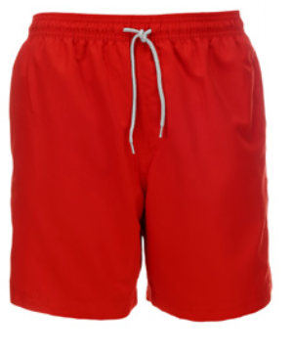
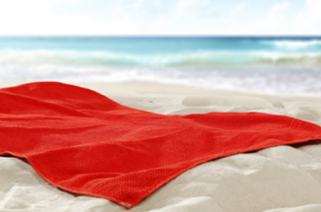
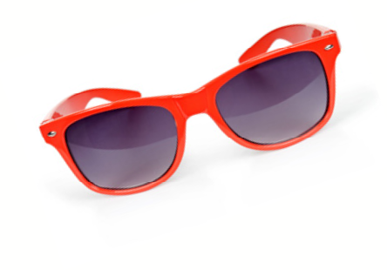
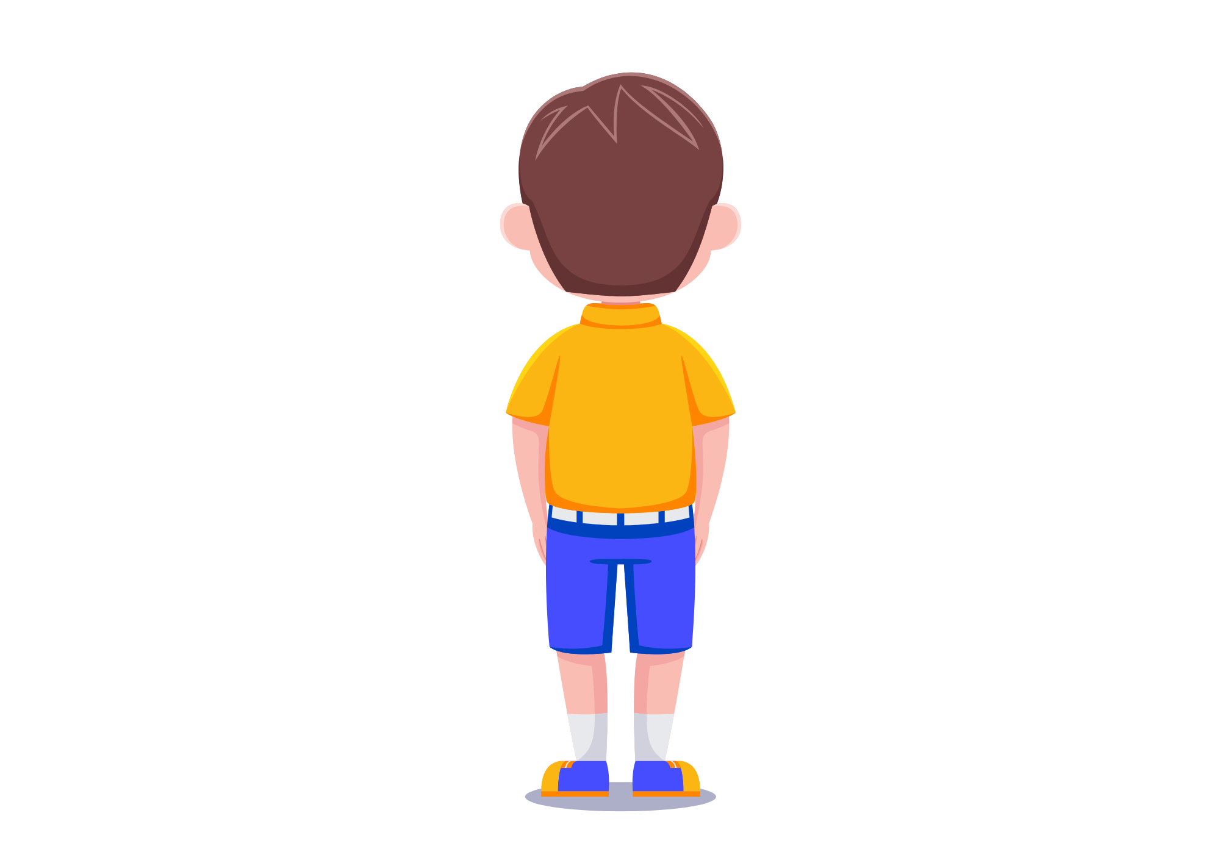
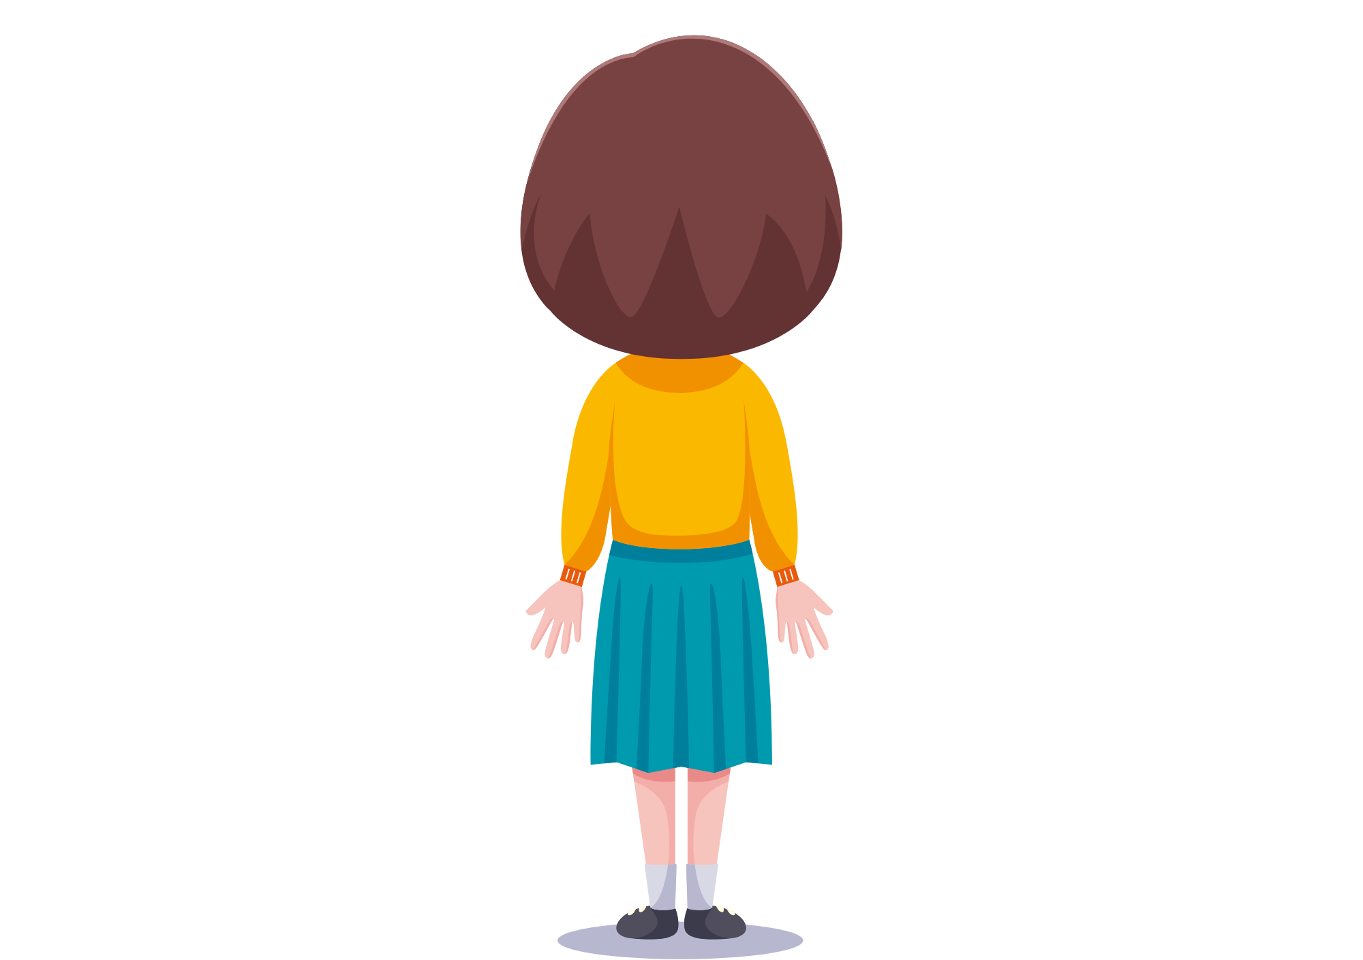
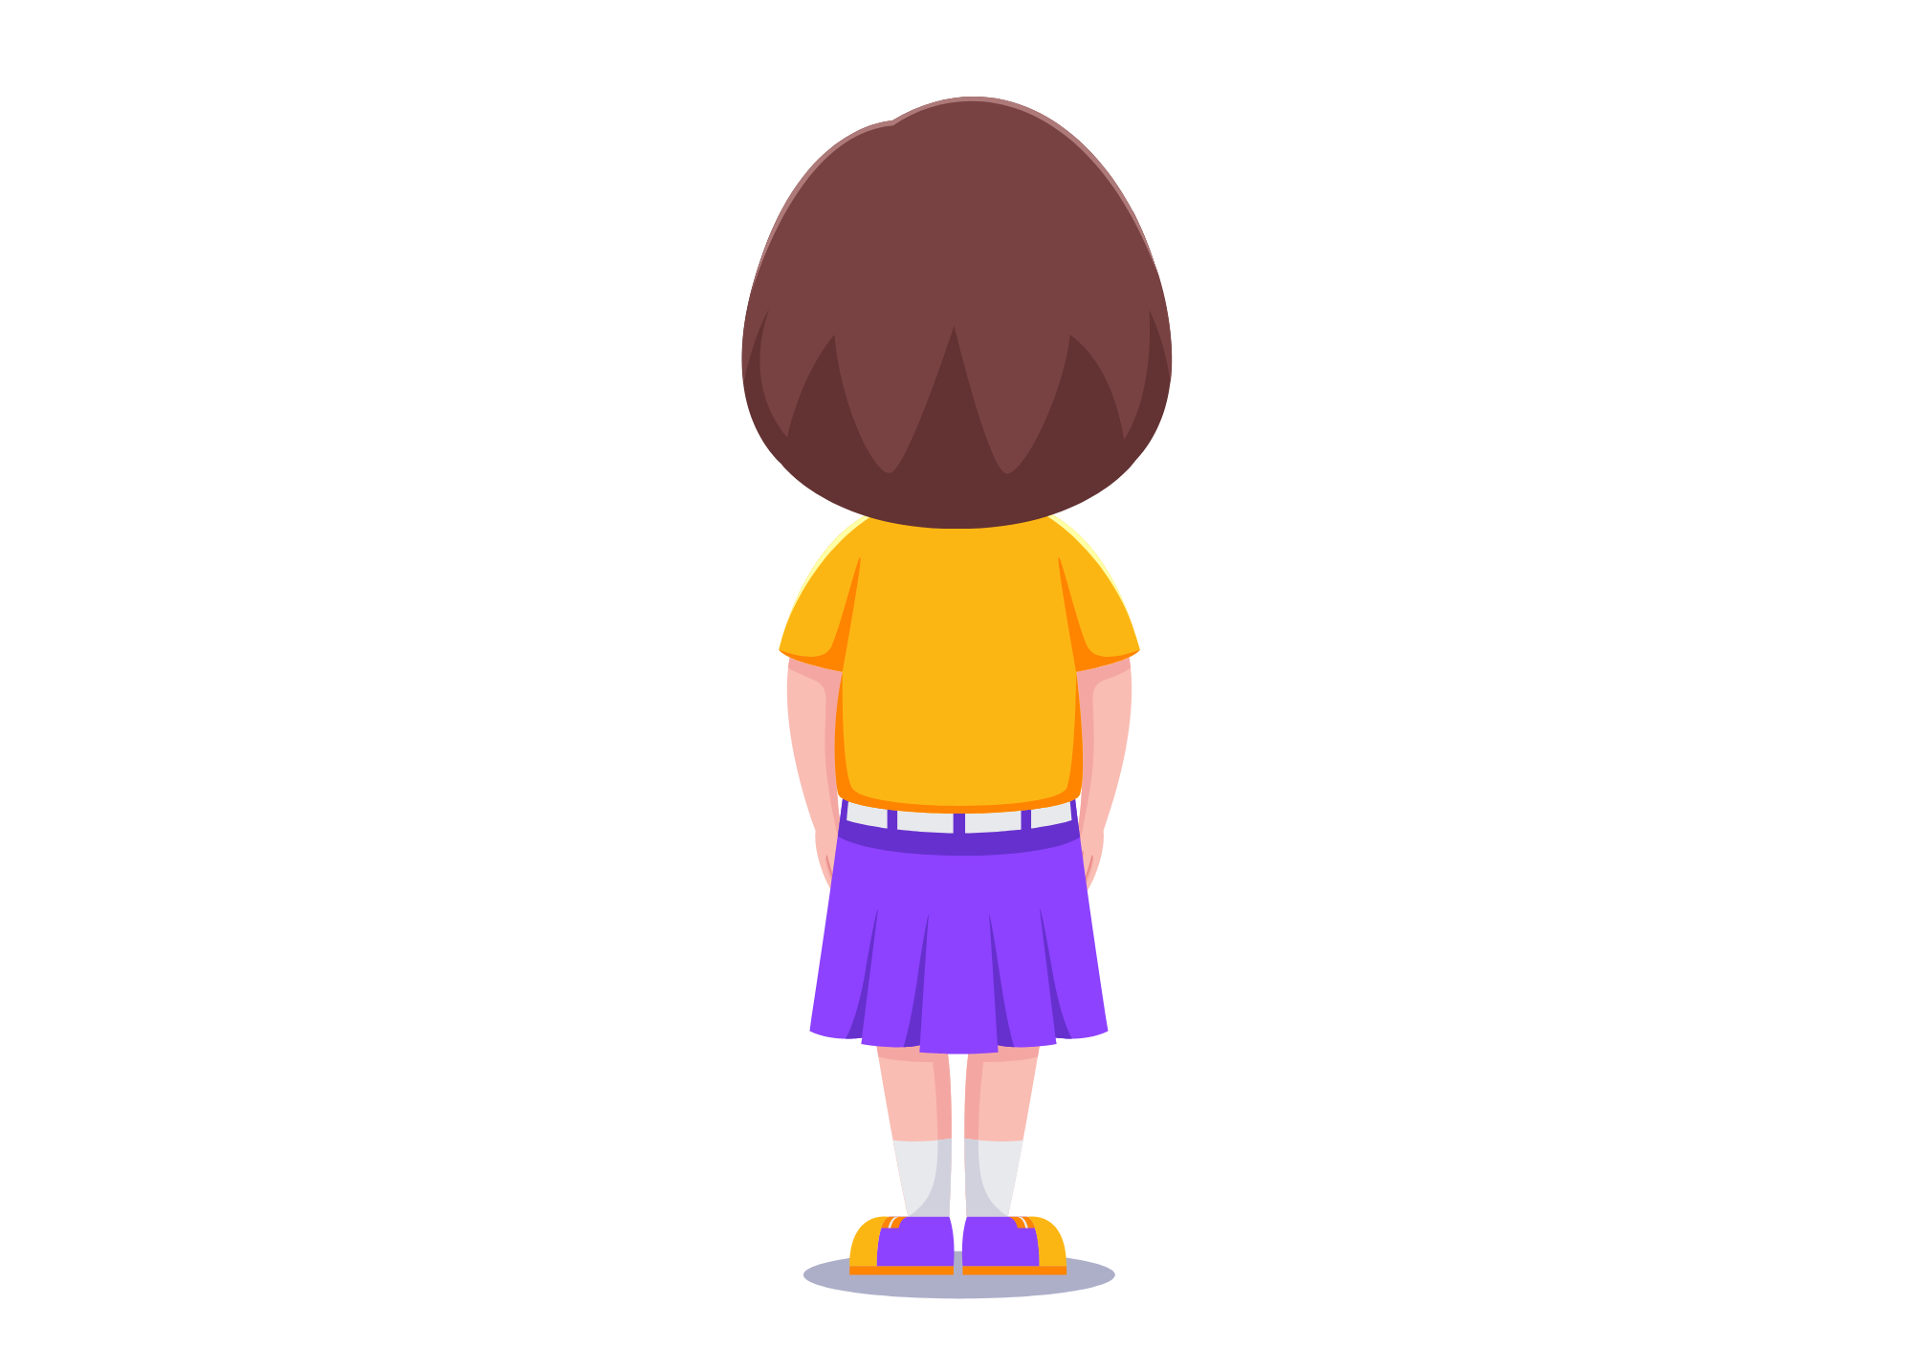
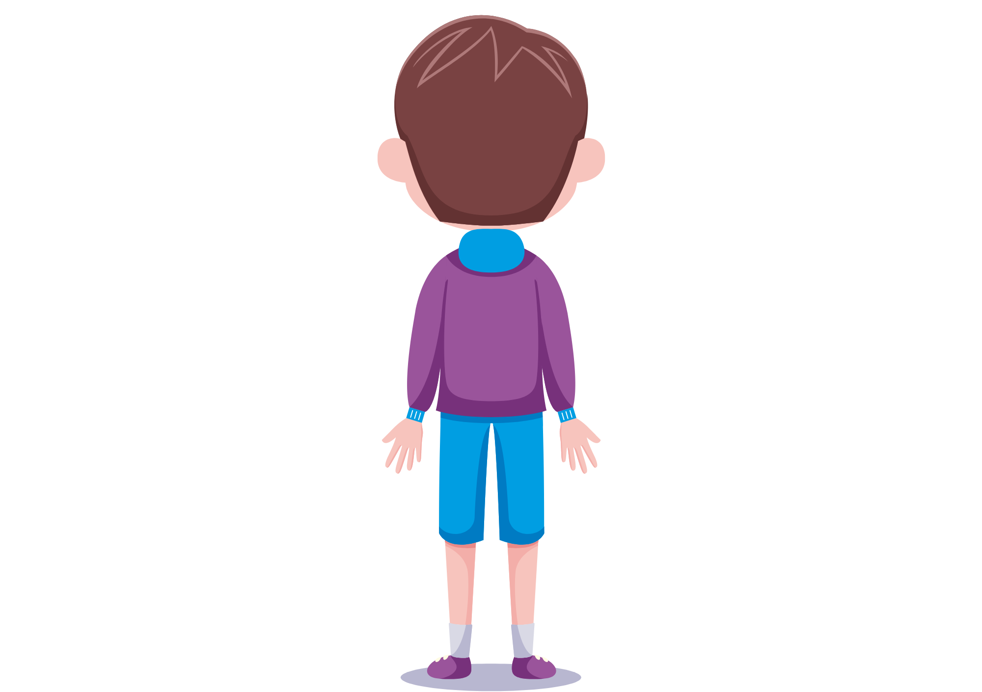
WARM-UP ACTIVITY
fishing net
fishing net

Slide 5
Pupils’ Book (p.104)
swimsuit
rockpool
bucket
swimming trunks
fishing net
sun hat
sunglasses
beach towel
ANSWER
Have students in pairs look at the picture in Activity 1.
Then, they work together to write the names of the things they find in the picture.
Teacher shows the answers to check with the whole class.

Slide 6
Pupils’ Book (p.104)
How many people are there in this picture?
There are three.
Have students in pairs look at the picture in Activity 2.
The teacher asks “How many people are in this picture?” and students answer.
Elicit the clothes they are wearing and the action.

Slide 7
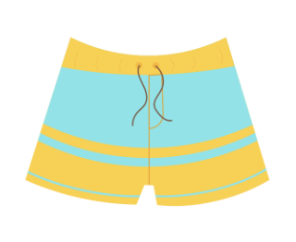
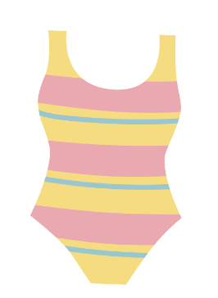
Pupils’ Book (p.104)
What are they wearing?
They are wearing …
What are they doing?
They are …
Have students in pairs look at the picture in Activity 2.
The teacher asks: “How many people are in this picture?” and students answer.
Elicit the clothes they are wearing and the action.

Slide 8
Pupils’ Book (p.104)
Ask students to work in groups of 3 or 4.
Students look at the pictures and take turns to ask and answer about them.
The teacher shows the bubble speech for students to practice.
Teacher invites some students to present in front of the whole class and gives them 2 points if they perform well.

Slide 9
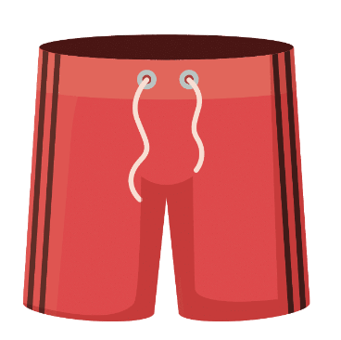
Pupils’ Book (p.104)
He’s wearing red swimming trunks.
What is the boy wearing?
What is the boy doing?
He’s running.
Show the bubble speech to ask and answer about the picture.
Then, invite some students to present in front of the whole class and give them 2 points.

Slide 10
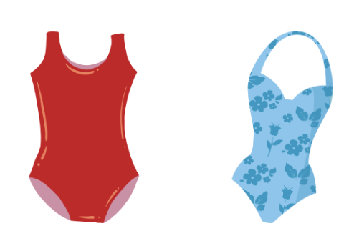
Pupils’ Book (p.104)
They’re wearing swimsuits and sunglasses.
What are the women wearing?
What are they doing?
They’re sitting on the beach towel and the sea.
Show the bubble speech to ask and answer about the picture.
Then, invite some students to present in front of the whole class and give them 2 points.

Slide 11
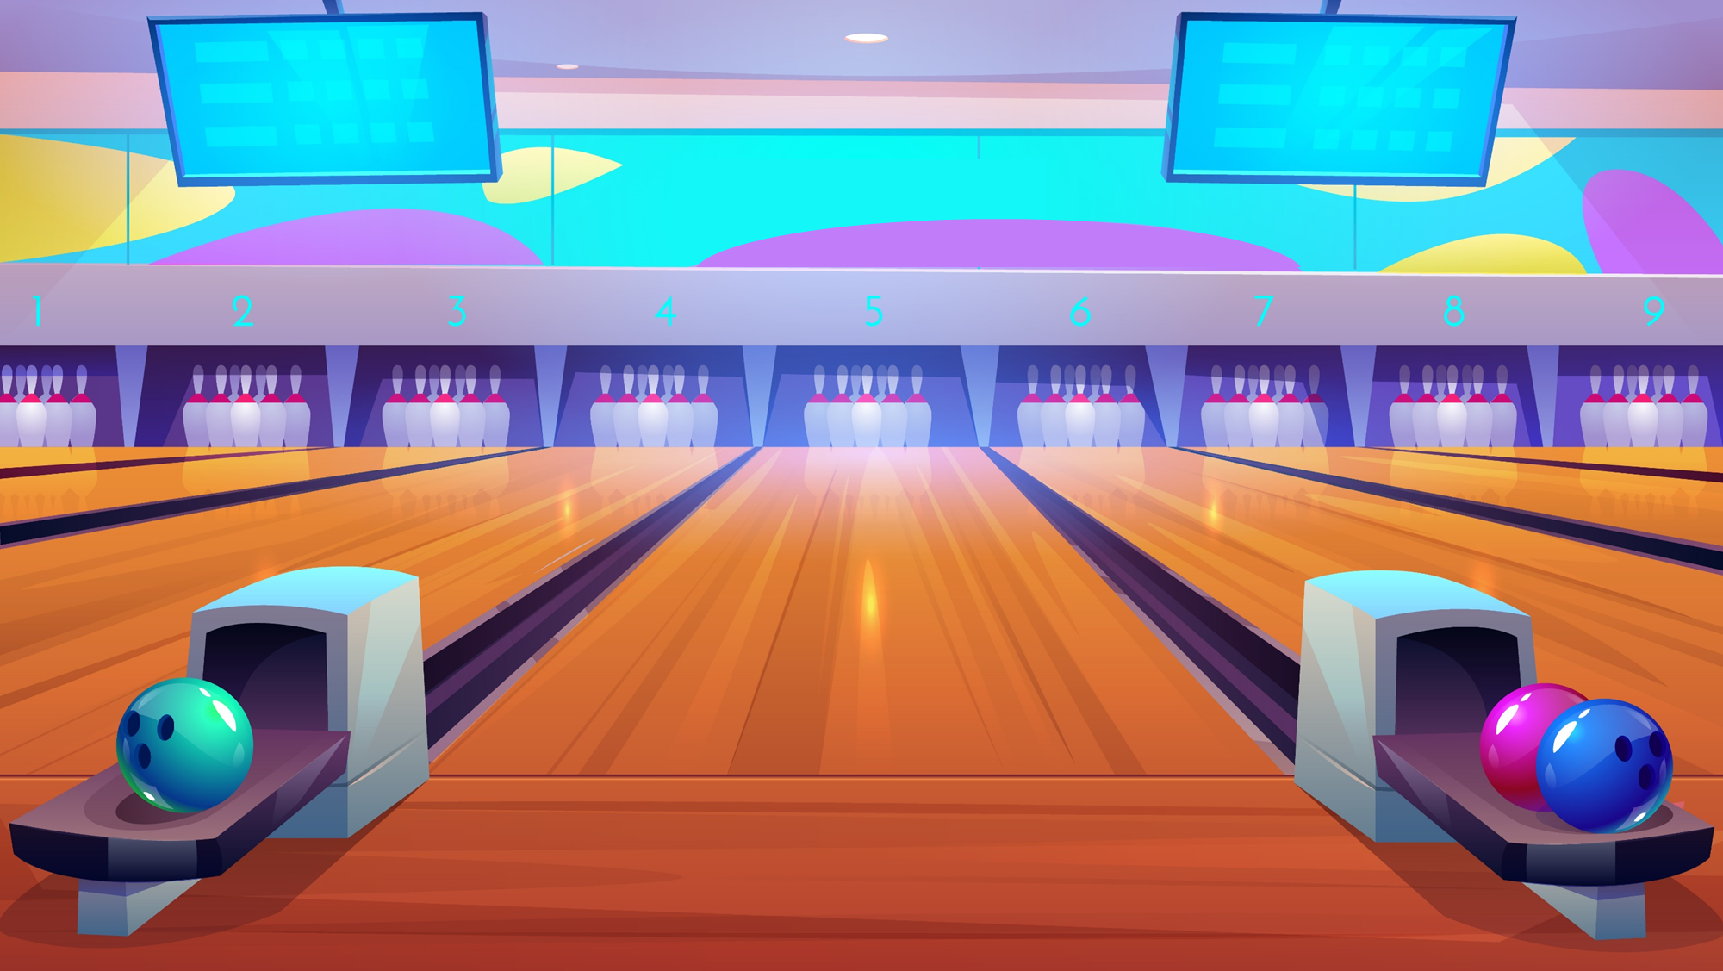
BOWLING
GAME

Slide 12
BOWLING
GAME
How to play:
- Put students into groups of four. Each team takes turns playing the activity.
- Students look at a picture with the given answers and choose the correct answer by saying it out loud.
- 1 correct answer = 1 point.
- All students repeat the answer.

Slide 13
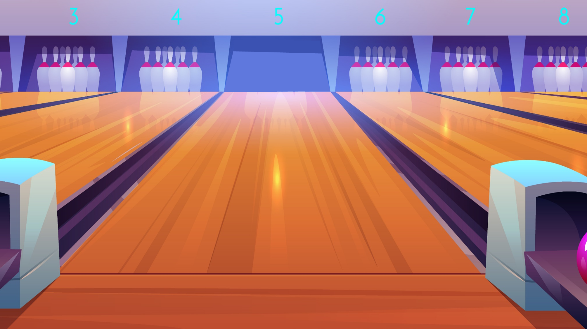
Look and choose the correct answer
Click on the answer to check
swimming trunks
swimsuit
sun hat
beach towel

Slide 14
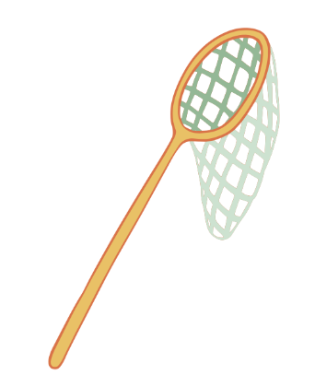
Look and choose the correct answer
Click on the answer to check
beach towel
fishing net
sun hat
rockpool

Slide 15
Look and choose the correct answer
Click on the answer to check
rock pool
beach towel
swimsuit
sun hat

Slide 16
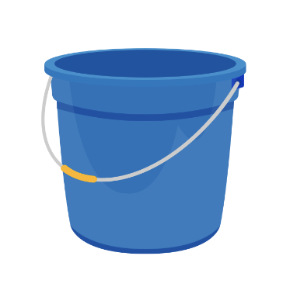
Look and choose the correct answer
Click on the answer to check
sun hat
bucket
swimsuit
sunglasses

Slide 17
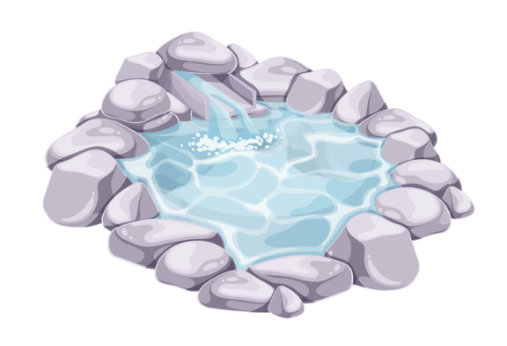
Look and choose the correct answer
Click on the answer to check
swimsuit
sunglasses
bucket
rockpool
Next

Slide 18
Look and choose the correct answer
Click on the answer to check
sun hat
beach towel
swimsuit
bucket

Slide 19
Look and choose the correct answer
Click on the answer to check
swimsuit
beach towel
bucket
sunglasses
Next

Slide 20
Look and choose the correct answer
Click on the answer to check
fishing net
sun hat
swimsuit
bucket

Slide 21
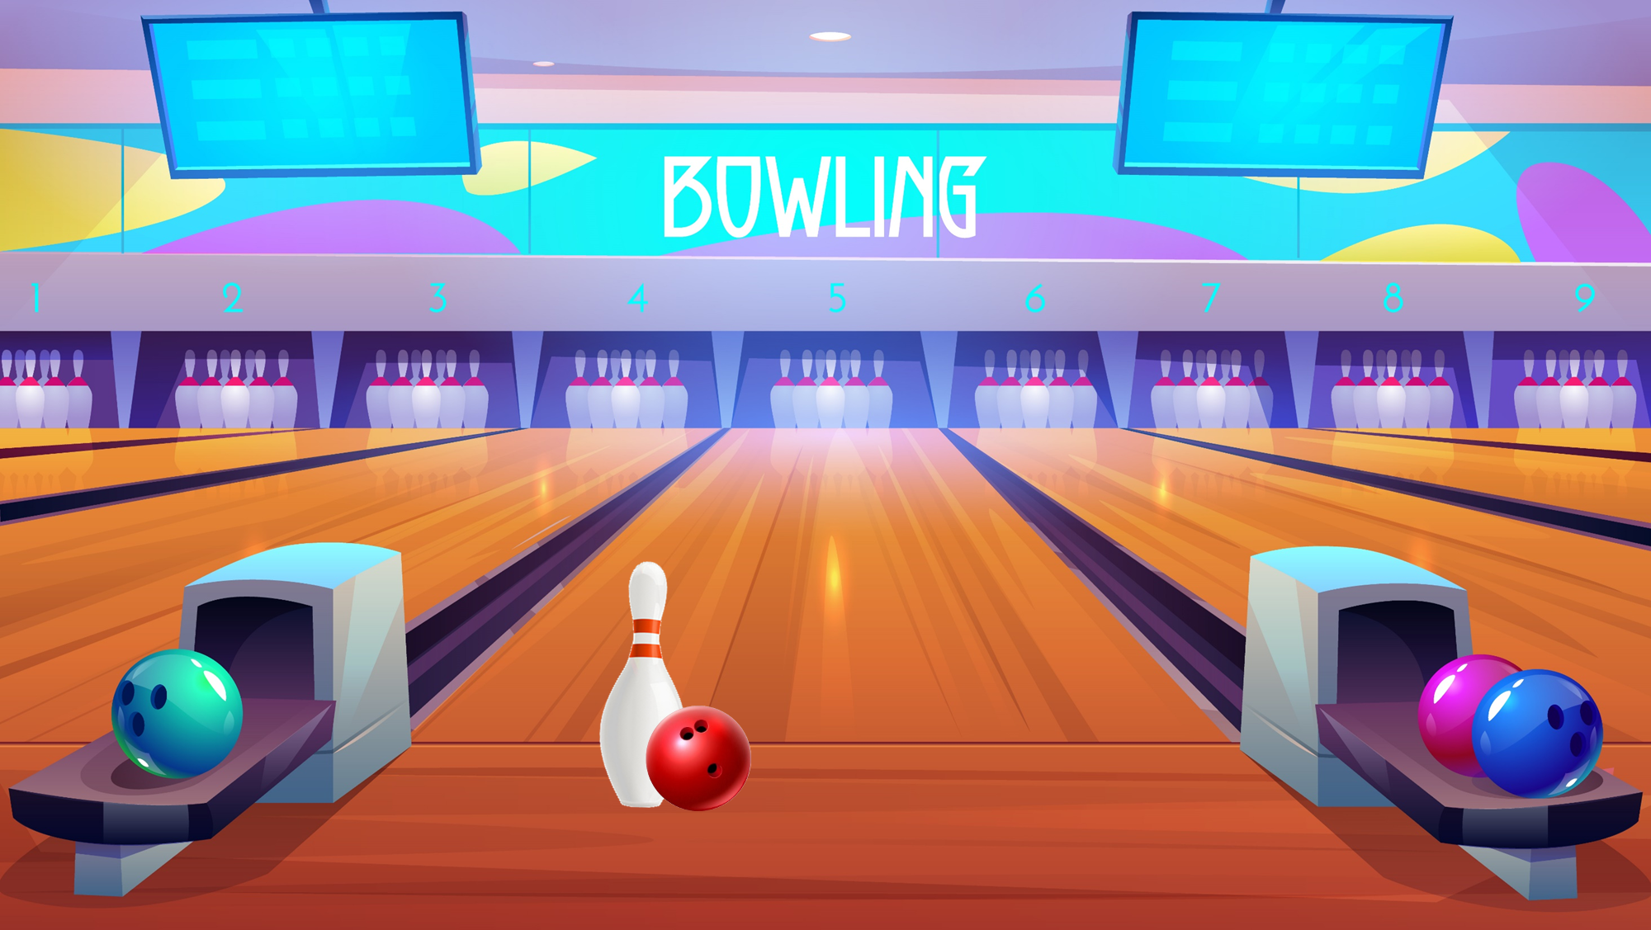

Slide 22
PRE-LISTENING - Pupils’ Book (p.104)
What will they bring?
They will bring beach towels, sunglasses, sun cream, and sun hat.
Put students work in pairs. Have students look at activity 2 on page 104.
Then, switch roles to ask and answer about the items Jack and Linh will bring for their beach holiday.

Slide 23
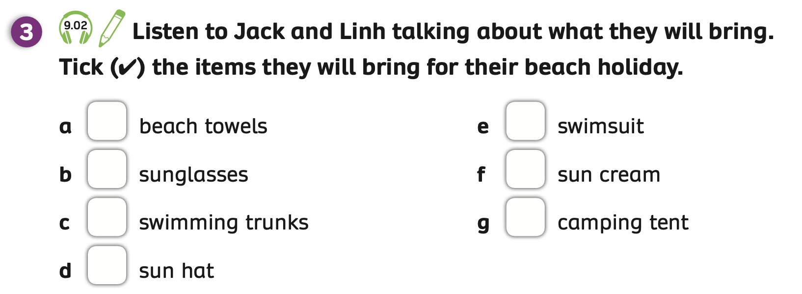
LISTENING - Pupils’ Book (p.104)
Answer
Play the audio, students listen and tick the answer.
Play the audio again, students listen and check.
Click on “Answer” to check.

Slide 24
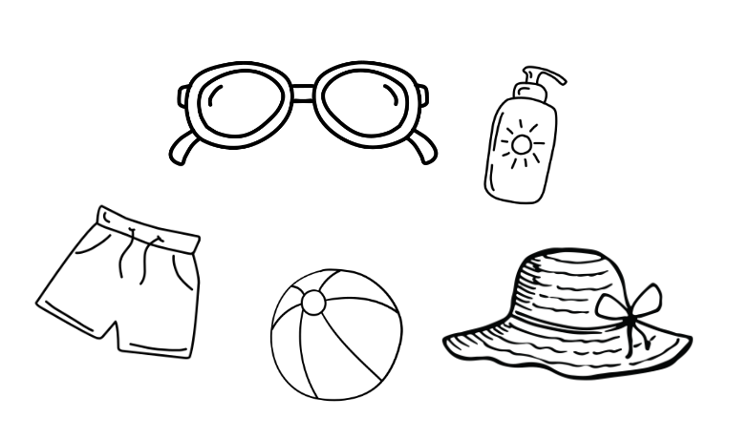
Pupils’ Book (p.104)
Have students work in pairs and look at Activity 4.
Students draw individually five things they will bring on a beach holiday without letting anyone see their items.

Slide 25
Pupils’ Book (p.104)
Will you bring a beach towel?
No, I won’t.
Yes, I will.
Will you bring a bucket?
After drawing, ask students to work in pairs to ask and guess about five things they have drawn.

Slide 26
PRODUCTION
I will bring ...
I won’t bring ...
Invite some students to show their pictures and talk about five things they will bring for their holiday.
Give them a point if they have a good presentation.

Slide 27
HOMEWORK
Review vocabulary and grammar.
Do exercises in the Activity Book (page 81).
Check the answers in the Teacher’s Book (page 179) or Active Teach.

Slide 28
UNIT 9 – Lesson 2
We’re learned…
- To spell words related to beach equipment and clothes.
- To use the sentence patterns: What will you bring to the beach?
I will bring a …
- To use present continuous for describing scenes.
- PB p.104
- AB p.81

