Slide 1
UNIT 9 – HOLIDAY TIME!
Lesson 5A – Vocabulary and Grammar 2

Slide 2
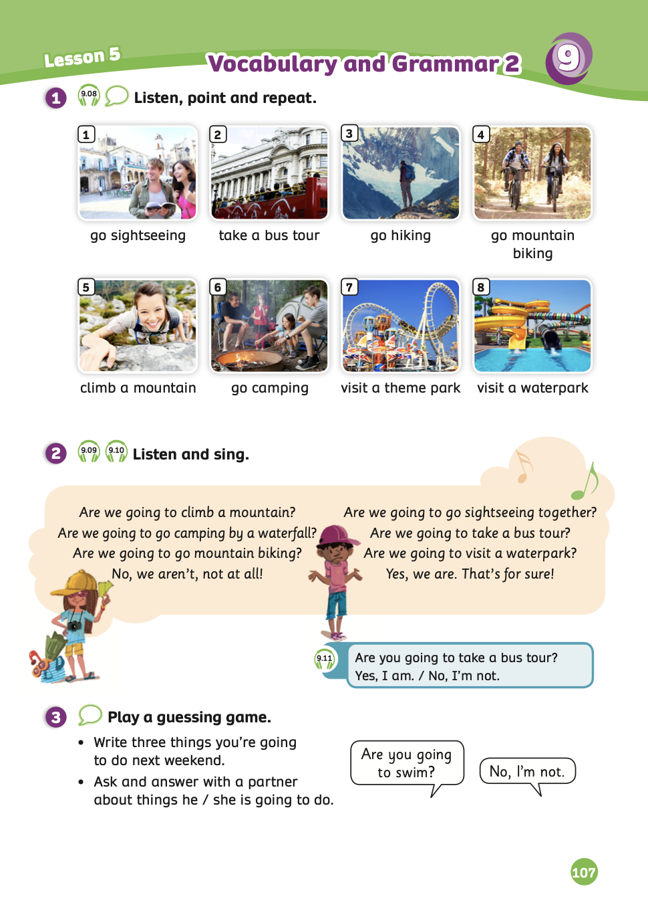
UNIT 9 – Lesson 5A
We’re learning…
- To use the question structures of going to + verb.
- To use the vocabulary: go sightseeing, take a bus tour, go hiking, go mountain biking …
- PB p.107
- AB p.84

Slide 3
WARM-UP ACTIVITY
Activity: WHO IS THE MILLIONAIRE?
Divide the class into two teams: team A and team B.
Each student takes out a mini-board.
Students look at the question and write down the answers.
Each question has 3 supports: 50:50, Audience, Call. Each team can choose when they need help.
If all students in the team write the correct answer, that team will receive 2 points. But if the team has 2 or 3 students write the wrong picture, they won’t receive points.
The team with the highest points wins the game.

Slide 4
START GAME

Slide 5
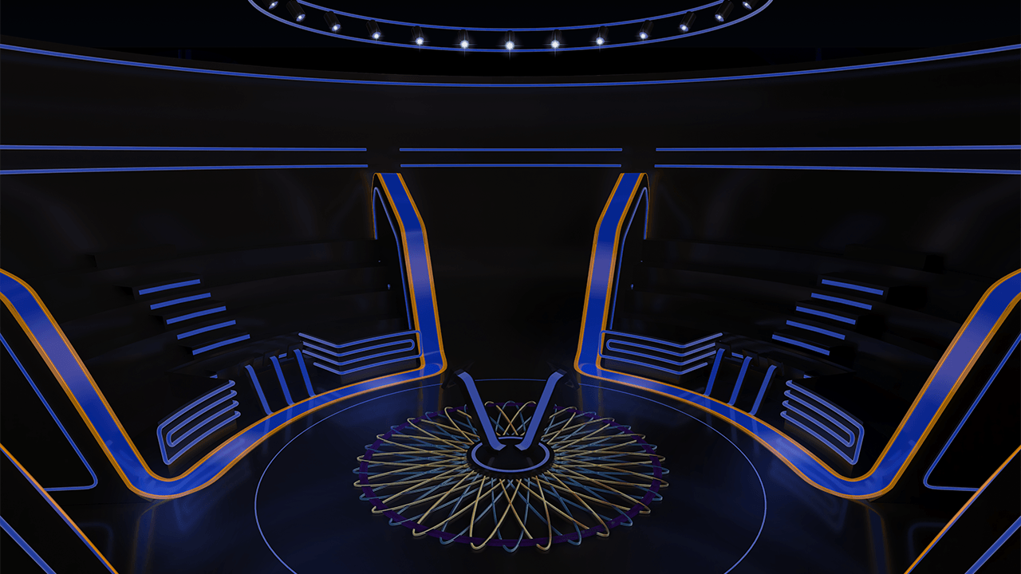
50:50
Call
Audience
ANSWER
NEXT
She’s going to _______ a sandcastle.
A. build
B. built
C. make
D. take

Slide 6
50:50
Call
Audience
ANSWER
NEXT
I’m going to ______ an ice cream and ____ snorkelling.
A. BUY – GO
B. BOUGHT – GO
C. BUY – WENT
D. BUY – GONE

Slide 7
50:50
Call
Audience
ANSWER
NEXT
We aren’t going to _____ swimsuit, a sun hat, and a ball.
A. go
B. bring
C. make
D. get

Slide 8
50:50
Call
Audience
ANSWER
NEXT
They’re going to _______ football with the kids.
A. PLAYED
B. MAKE
C. PLAY
D. GO

Slide 9
50:50
Call
Audience
ANSWER
NEXT
We’re going to ____ surfing, ____ snorkelling, ____ a sandcastle.
A. GO – WENT - BUILD
B. WENT – GO – BUILD
C. GO – GO – BUILT
D. GO – GO - BUILD

Slide 10
THANK YOU!

Slide 11
VOCABULARY – Holiday time!
- Play the audio, students listen, point and repeat the words.

Slide 12
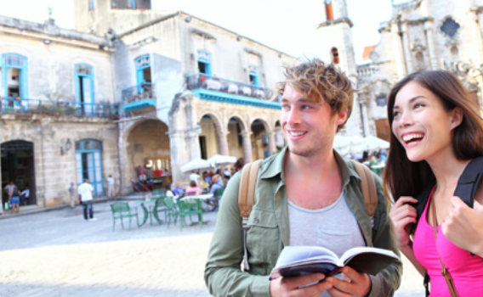
VOCABULARY – Holiday time!
c
Let’s spell!
go sightseeing
g
o
s
i
g
h
t
s
e
e
i
n
g
Students listen and repeat the word.

Slide 13
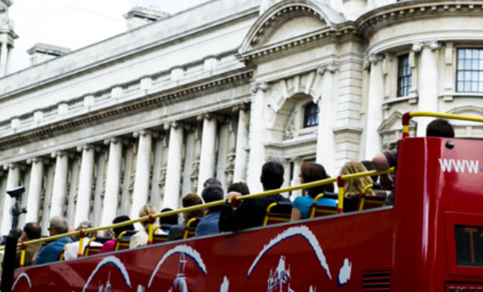
VOCABULARY – Holiday time!
c
Let’s spell!
take a bus tour
t
a
k
e
a
b
u
s
t
o
u
r
Students listen and repeat the word.

Slide 14
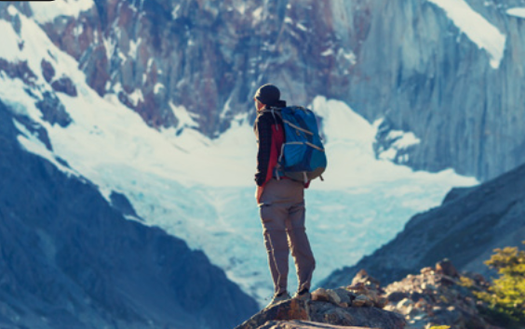
VOCABULARY – Holiday time!
Let’s spell!
c
go hiking
g
o
h
i
k
i
n
g
Students listen and repeat the word.

Slide 15
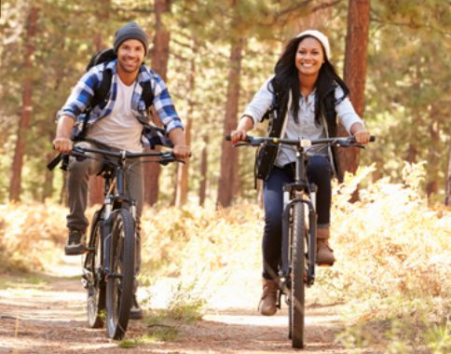
VOCABULARY – Holiday time!
c
Let’s spell!
go mountain biking
g
o
m
o
u
n
t
a
i
n
b
i
k
i
n
g
Students listen and repeat the word.

Slide 16
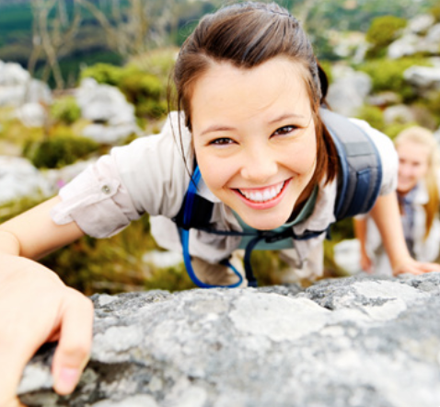
VOCABULARY – Holiday time!
c
Let’s spell!
climb a mountain
c
l
i
m
b
a
m
o
u
n
t
a
i
n
Students listen and repeat the word.

Slide 17
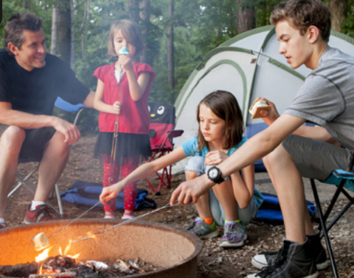
VOCABULARY – Holiday time!
c
Let’s spell!
go camping
g
o
c
a
m
p
i
n
g
Students listen and repeat the word.

Slide 18
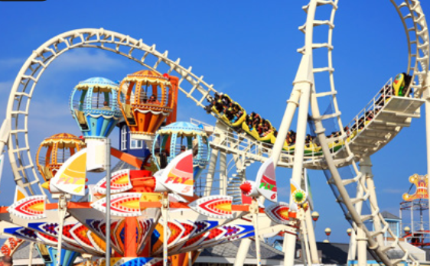
VOCABULARY – Holiday time!
c
Let’s spell!
visit a theme park
v
i
s
i
t
a
t
h
e
m
e
p
a
r
k
Students listen and repeat the word.

Slide 19
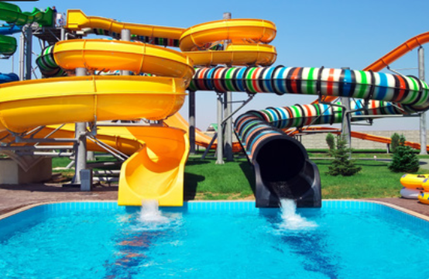
VOCABULARY – Holiday time!
c
Let’s spell!
visit a waterpark
v
i
s
i
t
a
w
a
t
e
r
p
a
r
k
Students listen and repeat the word.

Slide 20
VOCABULARY – Holiday time!
REVIEW
1
2
3
4
go sightseeing
take a bus tour
go hiking
go mountain biking
5
6
7
8
climb a mountain
go camping
visit a theme park
visit a waterpark
- Show all the pictures; the teacher says the number, and students say the word.
- Click on each number to show the word, students spell it again.

Slide 21
VOCABULARY – Practice
Put students work in groups of 3 or 4.
The teacher shows the pictures, and students look at it within 5 seconds to remember the pictures.
Then, they raise their hands to check the answers.
The fastest group with all the correct answers receive a point.

Slide 22
Finding picture
Play

Slide 23
How to play:
Divide the class into two teams
Look at these pictures in 5s to remember
After 5s, look at the text on top, choose the right number
If they’re a perfect pair = +2points
If they’re not correct, another team can play this turn
Check points

Slide 24
take a bus tour
1
2
3
4
Click “Start” to countdown
Click on the numbers to check
Next

Slide 25
go hiking
1
2
3
4
Click “Start” to countdown
Click on the numbers to check
Next

Slide 26
climb a mountain
1
2
3
4
Click “Start” to countdown
Click on the numbers to check
Next

Slide 27
go camping
1
2
3
4
Click “Start” to countdown
Click on the numbers to check
Next

Slide 28
go sightseeing
1
2
3
4
Click “Start” to countdown
Click on the numbers to check
Next

Slide 29
go mountain biking
1
2
3
4
Click “Start” to countdown
Click on the numbers to check
Next

Slide 30
visit a theme park
1
2
3
4
Click “Start” to countdown
Click on the numbers to check
Next

Slide 31
visit a waterpark
1
2
3
4
Click “Start” to countdown
Click on the numbers to check
Next

Slide 32
PRODUCTION
1
2
3
4
go sightseeing
take a bus tour
go hiking
go mountain biking
5
6
7
8
climb a mountain
go camping
visit a theme park
visit a waterpark
- Show all the pictures; the teacher says the number, and students say the word.
- Click on each number to show the word, students spell it again.

Slide 33
HOMEWORK
Review vocabulary and grammar.
Do exercises in the Activity Book (page 84).
Check the answers in the Teacher’s Book (page 184) or Active Teach.

Slide 34
UNIT 9 – Lesson 5A
We’re learning…
- To use the question structures of going to + verb.
- To use the vocabulary: go sightseeing, take a bus tour, go hiking, go mountain biking …
- PB p.107
- AB p.84

