Slide 1
UNIT 9 – HOLIDAY TIME!
Lesson 5B – Vocabulary and Grammar 2

Slide 2
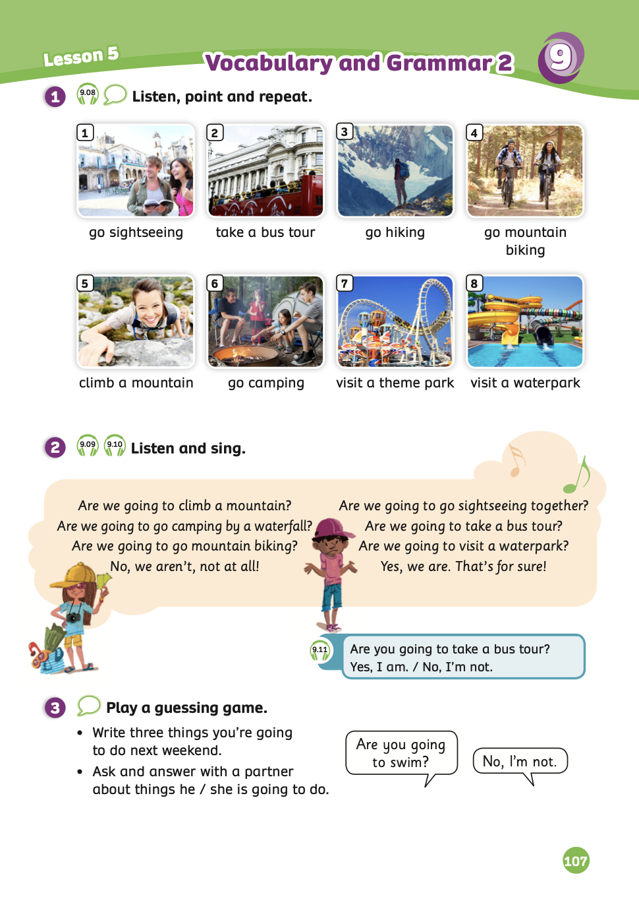
UNIT 9 – Lesson 5A
We’re learning…
- To use the question structures of going to + verb.
- To use the vocabulary: go sightseeing, take a bus tour, go hiking, go mountain biking …
- PB p.107
- AB p.84

Slide 3
WARM-UP ACTIVITY
Activity: LISTEN AND WRITE
Put students work in groups of 4. Each group takes out a mini-board.
Each member takes a turn coming to play the game.
The teacher spells a word. Ex: “g-o-c-a-m-p-i-n-g”
Students listen and write a correct word on the board. After finishing, they raise their board to check the answers.
The fastest group with the correct word receives 2 points for the team.

Slide 4
WARM-UP ACTIVITY
g – o – c-a-m-p-i-n-g
go camping
go camping
go caping
go canping

Slide 5
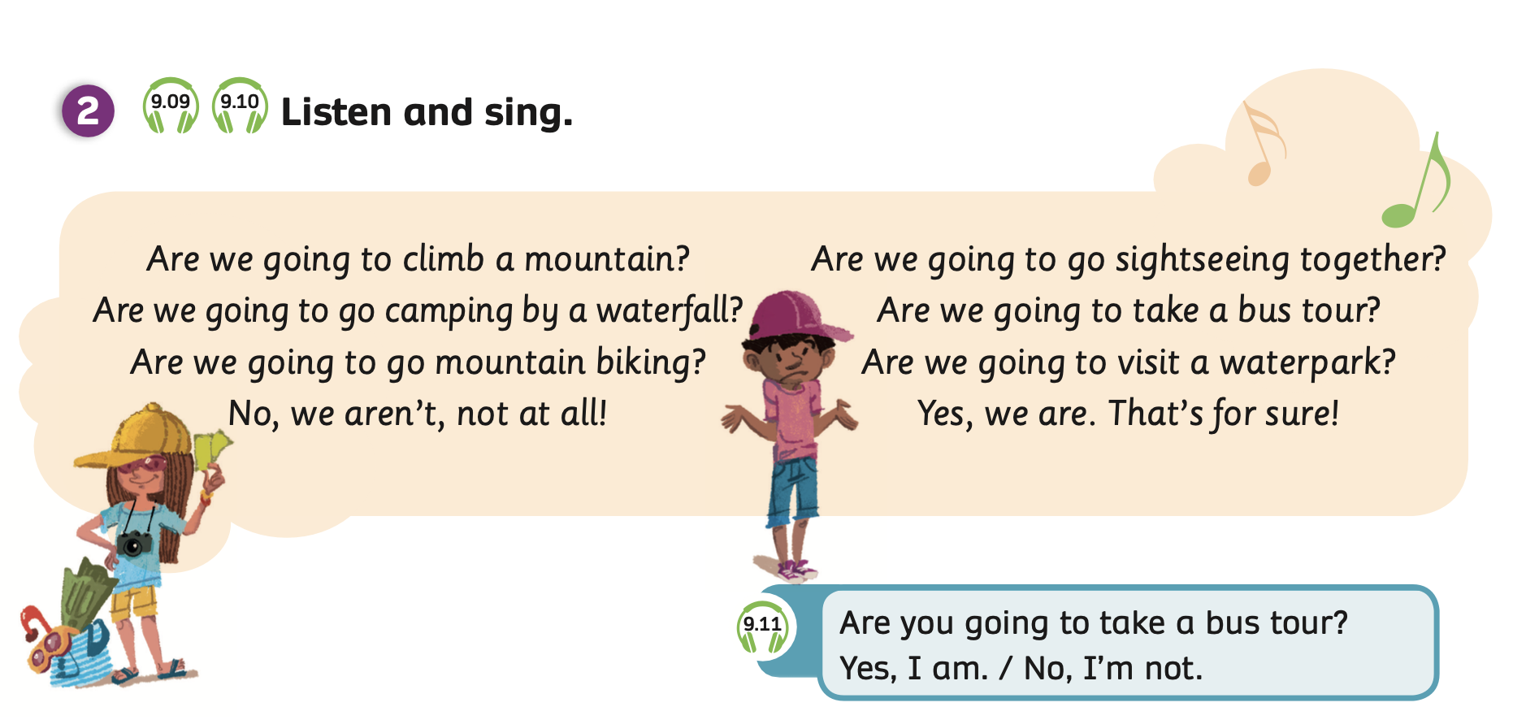
GRAMMAR - Pupils’ Book (p.107)
Listen and sing
Have students look at the song and read it.
Play the audio, students listen to the song.

Slide 6
GRAMMAR - Pupils’ Book (p.107)
Sing
Play the audio again, students listen and sing aloud.

Slide 7
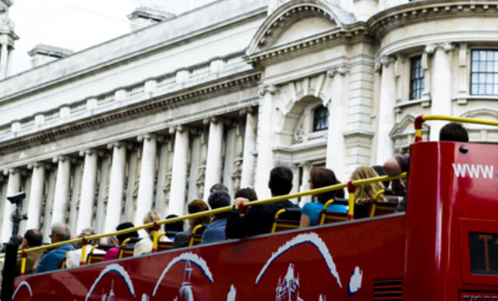
GRAMMAR - Pupils’ Book (p.107)
Have students look at the box.
Play the audio, and students listen.
Play the audio again, students listen and repeat.

Slide 8
GRAMMAR - Pupils’ Book (p.107)
STRUCTURE – QUESTION?
Use the question to ask about planned events in the future.
Are + S + going to + V_inf?
- Are you going to …?

Slide 9
GRAMMAR - Pupils’ Book (p.107)
STRUCTURE – ANSWERS
We will use:
Yes, I am.
No, I’m not.

Slide 10
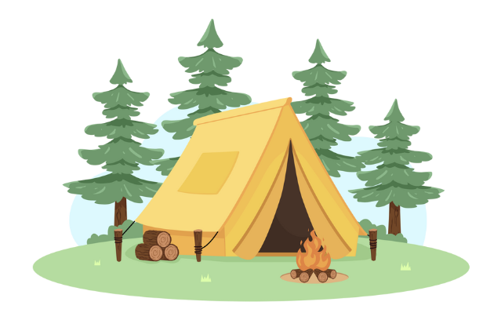
GRAMMAR - Pupils’ Book (p.104)
Are + S + going to + V_inf?
Are you going to go camping?
Yes, I am.

Slide 11
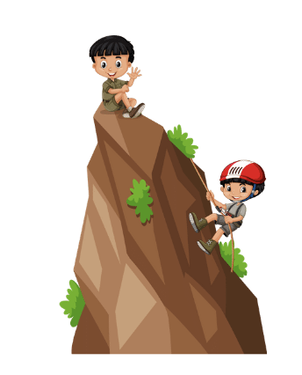
GRAMMAR - Pupils’ Book (p.104)
Are + S + going to + V_inf?
Are you going to climb a mountain?
No, I’m not.

Slide 12
GRAMMAR PRACTICE
Divide the class into groups of 4 to 6 students and each group takes out a mini-board.
Have students look at the words and icons to make sentences.
After finishing, they raise the boards to check the answers.
The fastest group with the correct answer receives 2 points for the team.

Slide 13
Make the sentences

Slide 14
going / to / Are / you / visit / a / park / theme / ?
Are you going to visit a theme park?
Answer

Slide 15
going / to / Are / we / climb / a / mountain / ?
Are we going to climb a mountain?
Answer

Slide 16
going / to / we / Are / take / a / tour / bus / ?
Are we going to take a bus tour?
Answer

Slide 17
to / going / you / Are / camping / go/ ?
Are you going to go camping?
Answer

Slide 18
to / going / you / Are / hiking / go/ ?
Are you going to go hiking?
Answer

Slide 19
to / going / you / Are / mountain / go/ biking /?
Are you going to go mountain biking?
Answer

Slide 20
Great!

Slide 21
Pupils’ Book (p.107)
take a bus tour
go sightseeing
visit a theme park
go camping
go sightseeing
visit a waterpark
Have students look at Activity 3.
Each student writes three things they’re going to do next weekend.
Then, put students in pairs take turns by asking Yes/ No questions to guess what their partner is planning to do.

Slide 22
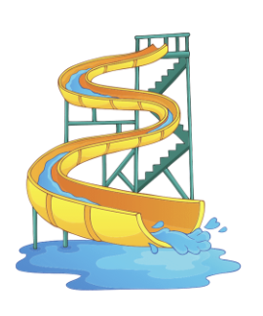
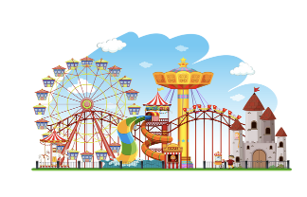
Pupils’ Book (p.107)
Yes, I am.
Are you going to
… ?
No, I’m not.
take a bus tour
visit a theme park
go sightseeing
visit a waterpark
go mountain biking
go camping
go hiking
climb a mountain
Then, put students in pairs take turns by asking Yes/ No questions to guess what their partner is planning to do.
Have students look at the speech bubbles for reference.

Slide 23
PRODUCTION
Are you going to visit a water park?
No, I’m not.
Invite some students to ask and answer to play a guessing game.
Each student will have 5 guesses, equivalent to 5 questions.
The first student can guess correctly the most things of their partner will receive a point.

Slide 24
HOMEWORK
Review vocabulary and grammar.
Do exercises in the Activity Book (page 84).
Check the answers in the Teacher’s Book (page 184) or Active Teach.

Slide 25
UNIT 9 – Lesson 5A
We’re learning…
- To use the question structures of going to + verb.
- To use the vocabulary: go sightseeing, take a bus tour, go hiking, go mountain biking …
- PB p.107
- AB p.84

