Slide 1



UNIT 9 – HOLIDAY TIME!
Lesson 7B – Story

Slide 2
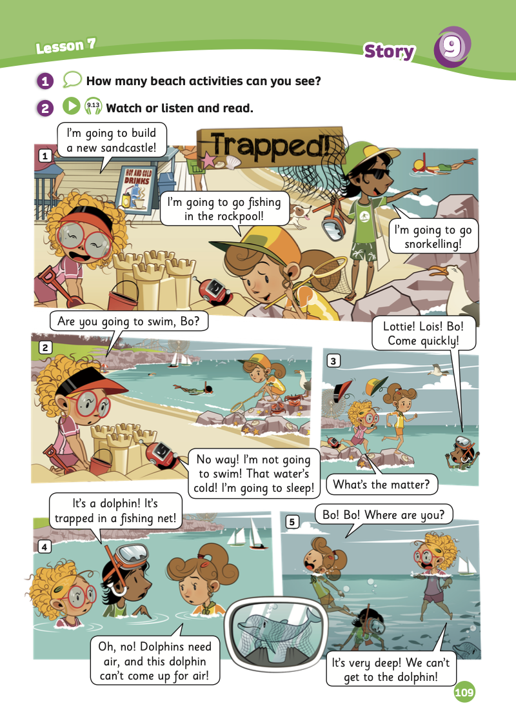
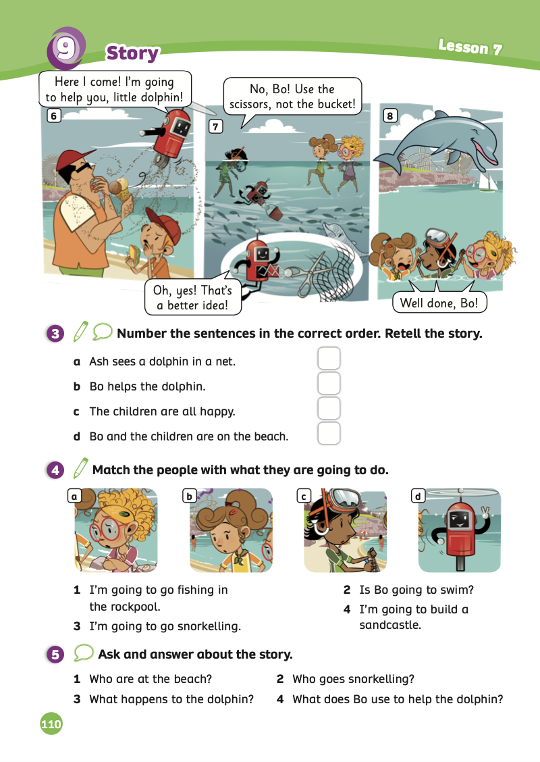
UNIT 9 – Lesson 7B
We’re learning…
- To understand simple cartoon stories.
- To review.
- PB p.109 & 110.
- AB p.86

Slide 3

WARM-UP ACTIVITY
Activity: TRUE or FALSE
Put the class into pairs. Each pair takes out 2 pieces of paper.
Students write True and False for each piece.
Show a sentence, students look at, choose and raise their answer: True or False.
The fastest pair with the correct answer receives 2 points.

Slide 4




Ms Huyền Phạm - 0936.082.789

Slide 5





1. Dolphin is trapped in a fishing net.
Ms Huyền Phạm - 0936.082.789
TRUE
FALSE

Slide 6
2. Lottie’s going to
go snorkelling.
Ms Huyền Phạm - 0936.082.789
TRUE
FALSE

Slide 7
3. Lois’s going to
go surfing.
Ms Huyền Phạm - 0936.082.789
TRUE
FALSE

Slide 8
4. Bo’s going to help little Dolphin.
Ms Huyền Phạm - 0936.082.789
TRUE
FALSE
Notes:
Ms Huyền Phạm - 0936.082.789

Slide 9
5. Ash’s going to build
a sandcastle.
Ms Huyền Phạm - 0936.082.789
TRUE
FALSE

Slide 10

Ms Huyền Phạm - 0936.082.789

Slide 11


STORY TIME

Slide 12
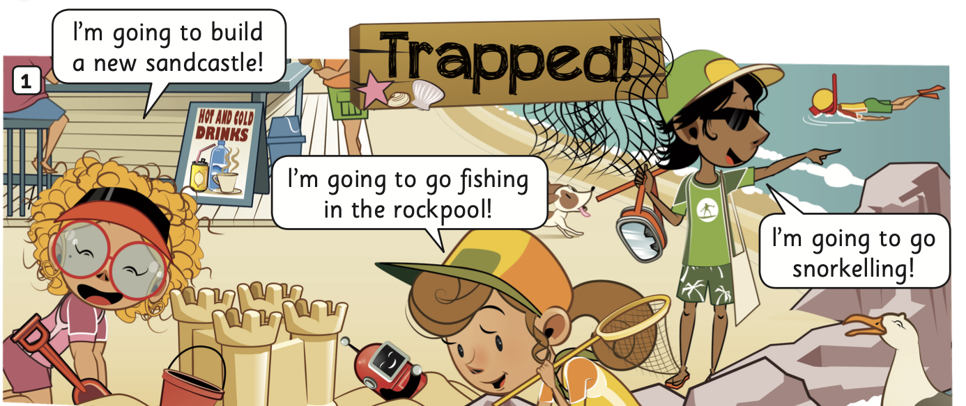

STORY TIME
Listen and read
Listen

Slide 13
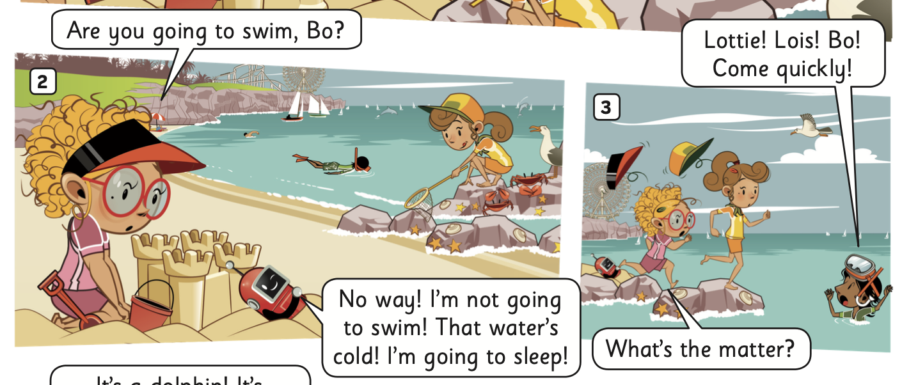
STORY TIME
Listen and read
Listen

Slide 14
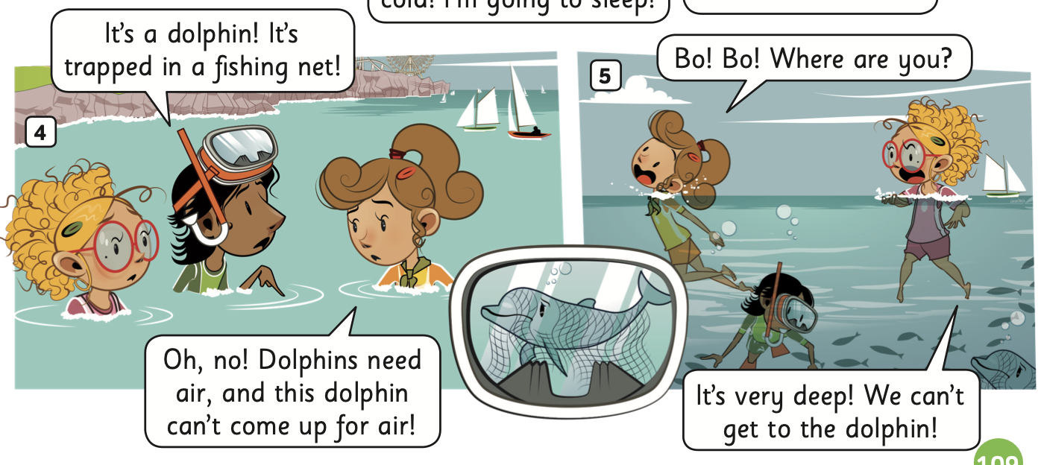
STORY TIME
Listen and read
Listen

Slide 15
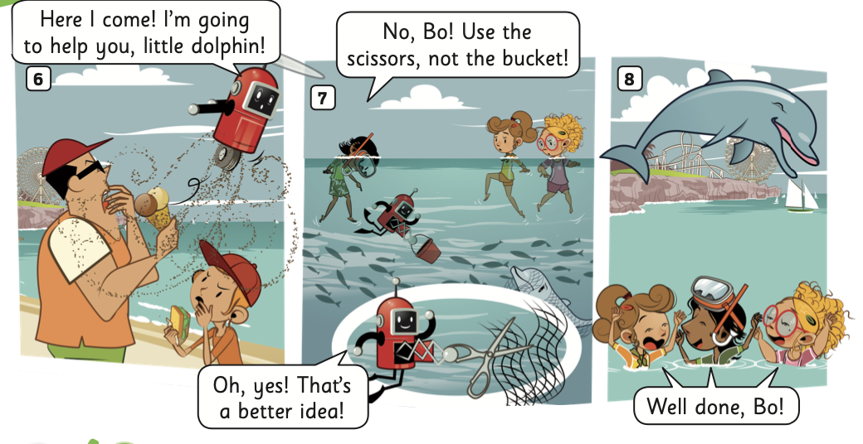
STORY TIME
Listen and read
Listen

Slide 16

PRACTICE ACTIVITY
Put the class into groups of 4.
Each pair takes out a mini-board.
The teacher clicks on each star, and students look at the questions with 3 answers and choose the correct answers by writing it on the board. Each member takes turns writing.
After finishing, they raise the board to check the answers.
The pairs with the correct answer receive a point.

Slide 17





PLAY WITH MARIO

Slide 18






Who finds the little Dolphin?
Lottie
Ash
Lois

Slide 19
What’s Lottie going to do?
go swimming
go fishing
build a new sandcastle

Slide 20
Who’s going to sleep?
Bo
Lottie
Ash

Slide 21
What traps the dolphin?
bucket
beach towel
fishing net

Slide 22
Who are on the beach?
Bo and the children
Bo and Ash
Ash, Lois, Lottile

Slide 23



Slide 24
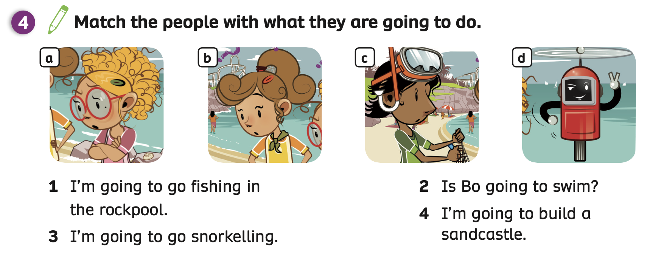
Pupils’ Book p.110
ANSWER
Students look at Activity 4 and do the task individually.
Then, put students in pairs to compare their answers.
The teacher checks the answers with the whole class.

Slide 25
PRACTICE
Activity: Dub Out The Story
Divide students into small groups.
Tell them to choose the characters and act out the story.
Give students a little time to practice.
Have groups perform in front of the class without the audio.

Slide 26

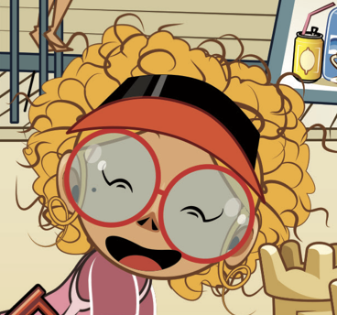


STORY TIME
CHARACTERS IN THE STORY
Ash
Lottie
Lois
Bo

Slide 27
PRACTICE
SHOW TIME!

Slide 28
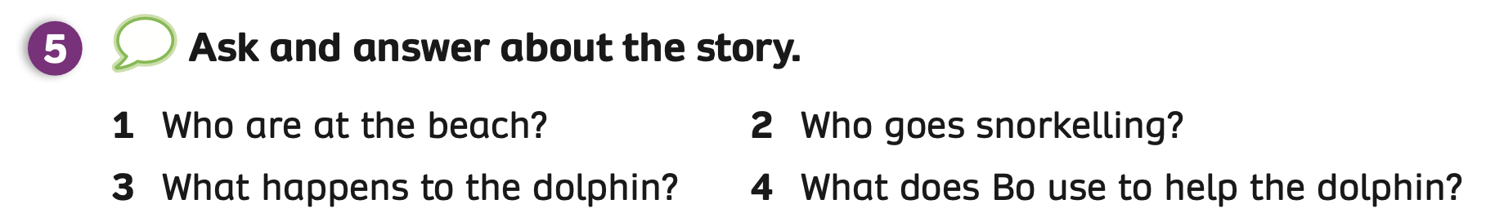


PRODUCTION
Have students look at the Activity 5.
Put students in pairs and switch roles to ask and answer about the story.
Invite some pairs to present in front of the whole class and give them a point.

Slide 29
PRODUCTION
Who are at the beach?
Bo and the children.
Who goes snorkelling?
Ash.
Have students look at the Activity 5.
Put students in pairs and switch roles to ask and answer about the story.
Invite some pairs to present in front of the whole class and give them a point.

Slide 30
PRODUCTION
It’s trapped in a fishing net.
What happens to the dolphin?
It’s the scissors.
What does Bo use to help the dolphin?
Have students look at the Activity 5.
Put students in pairs and switch roles to ask and answer about the story.
Invite some pairs to present in front of the whole class and give them a point.

Slide 31
HOMEWORK
Review vocabulary and grammar.
Do exercises in the Activity Book (page 86).
Check the answers in the Teacher’s Book (page 189) or Active Teach.

Slide 32
UNIT 9 – Lesson 7B
We’re learning…
- To understand simple cartoon stories.
- To review.
- PB p.109 & 110.
- AB p.86

