Slide 1
UNIT 9 – HOLIDAY TIME!
Lesson 8 – Project

Slide 2
UNIT 9 – Lesson 8
We’re learning…
- To review
- PB p.111
- AB p.87

Slide 3
WARM-UP ACTIVITY
Put students into groups of 4. Each group takes out a pen or a ruler and puts it in the middle of each group.
Show the text and give 2 minutes for students to read the information.
Ask the questions, students listen, find the information in the pictures and raise their pens or ruler to get a chance to say the answers.
The fastest group with the correct information receives 2 points.

Slide 4
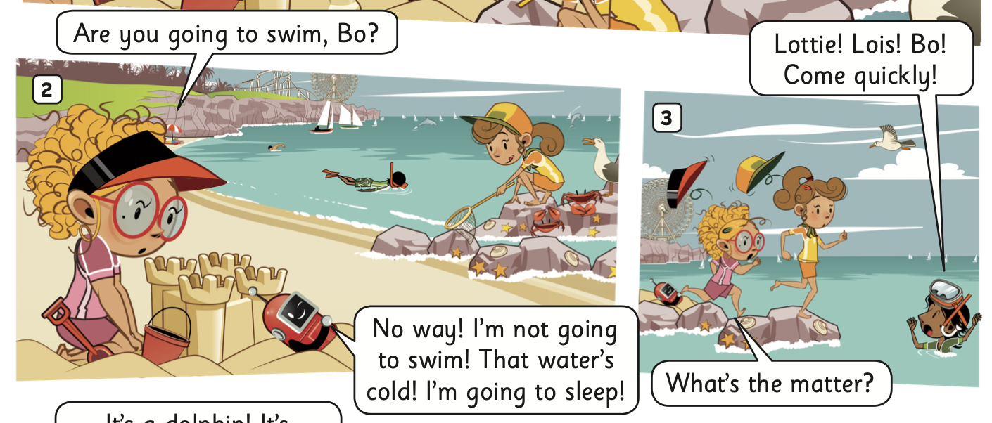
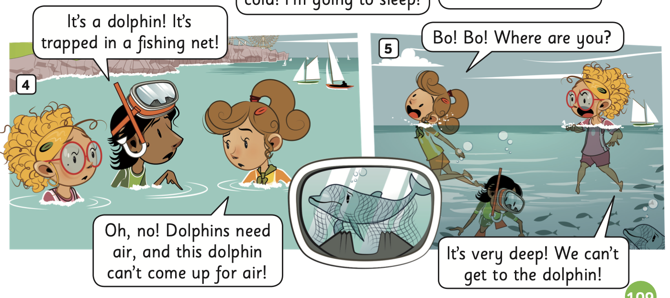
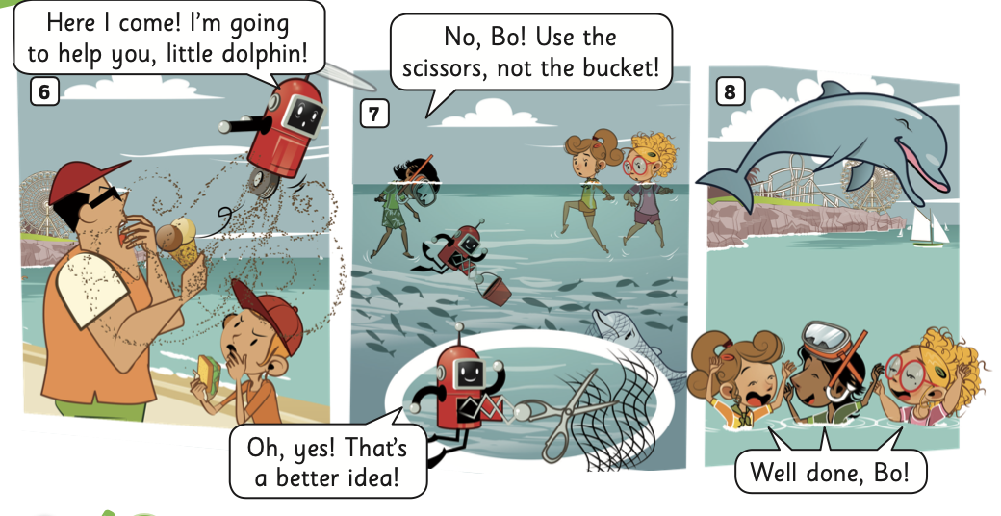
WARM-UP ACTIVITY
What’s the story title?
Trapped.
ANSWER

Slide 5
WARM-UP ACTIVITY
Who builds a sandcastle?
Lottie
ANSWER

Slide 6
WARM-UP ACTIVITY
Who sees a dolphin in a net?
Ash
ANSWER

Slide 7
WARM-UP ACTIVITY
Who helps the dolphin?
Bo
ANSWER

Slide 8
WARM-UP ACTIVITY
The children are all happy.
How do the children feel when Bo helped the dolphin?
ANSWER

Slide 9
Pupils’ Book (p.111)
ANSWER
Have students look at Activity 1.
Then, put students in pairs to read the postcard quickly and tick the answers.
The teacher shows the answers to check.

Slide 10
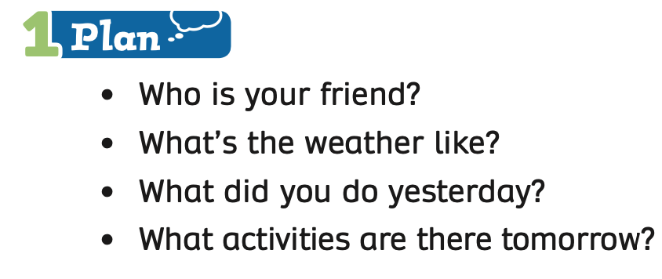
Pupils’ Book (p.111)
Put students into groups of 4. Each group takes out a sheet of paper. Students in the group discuss and write the answers for each question.
Each member takes turns writing the answers.
Show the example on the next slide.

Slide 11
Pupils’ Book (p.111)
1. Name of your friend:
Nam, Lien, Hoa, Minh,…
2. The weather:
sunny, windy, cloudy, snowy...
EXAMPLE

Slide 12
PUPILS’ BOOK p.31
3. What did you do:
- visited a waterpark, went surfing, went camping, climbed a mountain, took a bus tour,…
EXAMPLE
4. Activities:
- build a sandcastle, go sightseeing, visit a theme park, go mountain hiking, ...

Slide 13
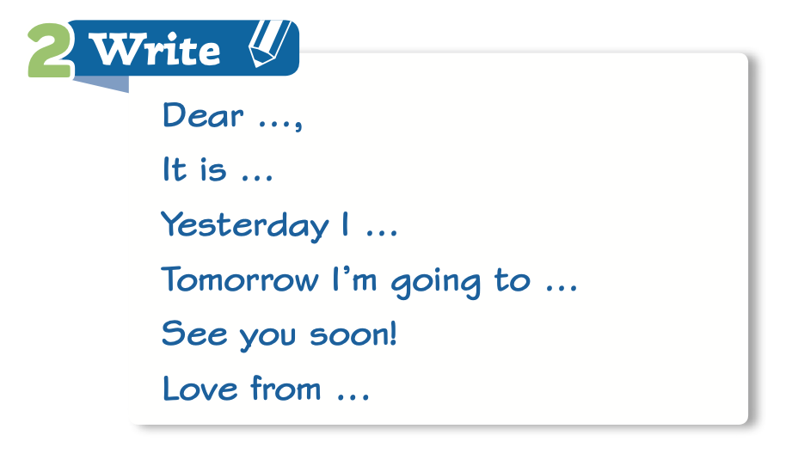
Pupils’ Book (p.111)
Next, students in the group discuss how to write a postcard.
They write the sentences of a postcard.
Show the example on the next slide.

Slide 14
Pupils’ Book (p.111)
- Dear Minh,
- It is sunny here.
- Yesterday I went swimming, went camping, and visited a waterpark.
- Tomorrow I’m going to visit a theme park and take a bus tour.
- See you soon!
- Love from Khanh.

Slide 15
Pupils’ Book (p.111)
After students finish their work, they raise their papers to check.
Call out each group to present their postcard in front of the class.
Give points.

Slide 16
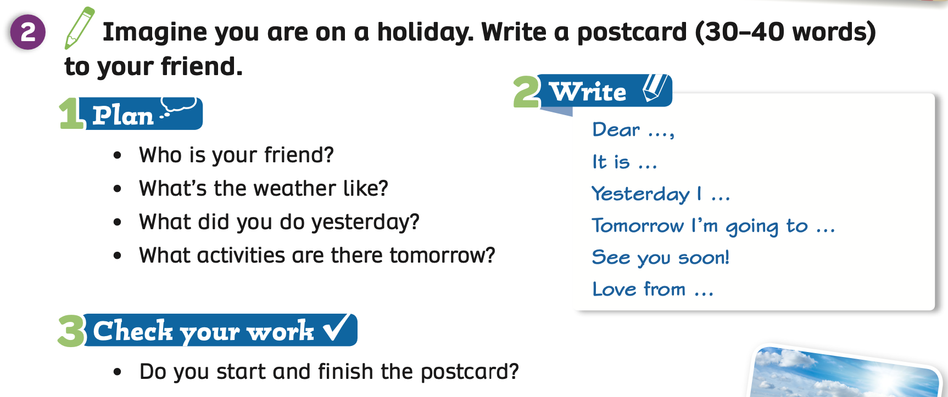
Pupils’ Book (p.111)
Have students open their books, use the prompts and write their postcards by themselves in their books.
After finishing, they say Bingo. The teacher reads and checks students’ work.

Slide 17
Pupils’ Book (p.111)
Dear Minh,
It is sunny here.
Yesterday I went swimming, went camping, and visited a waterpark.
Tomorrow I’m going to visit a theme park and take a bus tour.
See you soon!
Love from Khanh.
After writing, students draw activities they mentioned in their postcards to decorate them.

Slide 18
Pupils’ Book (p.111)
Dear …,
It is … here.
Yesterday I ...
Tomorrow I’m going to ...
See you soon!
Love from …
- After decorating, invite some students to hold their postcards and present in front of the whole class.

Slide 19
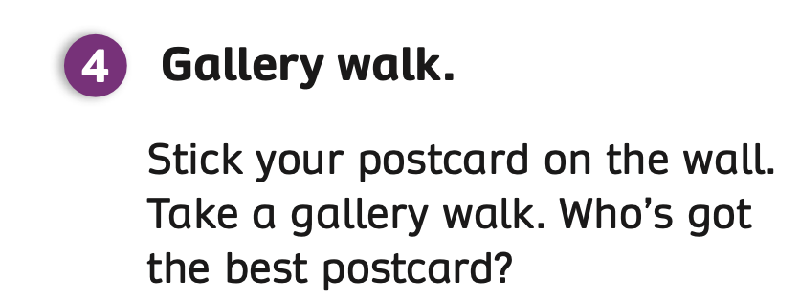
PRODUCTION
Have students stick their postcards on the wall.
Then, students take a gallery walk and vote for the best postcard by drawing a star on it.
At the end, the postcard with the most stars will be the best postcard.

Slide 20
HOMEWORK
Review vocabulary and grammar.
Do exercises in the Activity Book (page 87).
Check the answers in the Teacher’s Book (page 190) or Active Teach.

Slide 21
UNIT 9 – Lesson 8
We’ve learned…
- To review
- PB p.111
- AB p.87

