Slide 1


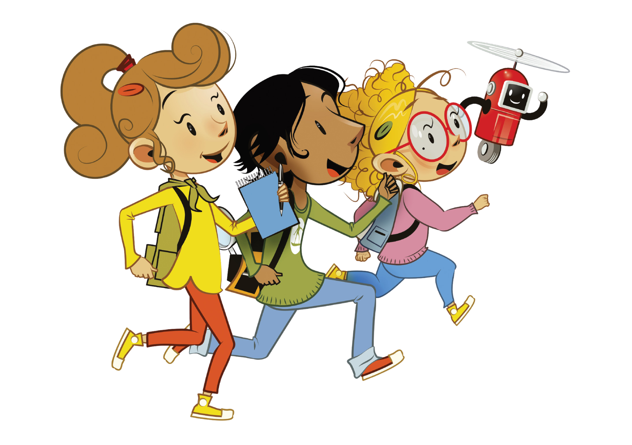
END-OF-TERM
REVISION 2B

Slide 2
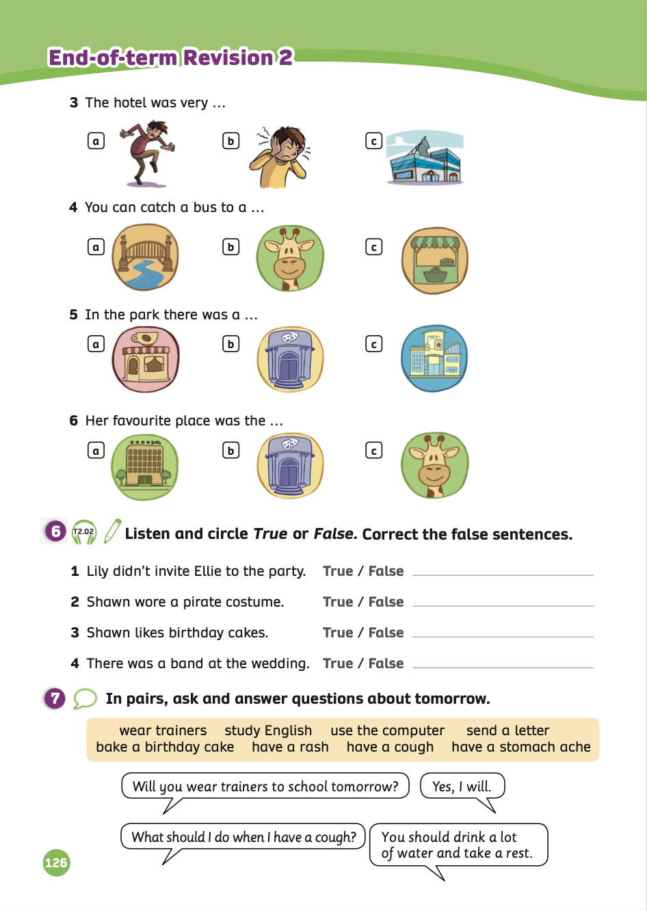
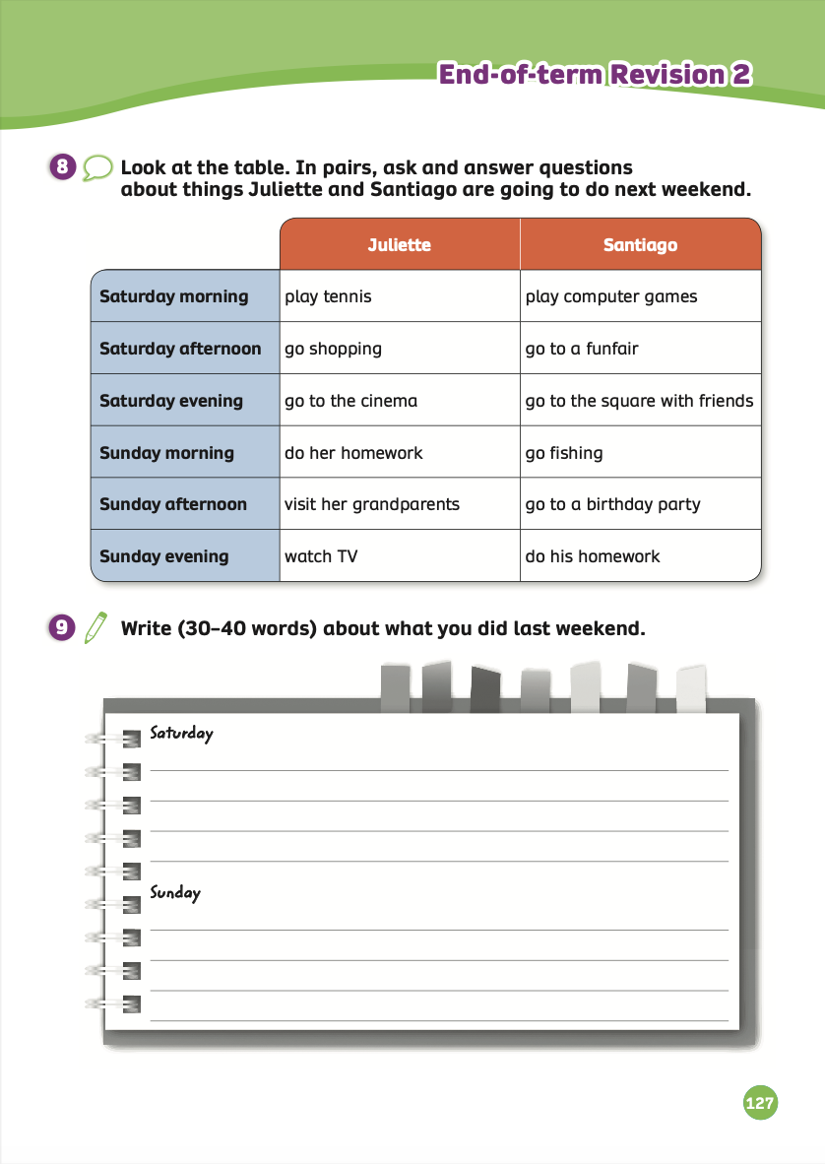
END-OF-TERM
REVISION 2B
We’re learning…
- To review Unit 6 – Unit 10
- PB p. 126, 127

Slide 3


WARM-UP ACTIVITY
Put students in groups of 3 or 4.
Each group takes out a mini-board.
Each team will look at the slides with unscrambled words from Unit 6, Unit 7, Unit 8, Unit 9 or Unit 10 and write the correct sentences.
Then, they raise their boards to check.
The fastest group with all correct answers will receive 2 points.

Slide 4

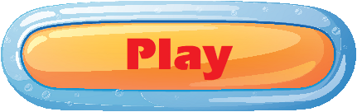
Warm-Up:

Slide 5






was
There
a
clothes
shop.
There was a clothes shop.

Slide 6
She’s
going
go
to
hiking.
She’s going to go hiking.

Slide 7

River
is
the
long
How
Ebro?
How long is the River Ebro?

Slide 8

you
to
What
bring
beach?
will
the
What will you bring to the beach?

Slide 9
an
ice
going
We’re
cream.
to
buy
We’re going to buy an ice cream.

Slide 10
Are
go
biking?
going
mountain
you
to
Are you going to go mountain biking?

Slide 11
clothes.
My
nice
dad
wore
very
My dad wore very nice clothes.

Slide 12
climbed
She
yesterday.
the
mountain
She climbed the mountain yesterday.

Slide 13
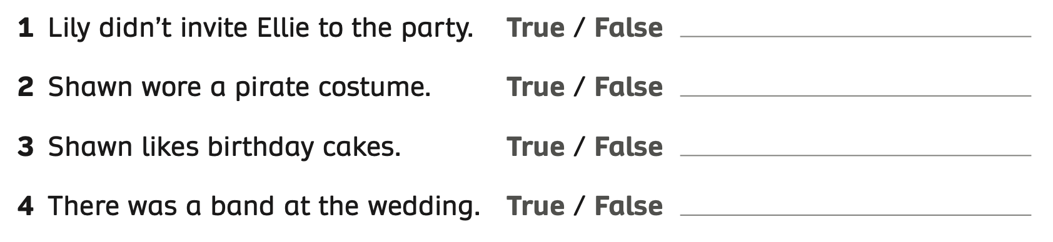
Pupils’ Book (p.126)
REVIEW
PRE LISTENING – Activity: Guess the answer
True
False
True
True
Example
- Ask students to work in pairs to guess the answers True or False.
Click on “Example” to show.

Slide 14
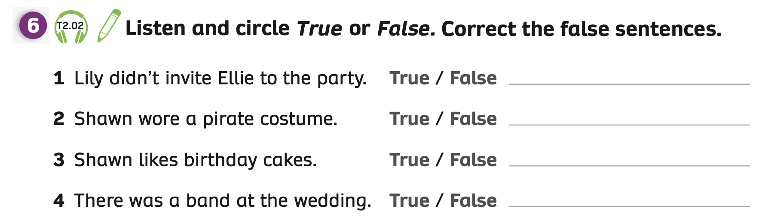

Pupils’ Book (p.126)
REVIEW
Answer
- Play the audio, students listen and circle True or False.
- Ask students to work in pairs to compare answers.
- Check the answers with the whole class.

Slide 15
Pupils’ Book (p.126)
REVIEW
Listen and correct the false sentences
Lily invited Ellie to the party but she didn’t go.
He doesn’t like cake.
Answer
- Play the audio again, students listen and correct the false sentences.
- Ask students to work in pairs to compare answers.
- Check the answers with the whole class.

Slide 16
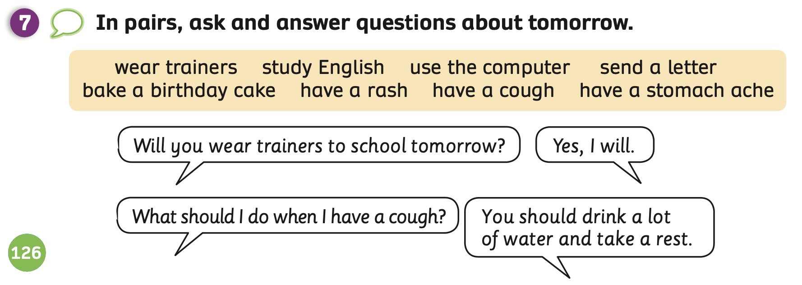
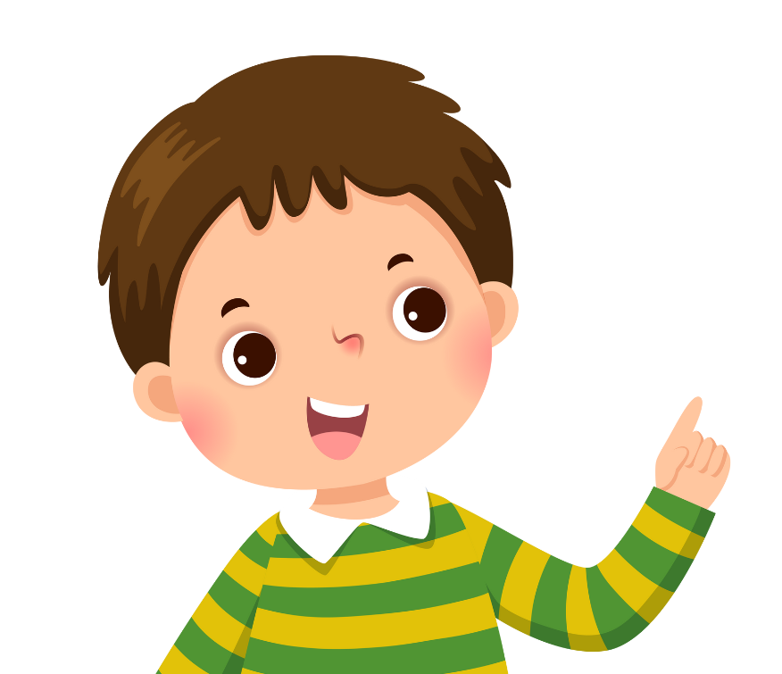
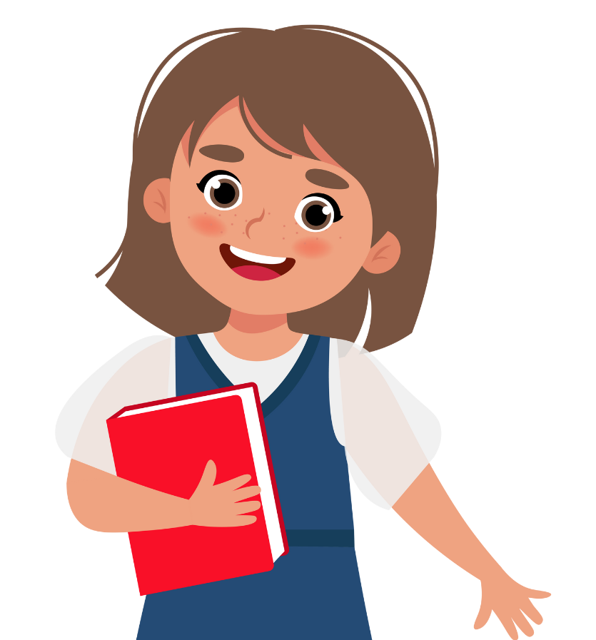
Pupils’ Book (p.126)
REVIEW
Ask students to work in pairs, switch roles to ask and answer the questions in the speech bubbles, using the given words in the box.
Show the example speech bubbles on the next slide.

Slide 17
Pupils’ Book (p.126)
REVIEW
Will you wear trainers to school tomorrow?
Yes, I will.
What should I do when I have a cough?
You should drink a lot of water and take a rest.
Look at the example speech bubbles for reference.
Invite some pairs to present in front of the class and give them 2 points.

Slide 18
Pupils’ Book (p.126)
REVIEW
Yes, I am.
Are you going to study English this summer?
You should take some rest.
What should I do when I have a stomach ache?
Look at the example speech bubbles for reference.
Invite some pairs to present in front of the class and give them 2 points.

Slide 19
Pupils’ Book (p.126)
REVIEW
Did your dad use the computer?
No, he didn’t.
Yes, he did.
Did your dad send a letter 20 years ago?
Look at the example speech bubbles for reference.
Invite some pairs to present in front of the class and give them 2 points.

Slide 20
Pupils’ Book (p.126)
REVIEW
Will you bake a
birthday cake?
Yes, I will.
What should I do when I have a rash?
You shouldn’t put cream on your skin.
Look at the example speech bubbles for reference.
Invite some pairs to present in front of the class and give them 2 points.

Slide 21
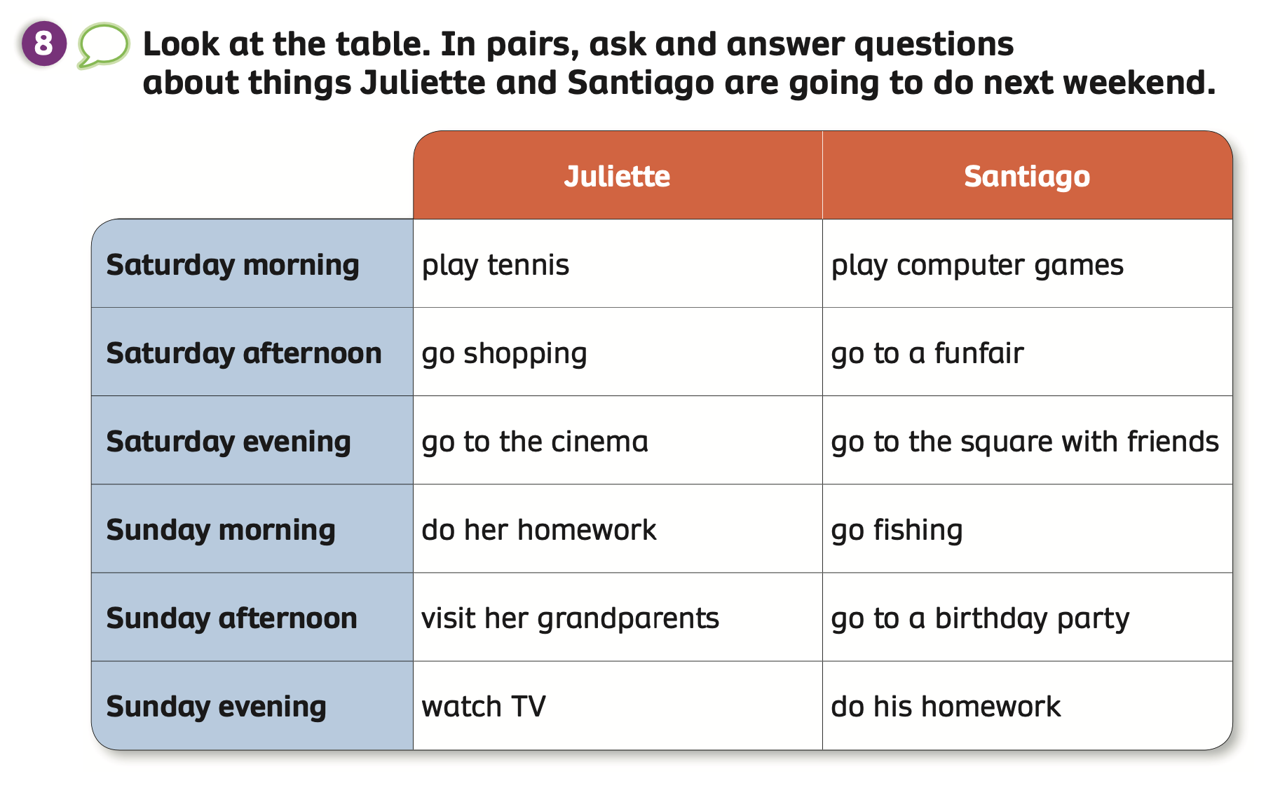
Pupils’ Book (p.127)
REVIEW
- Ask students to look at the table or ask them to open the book on page 127.
- Ask students to work in pairs and take turns to ask and answer questions.
- Example on the next slide.

Slide 22
Pupils’ Book (p.127)
REVIEW
What is Juliette going to do on Saturday morning?
She’s going to play tennis.
- Have students look at the example.
Put students in pairs and take turns to ask and answer about what Juliette is going to do next weekend.
Invite some pairs to present in front of the class and give them 2 points.

Slide 23
Pupils’ Book (p.127)
REVIEW
What is Juliette going to do on Sunday afternoon?
She’s going to visit her grandparents.
- Have students look at the example.
Put students in pairs and take turns to ask and answer about what Juliette is going to do next weekend.
Invite some pairs to present in front of the class and give them 2 points.

Slide 24
Pupils’ Book (p.127)
REVIEW
What is Juliette going to do on Sunday evening?
She’s going to watch TV.
- Have students look at the example.
Put students in pairs and take turns to ask and answer about what Juliette is going to do next weekend.
Invite some pairs to present in front of the class and give them 2 points.

Slide 25
Pupils’ Book (p.127)
REVIEW
What is Santiago going to do on Saturday afternoon?
He’s going to go to a funfair.
- Have students look at the example.
Put students in pairs and take turns to ask and answer about what Santiago is going to do next weekend.
Invite some pairs to present in front of the class and give them 2 points.

Slide 26
Pupils’ Book (p.127)
REVIEW
What is Santiago going to do on Sunday morning?
He’s going to go fishing.
- Have students look at the example.
Put students in pairs and take turns to ask and answer about what Santiago is going to do next weekend.
Invite some pairs to present in front of the class and give them 2 points.

Slide 27
Pupils’ Book (p.127)
REVIEW
What is Santiago going to do on Saturday evening?
He’s going to go to the square with friends.
- Have students look at the example.
Put students in pairs and take turns to ask and answer about what Santiago is going to do next weekend.
Invite some pairs to present in front of the class and give them 2 points.

Slide 28
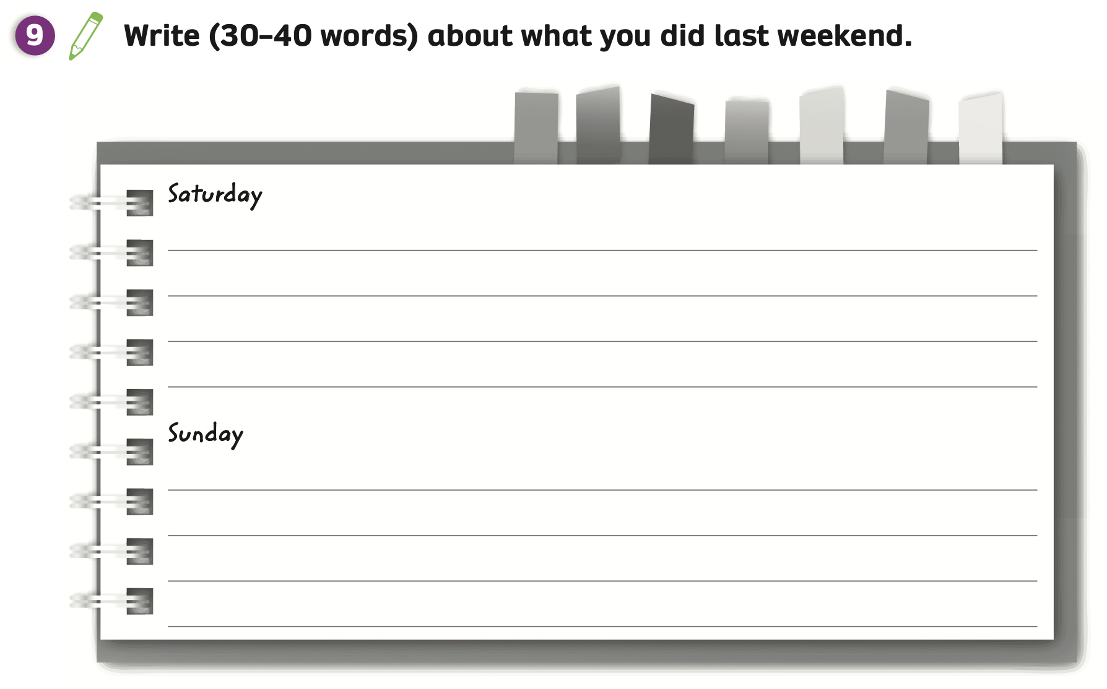
Pupils’ Book (p.127)
REVIEW
Have students look at Activity 9 and think about what they did last weekend.
Look at the example on the next slide.

Slide 29

Pupils’ Book (p.127)
REVIEW
Example
Saturday
In the afternoon, I went to the shopping centre with my mum. Then, we went to a funfair and I played rollercoaster. It was a happy day!
Sunday
In the morning, I played computer games with my friends. In the evening, I did the homework. Then, I went to sleep.
Look at the sample on the screen.
Then, they write about what they did last weekend.
Invite a few students to show their texts.

Slide 30
HOMEWORK
Review the classroom language.
Check answers in the Teacher’s book (page 212) or Active Teach.

Slide 31
END-OF-TERM
REVISION 2B
We’ve learned…
- To review Unit 6 - Unit 10
- PB p. 126, 127

